Slide 1

Keep Reading Chapter 5
Homework 5 due today, Friday 20 October

Slide 2
Multiply Down
Moles (n)
Weight (w) molecule count (N)
6.0*10²³
MW
ALL ROADS LEAD THROUGH MOLES
Divide up

Slide 3
DIVIDE UP
MULTIPLY DOWN

Slide 4
Sweet mole calculations part 1
weight per mole (MW): what does a mole
of C₆H₁₂O₆ weigh ? (C=12; H=1; O=16)
6*12 + 12*1 + 6*16 = 180 g/mol
1.1) mole to mass: how many g C₆ H₁₂O₆ of are
present in 0.00555 mole of C₆ H₁₂O₆?
0.00555 mol * 180 g/mol = 1 g
1.2) mass to mole: how many moles of C₆ H₁₂O₆ are
in 360 g of C₆H₁₂O₆?
360 g/180 g mol⁻¹ = 2 moles

Slide 5
mole calculations part 1 (continued)
1.3) mole to # molecule: how many molecules
of C₆ H₁₂O₆ are in 0.5 mol of C₆H₁₂O₆ ?
0.5 mol *6*10²³ molecules/mol =
3*10²³ molecules
1.4) mass to # molecules: how many molecules of
C₆ H₁₂O₆ are in 120 g of C₆H₁₂O₆ ?
(120/180) mol * 6*10²³ molecules =4*10²³ molecules mol

Slide 6
mole calculations part 1 (continued)
1.5) # molecules to moles: how many moles in
3*10²⁴ molecules of C₆ H₁₂O₆ ?
3*10²⁴ molecules/ 6*10²³ molecules/mol ⁼ 5 moles
1.6) # molecules to mass : How many grams of
C₆ H₁₂O₆ are in 2.0 *10²² molecules of C₆H₁₂O₆ ?
2*10²² molecules * 180 g
6*10²³ molecules/mol mol
=0.0333 * 180 = 6 grams

Slide 7
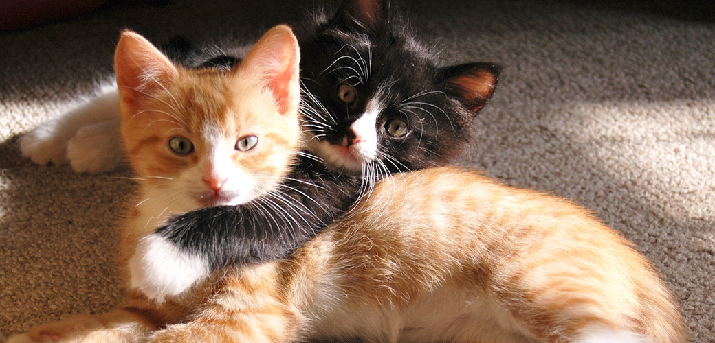
BasicTriangle problems with clickers and team effort

Slide 8
How many grams of oxycontin (oxy), MW=315 g/mol are in 0.06349 mol of oxy ?
3.8*10²³ g
4961 g
2.0 g
0.0002 g

Slide 9
How many moles of CO, MW=28 g, are in 3*10²³ molecules of CO ? Remember that 1 mol count=6*10²³
2
0.5
8.4*10²³
1.07

Slide 10
How many molecules of heroin, MW=369 g/mol are in 61.5 g of heroin ? Remember that 1 mol count=6*10²³
1*10²³
0.1667
2.27*10⁴
3.7*10²⁵

Slide 11
How many molecules of cocaine, MW=303.4 g/mol are in 10.11 g of cocaine? Remember that 1 mol count = 6*10²³ .
1.8*10²⁶ molecules
2*10²³ molecules
2*10²² molecules
1.98*10²¹ molecules

Slide 12

Harder problems….team efforts with clickers

Slide 13
The gram molecular mass of of ‘crystal meth’) is 149.2 g/mol. How many moles of crystal meth are in a typical street `teenth’ = 1/16 of an ounce= 1.80 grams ?
(1 mol count=6.0*10²³ .)
7.27*10²¹
0.0121
82.9
2.48*10⁻²²
My answer isn’t above

Slide 14
B1-Aflatoxin (MW=328.2 g/mol) is a naturally occurring, horribly toxic poison derived from Aspergillus fungi, a common contaminant in corn. It causes cancer in most humans at the staggeringly low exposure level of 1*10¹⁷ molecules. What is the equivalent mass of aflatoxin represented by this count ? ( 1 mol count=6.0*10²³ .)
3.3*10⁻⁸ g
1.8*10⁻⁴ g
5.47*10⁻⁵g
5.06*10⁻¹⁰g
Not any of above

Slide 15
Micro chip manufacture requires nearly oxygen-free conditions wherein the concentration of O₂ is at or below 17 pg/L. Given that the atomic mass of O is 16 g/mol, about how many molecules of O₂ /L does this represent ? Note: 1 mol count=6.0*10²³
5.4*10²⁴
3.5*10²²
3.2*10¹¹
5.3*10²²

Slide 16
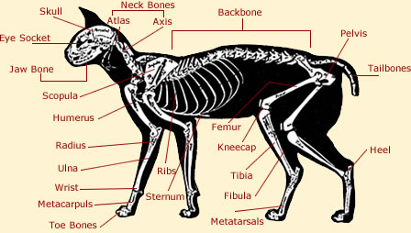

Moles: part 2 body parts (mole ratio) math: the knee bone is connected to the thigh bone….

Slide 17
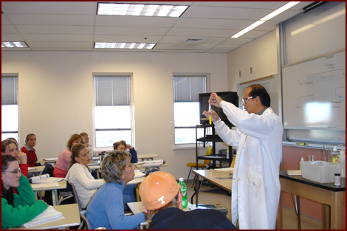
How many hands ???
1
6
5
2
3
4
7
9
8
10
11
2 hands
1 people
= 22 hands
11 people
x

Slide 18

How many toes connected to the hands (assuming no deformities) ?
5 hands
x
1 person
hand
5
x
10 toes
person
= 50 toes
4
3
2
1

Slide 19
Simplest `body’ parts example :
mole→ Mole
Octane = C₈H₁₈
How many H are in 20 moles of octane ?
20 mols octane * 18 mol H = 360 mol H
mol octane

Slide 20
Isohexane has the formula C₆H₁₄. How many C moles are present if we have 0.1667 moles of isohexane ?
0.0277 mol C
1.00 mol C
36 mol C
2.333 mol
None of the above

Slide 21
`body’ parts example 2 :
Weight→ moles first, then mol→ Mol
Octane = C₈H₁₈
How many moles of octane contain 24 grams of C (at. wt. = 12 g/mol)
Step 1) Convert grams C to moles C
(all roads lead through moles divide up)
24 g = 2 moles C
12 g/mol C

Slide 22
`body’ parts example 2 : (continued)
Octane = C₈H₁₈
How many moles of octane contain 24 grams of C (at. wt. = 12 g/mol)
Step 2) 2 moles C => how many moles octane?
(body parts relationship ?)
1 mol octane = x
8 mol C 2
x= 2/8=0.25 moles octane

Slide 23
Isohexane has the formula C₆H₁₄. How many moles of isohexane are formed with 24 grams of C (1 mol C=12 g)
0.333 moles isohexane
2 moles isohexane
0.1667 moles isohexane
3 moles isohexane
Stoichiometry blows
F. None of the above

Slide 24
`body’ parts example 3 :
Weight→ moles , then mol→ Mol→ weight
Octane = C₈H₁₈ (MW=114)
How many grams of H are in 10 grams of Octane ? (1 mole H=1 g H)
Step 1) Convert grams octane to moles octane
All roads lead through moles; divide up
10 g = 0.0877 mol octane
114 g/mol

