Slide 1

Homework 4 Due Today
Keep Reading Chapter 5
Homework 5 posted and due this Friday 20 October
Interim Grades Issued this week !
We’re half-way through !!!
Hang tough to the end `

Slide 2
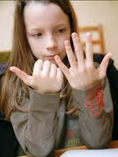
From your lecture syllabus….
Student Learning Outcome 5
Students should be able to perform
basic chemical calculations connected to:
mole-weight-count conversions
reaction stoichiometry
limiting yields.
Translation:
How do chemists count atoms
and molecules without actually
having to count them ???

Slide 3

Chemists count atoms and molecules using…
Moles

Slide 4
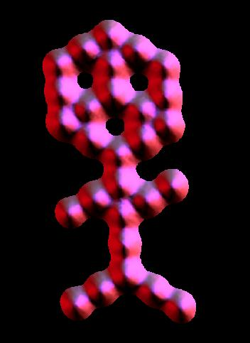
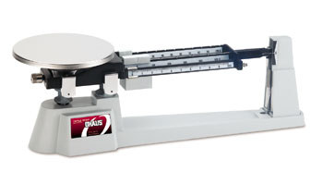

A trip to Mole land
Moles connect the atomic world to human world
~ 10²⁷ molecules in the shape of a couch potato
~0.00000002 m
~2 m
~30 CO₂ molecules arranged in shape of muffin man (IBM)
Moles allow us to conveniently connect between these worlds using a scale.

Slide 5
The mole: starting definitions
What is a chemical mole ?
The classic textbook rant…….(but not your text’s rant, fortunately)
≡ # atoms in 12.000 g of ¹²C
≅ 6.0221335 *10²³ atoms
(Avogadro’s Number)
…Not that helpful when first starting out… ☹

Slide 6
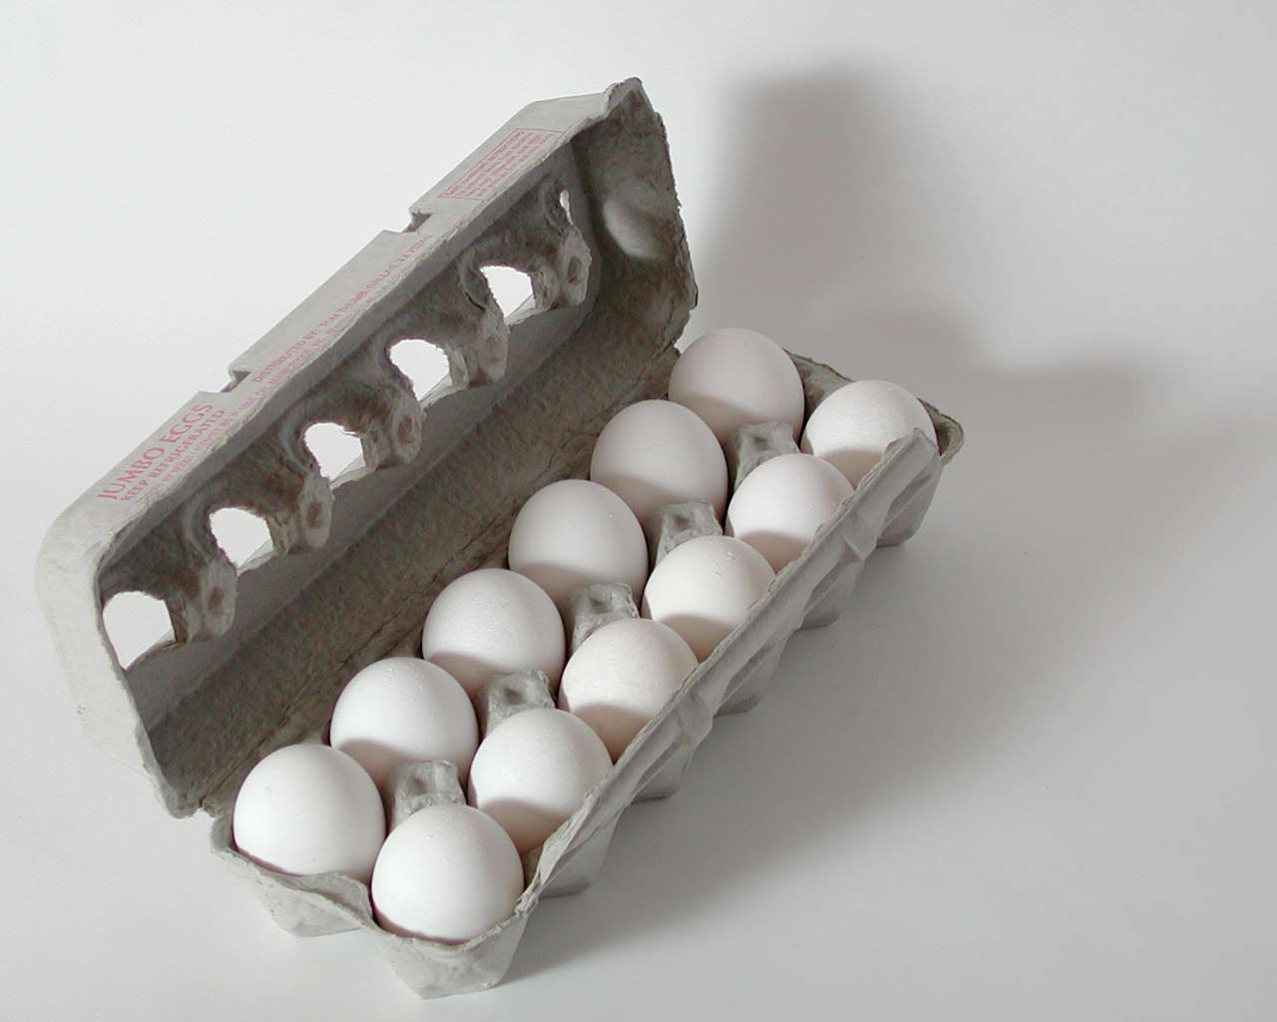
A better beginning:
the mole concept is really …
the same idea as a `dozen.’
≈

Slide 7
IN-CLASS EGG CALCULATIONS

Slide 8

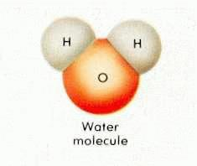
EGG WORLD
CHEMISTRY WORLD
Smallest unit
1 egg
1 molecule
Practical
Counting unit
Mole
(The chemist’s dozen)
Dozen

Slide 9
Eggs vs. chemistry world (continued)
EGG WORLD
CHEMISTRY WORLD
# units in practical counting unit
1 dozen=12
1 mole ≈ 6.022 *10²³
(Avogadro’s #)
grams/mole
=gram molecular weight
= MW (molecular weight)
(ADD)
Practical mass unit
grams/dozen
(WEIGH)

Slide 10
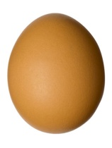
THE ONE PLACE EGG WORLD AND CHEMISTRY WORLD DEVIATE A TEENY BIT:
Egg world
Chemistry world
Mass
dozen
Mass = molecular weight
mol (MW)
Must weigh box of eggs
Just add up atomic masses using Periodic Table in grams

Slide 11
Mass (grams) = MW=Molecular
mol Weight
= sum of masses in grams of component elements in a compound .
(element masses are average masses taken from Periodic Table)

Slide 12
Example of MW Calculation:
What is the MW of methane =CH₄ ??
atomic mass (Table)
# atoms/molecule
product
C
H
12.011~12
1.00794~1
1
4
~12*1=12
~1*4 = 4
Sum = MW = 12+4=16 g/mole

Slide 13
In – class exercise on Molecular Weight (MW) calculations
Find the MW of…
H₂SO₄
2*1 + 1*32 + 4*16 = 98 g/mol

Slide 14
In – class exercise on Molecular Weight (MW) calculations (continued)
Find the MW of…
CaCl₂
1*40 + 2*35.4 = 110.4 g/mol

Slide 15
In – class exercise on Molecular Weight (MW) calculations (continued)
Find the MW of…
Cu₃(PO₄)₂
3*63.5 + 2*(1*31 +4*16) = 380.5 g/mol

Slide 16
In – class exercise on Molecular Weight (MW) calculations (continued)
Find the MW of…
CaCl₂*2H₂O
2 `waters of hydration’ per CaCl₂
1*40 + 2*35.4 + 2*(2*1 + 1*16)
=146.8 g/mol

Slide 17
IN-CLASS simple mole calculations
(on board) the dozen method way

Slide 18
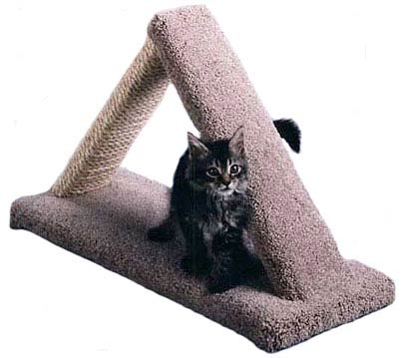
The triangle `trick’ for those allergic to eggs
moles
weight
Molecule count

Slide 19
Multiply Down
Moles (n)
Weight (w) molecule count (N)
6.0*10²³
MW
ALL ROADS LEAD THROUGH MOLES
Divide up

Slide 20
the dozen concept is really the triangle trick
Given 6000 g of eggs= ???? dozens
6
# of dozens
1000 g
1 dozen eggs
12 eggs in a dozen
Weight of eggs
# of eggs (count)
6000 grams
DIVIDE UP: 6000/1000=6

Slide 21
the dozen concept is really the triangle trick
Given 6000 g of eggs= ???? # eggs ?
6
Multiply down
# of dozens
6*12=72
1000 g
1 dozen eggs
12 eggs in a dozen
Weight of eggs
# of eggs (count)
6000 grams
72 g

Slide 22
On the triangle…,.
DIVIDE UP
MULTIPLY DOWN

Slide 23
IN-CLASS simple mole calculations
(on board) the triangle trick way

Slide 24
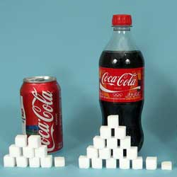
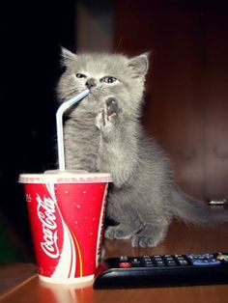
MORE “Sweet” Mole Calculations: but first a public service message
Sucrose → 2 glucose
C₁₁H₂₂O₁₁ 2 C₆H₁₂O₆
In Coke What your body burns

Slide 25
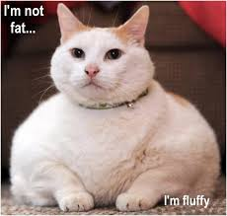
The result of steady Coke drinking……

Slide 26
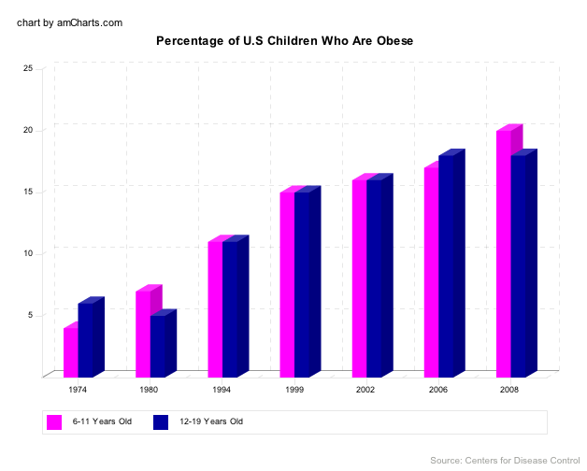
Obese=> BMI > 30
(~30-35 lbs over weight)

Slide 27
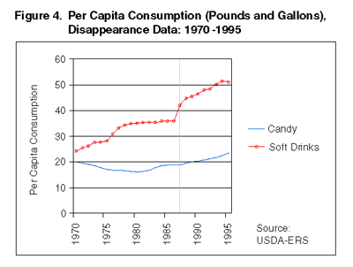

Slide 28
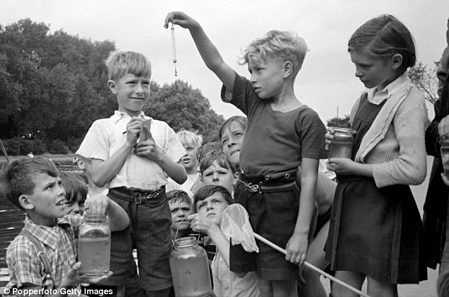
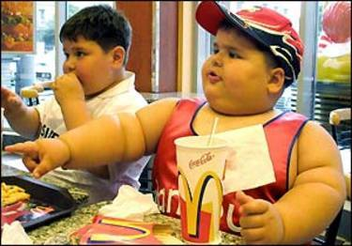
Children
circa 1955
Children circa 2016

Slide 29
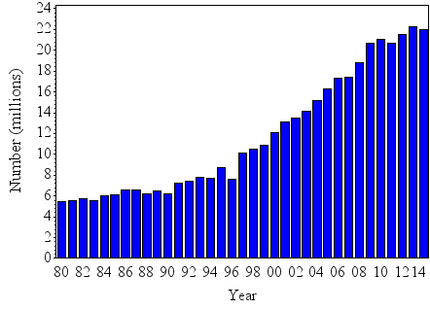
Reported US Diabetes Diagnoses vs. year

Slide 30
Sweet mole calculations part 1
weight per mole (MW): what does a mole
of C₆H₁₂O₆ weigh ? (C=12; H=1; O=16)
6*12 + 12*1 + 6*16 = 180 g/mol
1.1) mole to mass: how many g C₆ H₁₂O₆ of are present in 0.00555 mole of C₆ H₁₂O₆?
0.00555 mol * 180 g/mol = 1 g
1.2) mass to mole: how many moles of C₆ H₁₂O₆ are in 360 g of C₆H₁₂O₆?
360 g/180 g mol⁻¹ = 2 moles

Slide 31
mole calculations part 1 (continued)
1.3) mole to # molecule: how many molecules of C₆ H₁₂O₆ are in 0.5 mol of C₆H₁₂O₆ ?
0.5 mol *6*10²³ molecules/mol =
3*10²³ molecules
1.4) mass to # molecules: how many molecules of C₆ H₁₂O₆ are in 120 g of C₆H₁₂O₆ ?
(120/180) mol * 6*10²³ molecules =4*10²³ molecules mol

Slide 32
mole calculations part 1 (continued)
1.5) # molecules to moles: how many moles in 3*10²⁴ molecules of C₆ H₁₂O₆ ?
3*10²⁴ molecules/ 6*10²³ molecules/mol ⁼ 5 moles
1.6) # molecules to mass : How many grams of C₆ H₁₂O₆ are in 2.0 *10²² molecules of C₆ H₁₂O₆ ?
2*10²² molecules * 180 g
6*10²³ molecules/mol mol
=0.0333 * 180 = 6 grams

Slide 33
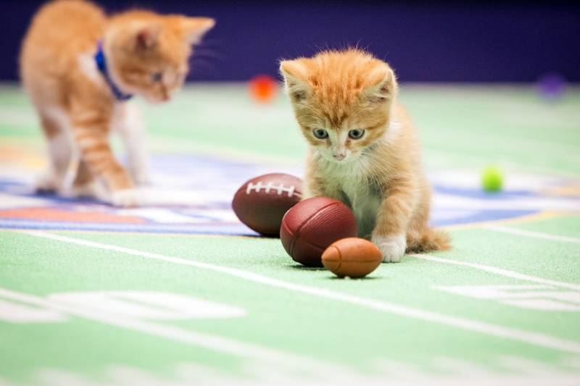
Harder problems….team efforts with clickers

Slide 34
The gram molecular mass of of ‘crystal meth’) is 149.2 g/mol. How many moles of crystal meth are in a typical street `teenth’ = 1/16 of an ounce= 1.80 grams ?
(1 mol count=6.0*10²³ .)
7.27*10²¹
0.0121
82.9
2.48*10⁻²²
My answer isn’t above

Slide 35
B1-Aflatoxin (MW=328.2 g/mol) is a naturally occurring, horribly toxic poison derived from Aspergillus fungi, a common contaminant in corn. It causes cancer in most humans at the staggeringly low exposure level of 1*10¹⁷ molecules. What is the equivalent mass of aflatoxin represented by this count ? ( 1 mol count=6.0*10²³ .)
3.3*10⁻⁸ g
1.8*10⁻⁴ g
5.47*10⁻⁵g
5.06*10⁻¹⁰g
Not any of above

Slide 36
Micro chip manufacture requires nearly oxygen-free conditions wherein the concentration of O₂ is at or below 17 pg/L. Given that the atomic mass of O is 16 g/mol, about how many molecules of O₂ /L does this represent ? Note: 1 mol count=6.0*10²³
5.4*10²⁴
3.5*10²²
3.2*10¹¹
5.3*10²²

