Slide 1

Homework 4 Due Monday 16 October
Start Reading Chapter 5
Homework 5 posted and due this Friday 20 October

Slide 2
Calculations done to correct sig fig
Adding/subtracting
The decimal count of the least precise value sets the determines the calculation’s decimal count….
3.1
3.001 + 0.1 + 0.01 =_____
16
14.5- 0.100 + 2 = _____

Slide 3
1.00+50.1+ 0.100=
51.200
51
51.2
51.20

Slide 4
400 + 2.0 -1.999 +0.03= ?
400
400.03
400.0
400.031

Slide 5
Calculations done to correct sig fig (cont.)
Multiplying/dividing
The value with the lowest sig fig count dictates the calculation’s sig fig count
9
11*0.9 =_____ 5.1000*0.211
1.0
(10.1/2.000) =______
5.0*0.99876

Slide 6
Calculations done to correct sig fig (continued)
Combos of Multiplying/dividing with adding/subtracting
Do +/- first to correct count; then x and / to lowest sig fig count
3.1
3.001 + 0.1 + 0.01 = _______ 1.5000*2.00
= 1.0
3.00

Slide 7
Compute 6.0*3.00/2.0000 to the correct sig fig count.
9.0
9.00
9.0000
9

Slide 8
Compute this combined calculation to the correct # of sig fig.:
(1.00 + 2.000 +3.0)*5.000/10
3.0
3.00
3
3.000

Slide 9

Need more practice ???

Slide 10
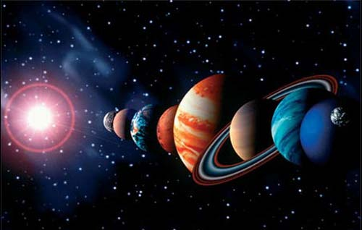
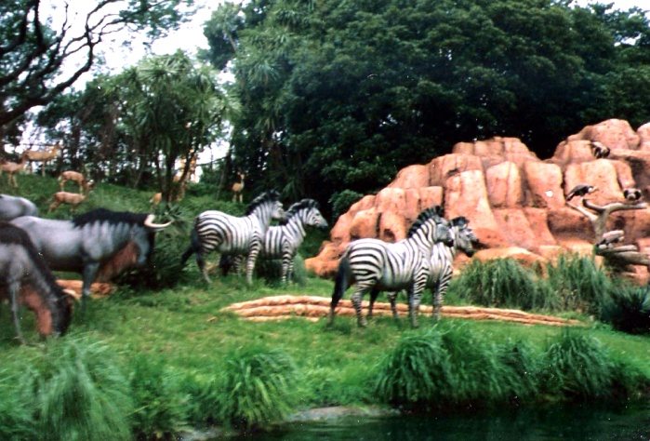

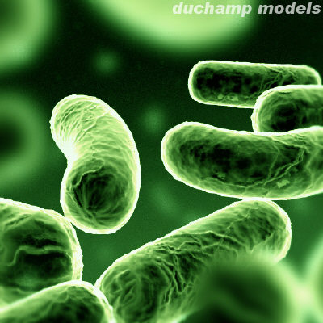
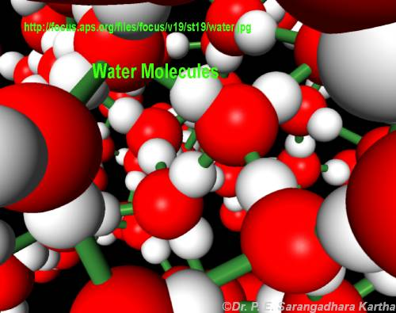
Chapter 3: MOLES- Every science involves counting
Astronomers count ……
Animal biologists count …
Bacteriologists count ...
Chemists count…….

Slide 11
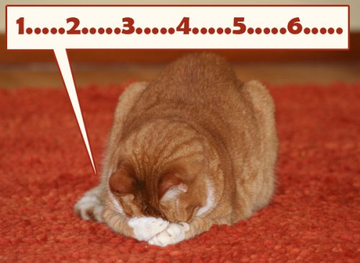
Even worse news…even if we could see molecules…guess long would it take to count the number of water molecules in a tea cup ??

Slide 12
Let’s use the Chinese Tihane-2 computer (world’s current fastest computer) to count all the molecules of water in a teacup assuming it counted at its maximum processor rate = 34,000,000,000,000,000 molecules/second
(=3400 THz=3.4*10⁶ GHz¹ ) ?
How long would it take to count them all ?
Answer: ~ 3.2 years
¹ ~ 1 million times faster than a typical laptop
(It houses 3 million processors in parallel)

Slide 13

From your lecture syllabus….
Student Learning Outcome 5
Students should be able to perform
basic chemical calculations connected to:
mole-weight-count conversions
reaction stoichiometry
limiting yields.
Translation:
How do chemists count atoms
and molecules without actually
having to count them ???

Slide 14

Chemists count atoms and molecules using…
Moles

Slide 15
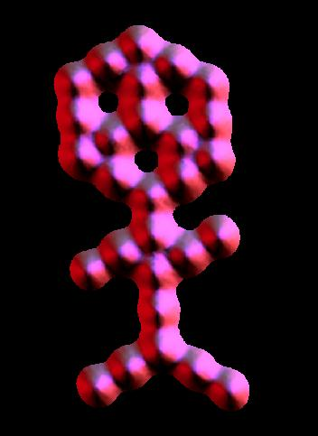
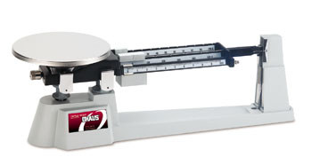

A trip to Mole land
Moles connect the atomic world to human world
~ 10²⁷ molecules in the shape of a couch potato
~0.00000002 m
~2 m
~30 CO₂ molecules arranged in shape of muffin man (IBM)
Moles allow us to conveniently connect between these worlds using a scale.

Slide 16
The mole: starting definitions
What is a chemical mole ?
The classic textbook rant…….(but not your text’s rant, fortunately)
≡ # atoms in 12.000 g of ¹²C
≅ 6.0221335 *10²³ atoms
(Avogadro’s Number)
…Not that helpful when first starting out… ☹

Slide 17
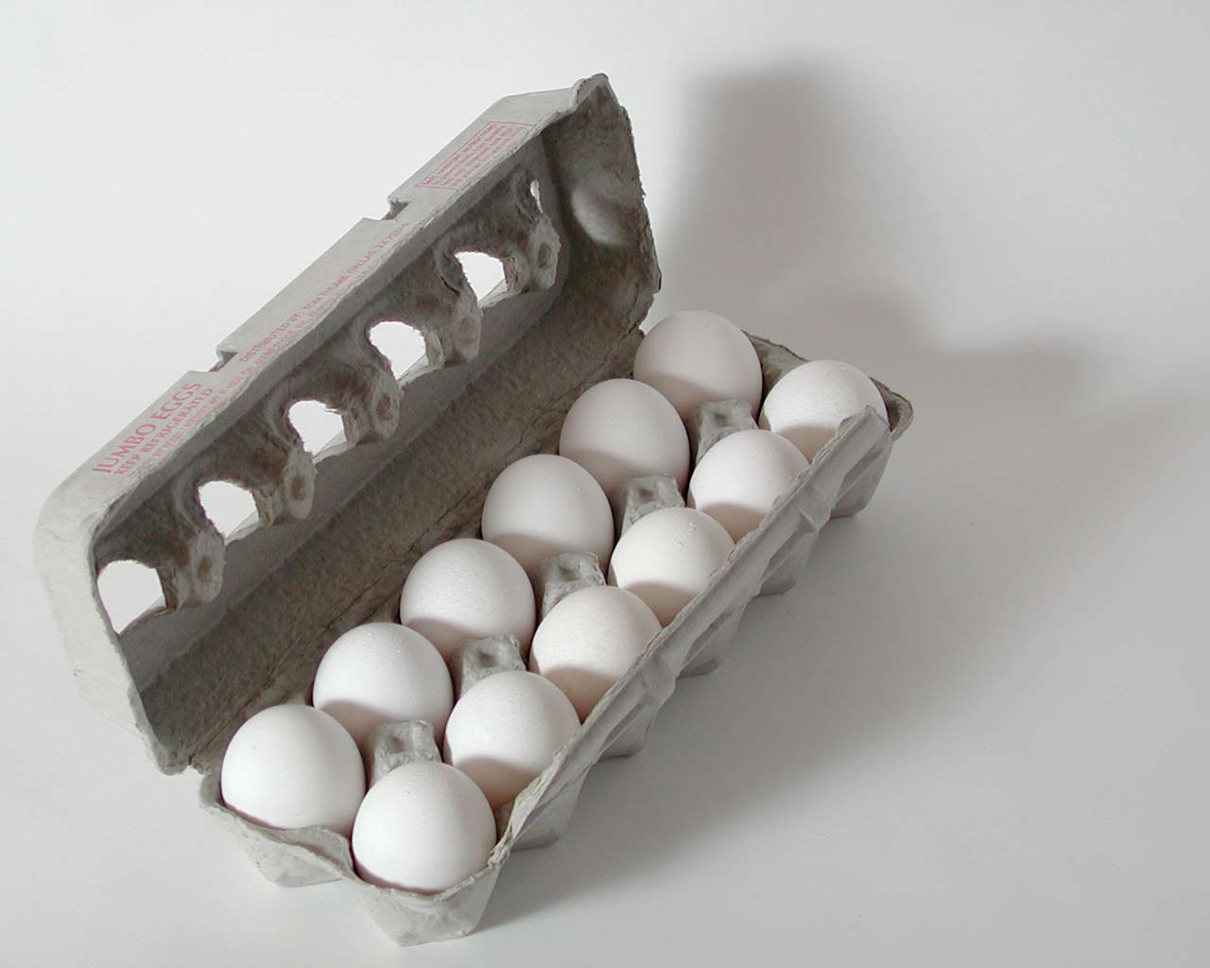
A better beginning:
the mole concept is really …
the same idea as a `dozen.’
≈

Slide 18
IN-CLASS EGG CALCULATIONS

Slide 19

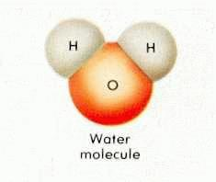
EGG WORLD
CHEMISTRY WORLD
Smallest unit
1 egg
1 molecule
Practical
Counting unit
Mole
(The chemist’s dozen)
Dozen

Slide 20
Eggs vs. chemistry world (continued)
EGG WORLD
CHEMISTRY WORLD
# units in practical counting unit
1 dozen=12
1 mole ≈ 6.022 *10²³
(Avogadro’s #)
grams/mole
=gram molecular weight
= MW (molecular weight)
(ADD)
Practical mass unit
grams/dozen
(WEIGH)

Slide 21
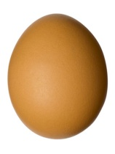
THE ONE PLACE EGG WORLD AND CHEMISTRY WORLD DEVIATE A TEENY BIT:
Egg world
Chemistry world
Mass
dozen
Mass = molecular weight
mol (MW)
Must weigh box of eggs
Just add up atomic masses using Periodic Table in grams

Slide 22
Mass (grams) = MW=Molecular
mol Weight
= sum of masses in grams of component elements in a compound .
(element masses are average masses taken from Periodic Table)

Slide 23
Example of MW Calculation:
What is the MW of methane =CH₄ ??
atomic mass (Table)
# atoms/molecule
product
C
H
12.011~12
1.00794~1
1
4
~12*1=12
~1*4 = 4
Sum = MW = 12+4=16 g/mole

Slide 24
In – class exercise on Molecular Weight (MW) calculations
Find the MW of…
H₂SO₄
2*1 + 1*32 + 4*16 = 98 g/mol

Slide 25
In – class exercise on Molecular Weight (MW) calculations (continued)
Find the MW of…
CaCl₂
1*40 + 2*35.4 = 110.4 g/mol

Slide 26
In – class exercise on Molecular Weight (MW) calculations (continued)
Find the MW of…
Cu₃(PO₄)₂
3*63.5 + 2*(1*31 +4*16) = 380.5 g/mol

Slide 27
In – class exercise on Molecular Weight (MW) calculations (continued)
Find the MW of…
CaCl₂*2H₂O
2 `waters of hydration’ per CaCl₂
1*40 + 2*35.4 + 2*(2*1 + 1*16)
=146.8 g/mol

Slide 28
IN-CLASS simple mole calculations
(on board) the dozen method way

Slide 29
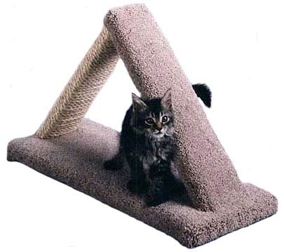
The triangle `trick’ for those allergic to eggs
moles
weight
Molecule count

Slide 30
Multiply Down
Moles (n)
Weight (w) molecule count (N)
6.0*10²³
MW
ALL ROADS LEAD THROUGH MOLES
Divide up

Slide 31
the dozen concept is really the triangle trick
Given 6000 g of eggs= ???? dozens
6
# of dozens
1000 g
1 dozen eggs
12 eggs in a dozen
Weight of eggs
# of eggs (count)
6000 grams
DIVIDE UP: 6000/1000=6

Slide 32
the dozen concept is really the triangle trick
Given 6000 g of eggs= ???? # eggs ?
6
Multiply down
# of dozens
6*12=72
1000 g
1 dozen eggs
12 eggs in a dozen
Weight of eggs
# of eggs (count)
6000 grams
72 g

Slide 33
On the triangle…,.
DIVIDE UP
MULTIPLY DOWN

Slide 34
IN-CLASS simple mole calculations
(on board) the triangle trick way

