Slide 1

Pre-fix mini-quiz
How chemists use numbers (continued)
Still ick

Slide 2
So far:
Metric system (MKS)
Scientific notation
prefixes

Slide 3

(Unfortunately) there are many competing choices of prefixes for a given quantity in chemistry (and physics and biology)
“How do I convert between these %%&! prefix systems ?”
EXAMPLE
Common prefix units used to define wavelength, λ:
μm
nm
pm
mμm (millimicron)
Å =10⁻¹ nm

Slide 4
15 μm = ??? pm

Slide 5

2 ways to convert between metric units
1) Algebraic (‘Marine’ way)
Doc’s story about his HS chem teacher
Divide and conquer,
maggot !

Slide 6
15 μm = ??? pm

Slide 7
2 ways to convert between metric units
1) Algebraic (‘Marine’ way)
Doc’s story about his HS chem teacher
Divide and conquer,
maggot !

Slide 8
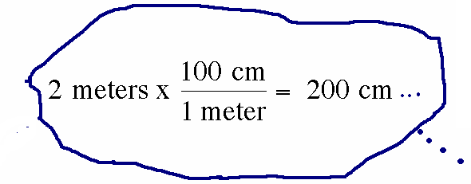
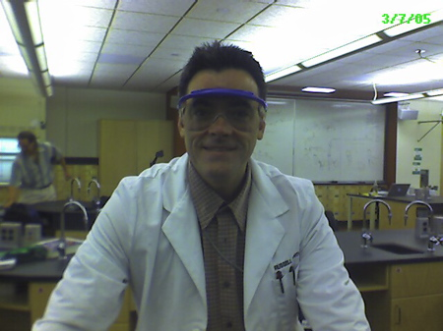
2) Factor-label (commonly taught by high school teachers) Major stumbling block for many students

Slide 9
15 μm = ??? pm
Done two ways on blackboard

Slide 10
Guided practice Unit conversions
answers
Convert 45.7 kg to g
4.57*10⁴ g
Convert 0.73 mL to μL
730 μL =7.3*10² μL
Convert 100 ps to ns
100 ps =0.1 ns
Convert 7.2 kg/L to mg/ μL
7.2 mg/μL

Slide 11
Convert 100 pm to nm
0.01 nm
0.001 nm
1 nm
0.1 nm
No clue…help !

Slide 12
Convert 5000 kg to Mg
5 Mg
50 Mg
0.5 Mg
500 Mg
Still no clue…need nap

Slide 13
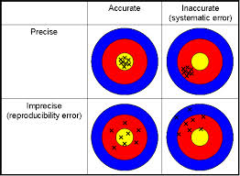
PRECISION AND ACCURACY : what are they ?
Your thoughts…..

Slide 14
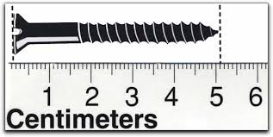
Why do we care about Sig Figs in Chemistry?
The Sig Fig count tells us the precision of measurement
How long is the screw ?
1 sig fig
5 cm
How long is the screw now?
5.1 cm
2 sig fig

Slide 15
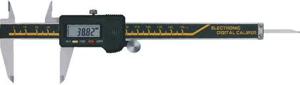
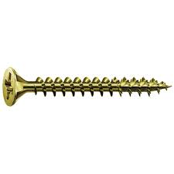
Metric micrometer does even better
51.03^{mm}
How long is the screw now in cm ?
5.103 cm
How many sig figs now ?
4 sig fig

Slide 16
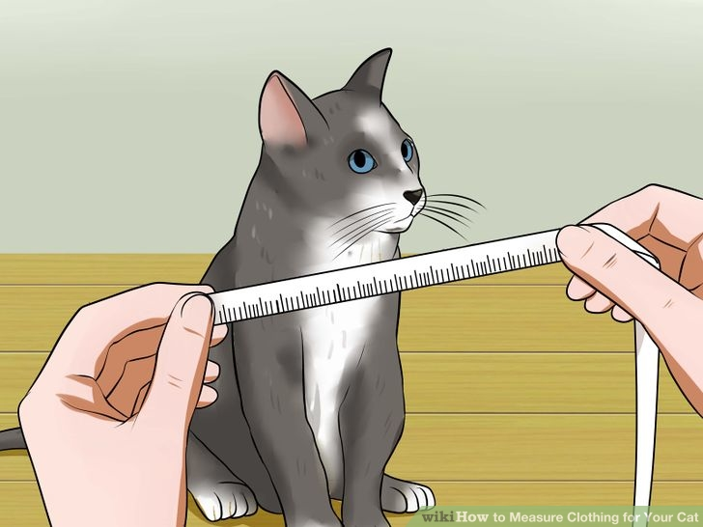
Technological aside:
Higher verifiable precision
(more sig figs) correlates
with higher technical development
1492: Columbus is within + 10,000 miles of estimate for Earth’s diameter
2016: we can pin point the position of anyone via GPS to within ~ + 0.0001 miles (within 12 inches)
In ~ 500 years human measurement precision has increased by > 10 million

Slide 17
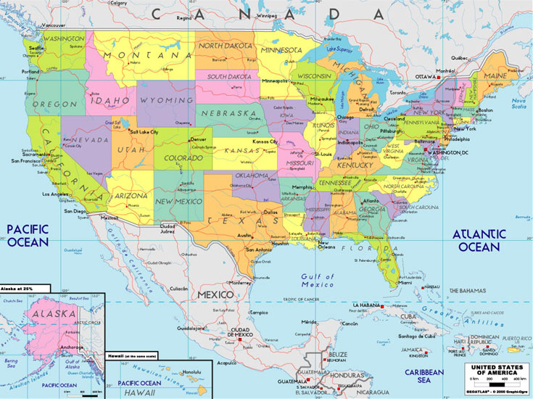
Counting sig figs: Atlantic & Pacific method
Absent Decimal…
move from right (Atlantic side) and start counting when first non-zero digit encountered
10020
300
450070
4
1
5
# sig fig ?

Slide 18
Counting sig figs: Atlantic & Pacific method
Possesses decimal
…move from left (Pacific side) and start counting when first non-zero digit encountered
1.002
0.030
0.00400
4
2
# sig fig ?
3

Slide 19

What is the sig fig count given a scientific notation version of a number ???
3 sig figs
exponent
Example: 6.02*10²³
Pre-exponent
The count of digits in the pre-exponent is the sig fig count.

Slide 20
# sig figs ?
value | 0.0051 | 510 | 5.10 | 5.0010 | 5.0*10⁶⁰
# sig figs =
2
2
3
5
2

Slide 21
Calculations done to correct sig fig
Adding/subtracting
The decimal count of the least precise value sets the determines the calculation’s decimal count….
3.1
3.001 + 0.1 + 0.01 =_____
16
14.5- 0.100 + 2 = _____

Slide 22
1.00+50.1+ 0.100=
51.200
51
51.2
51.20

Slide 23
400 + 2.0 -1.999 +0.03= ?
400
400.03
400.0
400.031

Slide 24
Calculations done to correct sig fig (cont.)
Multiplying/dividing
The value with the lowest sig fig count dictates the calculation’s sig fig count
9
11*0.9 =_____ 5.1000*0.211
1.0
(10.1/2.000) =______
5.0*0.99876

Slide 25
Calculations done to correct sig fig (continued)
Combos of Multiplying/dividing with adding/subtracting
Do +/- first to correct count; then x and / to lowest sig fig count
3.1
3.001 + 0.1 + 0.01 = _______ 1.5000*2.00
= 1.0
3.00

