Slide 1

Chapter 4: How Chemists Use Numbers
ICK!

Slide 2

WHY UNITS ????? (BORING….)
What is water, ugly human ?
(A visceral way to explain why units)

Slide 3
Fundamental SI (le Systeme International) Units (see Table 4.1, p 123)
Length (meters, m)
Mass (kilograms, kg)
time (seconds, s)
Temperature (Kelvin, K)
Basic biggies to know
`mks’
+Chemistry add-on
count of stuff (moles, mol)

Slide 4
DERIVED UNITS
derived units = combos of fundamental L,M, t, T...
Derived unit
Area =
L(m) x L(m)
m²
Volume (V)=
L(m) x L(m) x L(m)
m³
M(kg)
V(m³⁾
Density=
kg
m³
Speed=
L(m)
t(s)
m
s
Energy=
M(kg)*L(m) x L(m)
t(s)*t(s)
kg m²
s²

Slide 5
The “problem’ with the MKS system…
Width of a human blood cell: ~0.000002 m
time for computer to do a single operation:
~ 0.000000003 s
Nimitz class aircraft carrier weighs:
~ 100,000,000 kg
Distance to Sun: ~13,000,000,000 m
….It’s hard to recognize/remember
how many zeroes….

Slide 6
Two ways to keep track of the zeroes and the decimal place:
scientific notation
Prefixes

Slide 7

Review of scientific notation:
aka: Bunny hop arithmetic
Example: Width of a human blood cell in scientific notation
0.000002 m
6 bunny hops to right starting from decimal to
form a number (2) which is between 1 and 9….
0.000002 m=
2 *10⁻⁶ m
decimal
scientific notation

Slide 8
In-class board practice converting decimal to scientific notation…count with me !
time for computer to do a single operation:
~ 0.000000003 s
Nimitz class aircraft carrier weighs:
~ 100,000,000 kg
Distance to Sun: ~13,000,000,000 m
3*10⁻⁹ s
1*10⁺⁹ kg
1.3*10⁺¹⁰ m

Slide 9

Can we `simplify’ scientific notation expressions even more ??? (The 10^{xx} thingie still requires remembering sign and exponent…)

Slide 10
Prefixes are symbolic, `word’ versions of powers of 10
Example: 10⁻³ = m= milli

Slide 11
get this table in your head by Monday (mini-quiz)
Prefix symbol | Prefix name | Power of 10 equivalent
T | Tera | 10¹²
G | giga | 10⁹
M | mega | 10⁶
k | kilo | 10³
d | deci | 10⁻¹
c | centi | 10⁻²
m | milli | 10⁻³
μ | micro | 10⁻⁶
n | nano | 10⁻⁹
p | pico | 10⁻¹²
see also-
Text
table 4.2
p. 125

Slide 12
Board practice with:
prefix assignment

Slide 13
Express the width of a human blood cell (0.000001 m=1*10⁻⁶ m) in prefix notation
1 mm
1 Mm
1 Gm
1 μm

Slide 14
Express the time for a single computer operation 0.000000003 s in prefix notation
(recall 0.000000003=3*10⁻⁹)
3 Gs
0.3 ns
0.003 μs
3 ns

Slide 15
Express the mass of a Nimitz class aircraft carrier in the most reasonable prefixed unit. (It weighs 100,000,000 kg =100,000,000,000 g = 1*10¹¹ g
100 Gg
100000 Mg
0.01 Tg
1 Gg

Slide 16

(Unfortunately) there are many competing choices of prefixes for a given quantity in chemistry (and physics and biology)
“How do I convert between these %%&! prefix systems ?”
EXAMPLE
Common prefix units used to define wavelength, λ:
μm
nm
pm
mμm (millimicron)
Å =10⁻¹ nm

Slide 17
15 μm = ??? pm

Slide 18

2 ways to convert between metric units
1) Algebraic (‘Marine’ way)
Doc’s story about his HS chem teacher
Divide and conquer,
maggot !

Slide 19
15 μm = ??? pm

Slide 20
2 ways to convert between metric units
1) Algebraic (‘Marine’ way)
Doc’s story about his HS chem teacher
Divide and conquer,
maggot !

Slide 21
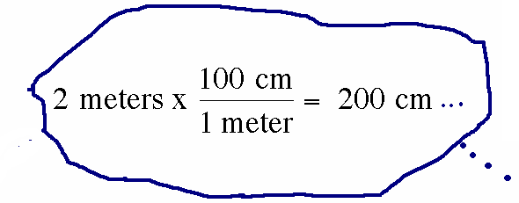
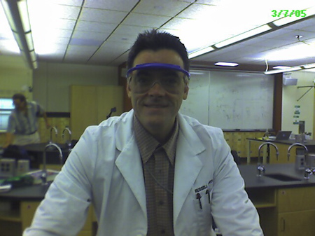
2) Factor-label (commonly taught by high school teachers) Major stumbling block for many students

Slide 22
15 μm = ??? pm
Done two ways on blackboard

Slide 23
Guided practice Unit conversions
answers
Convert 45.7 kg to g
4.57*10⁴ g
Convert 0.73 mL to μL
730 μL =7.3*10² μL
Convert 100 ps to ns
100 ps =0.1 ns
Convert 7.2 kg/L to mg/ μL
7.2 mg/μL

Slide 24
Convert 100 pm to nm
0.01 nm
0.001 nm
1 nm
0.1 nm
No clue…help !

Slide 25
Convert 5000 kg to Mg
5 Mg
50 Mg
0.5 Mg
500 Mg
Still no clue…need nap

Slide 26
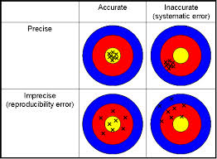
PRECISION AND ACCURACY : what are they ?
Your thoughts…..

Slide 27
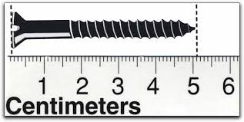
Why do we care about Sig Figs in Chemistry?
The Sig Fig count tells us the precision of measurement
How long is the screw ?
1 sig fig
5 cm
How long is the screw now?
5.1 cm
2 sig fig

Slide 28
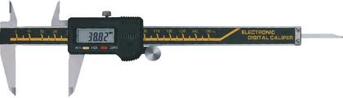
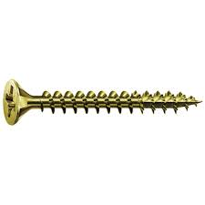
Metric micrometer does even better
51.03^{mm}
How long is the screw now in cm ?
5.103 cm
How many sig figs now ?
4 sig fig

Slide 29
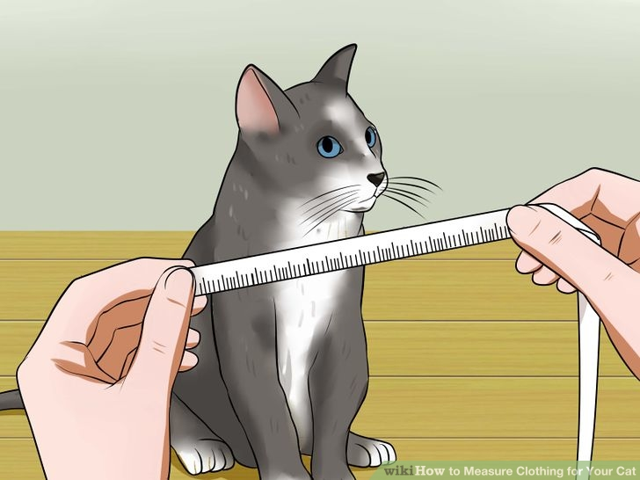
Technological aside:
Higher verifiable precision
(more sig figs) correlates
with higher technical development
1492: Columbus is within + 10,000 miles of estimate for Earth’s diameter
2016: we can pin point the position of anyone via GPS to within ~ + 0.0001 miles (within 12 inches)
In ~ 500 years human measurement precision has increased by > 10 million

Slide 30
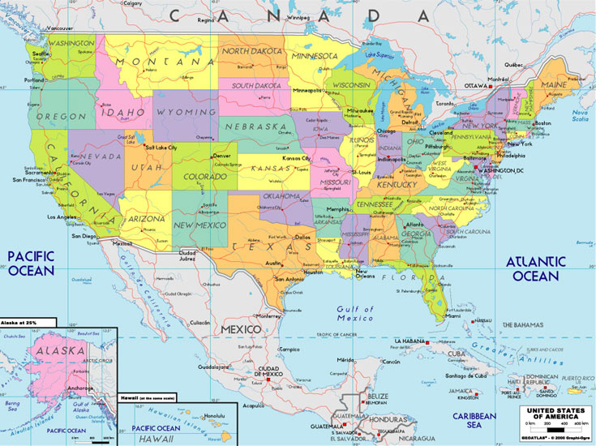
Counting sig figs: Atlantic & Pacific method
Absent Decimal…
move from right (Atlantic side) and start counting when first non-zero digit encountered
10020
300
450070
4
1
5
# sig fig ?

Slide 31
Counting sig figs: Atlantic & Pacific method
Possesses decimal
…move from left (Pacific side) and start counting when first non-zero digit encountered
1.002
0.030
0.00400
4
2
# sig fig ?
3

Slide 32

What is the sig fig count given a scientific notation version of a number ???
3 sig figs
exponent
Example: 6.02*10²³
Pre-exponent
The count of digits in the pre-exponent is the sig fig count.

Slide 33
# sig figs ?
value | 0.0051 | 510 | 5.10 | 5.0010 | 5.0*10⁶⁰
# sig figs =
2
2
3
5
2

