Slide 1

Meh…Welcome Back. Doesn’t coming back from Break suck ???
Homework 4 posted and due Friday 13 October

Slide 2

Chemspeak:
Part 2: The Stock Naming Scheme (Lab)
Using the Periodic Table to Classify and Name Inorganic Compounds
Non-metals (NM)+Non metals (NM)
Metals (M) + NM
Transition metals (TM) + NM
M and TM with
Oxyanions (OXY)
replacing (NM)

Slide 3

Reading about Naming Schemes
Pages 85-89 of your text (section 3.3)

Slide 4
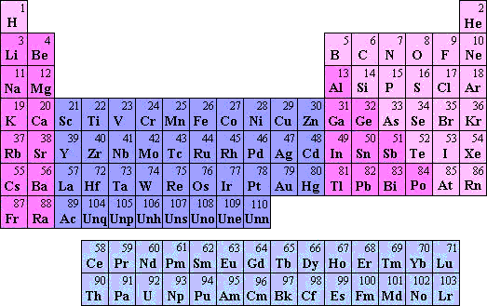
Naming Inorganic compounds: in-class practicing
metals
Non-metals
Transition metals
Lanthanides
Actinides

Slide 5
Common Oxyanions: names, formulas, charges
(See also: Table 3.6 page 100 of text)

