Slide 1

Exam 1 Friday Sept 29 Sept
You can have your spdf marked Tables

Slide 2
Lewis rules for covalent bonding of larger compounds : octet rule
1) All bonds (lines between atoms) hold 2 valence electrons
2) The number of electrons binding the atoms =
the sum of the atoms’ valence electrons
3) The element most in the middle of the Periodic Table
goes in the middle of the compound
4) Distribute bonds and/or lone pairs around each atom so
that each atom `sees’ 8 electrons (done via trial and error)

Slide 3
Board practice drawing covalently bonded molecules using octet rule and the role of formal charge
Alternate octet versions of CO₂ and COCl₂
CO and why formal charge makes it a poison

Slide 4
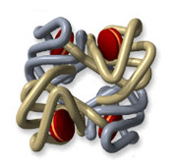
CO and blood
Fe³⁺
vs.
-
CO has 200-400X stronger electrostatic attraction to Fe³⁺ from formal charge vs. O₂. Explains why CO so easily asphyxiates humans even at `low’ concentrations (400 ppm)…it never lets go of the Fe³⁺

Slide 5
examples of 3D organic structures in the “flesh”
(models and pix)

Slide 6
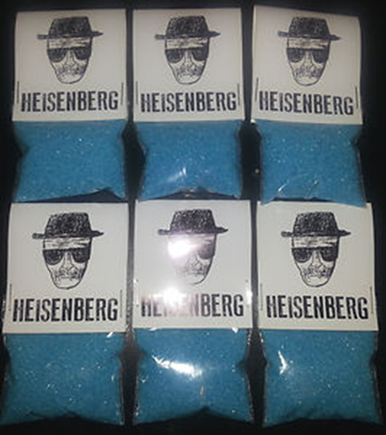
Crystal meth

Slide 7
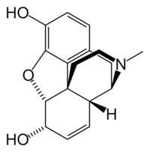
morphine

Slide 8
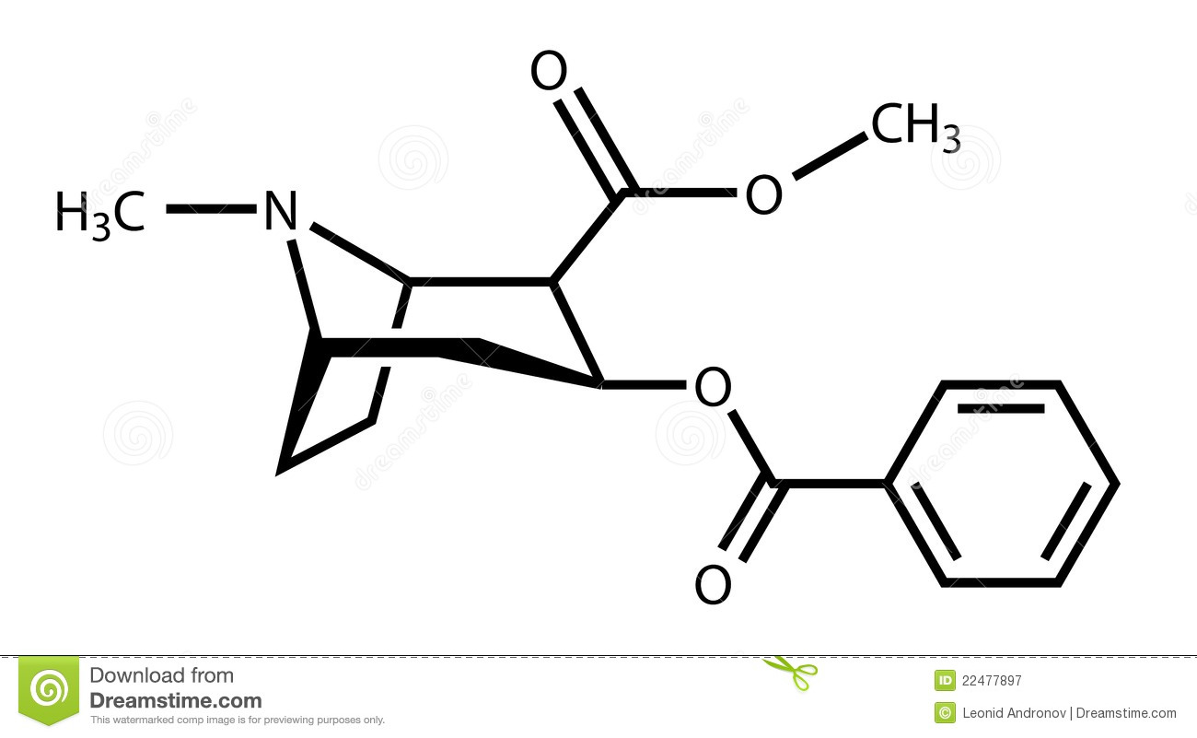
Heroin

Slide 9
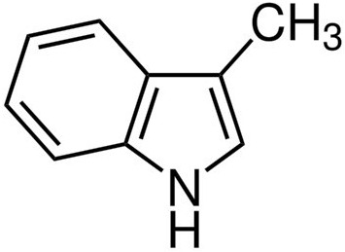
skatole
………poop smell

Slide 10
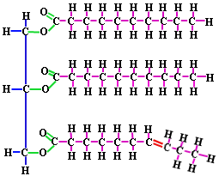
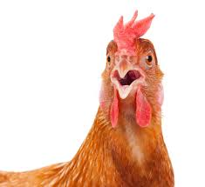
Chicken fat

Slide 11
`Chemspeak’
Part 1: Molecular Formulas (see p. 93-96)
Definition:
empiric formula= ratio of elements in a compound expressed in lowest whole numbers
Example: CH₂O = empiric formula of glucose (sugar we metabolize)

Slide 12
Empiric formulas (continued)
CH₂O = empiric formula of glucose (sugar we metabolize)
molecular formula (what it really has in atom count):
C₆H₁₂O₆=
(CH₂O)₆
Sugar =Carbo hydrate

Slide 13
Which formulas below are empiric
(= lowest common denominator form) ??
NOT EMPIRIC
÷ 3
EMPIRIC
C₃H₆O₃
CH₂O

Slide 14
Which formulas below are empiric (continued) ??
N₃F₇
EMPIRIC…3 & 7 have no shared factors

Slide 15
Which formulas below are empiric (continued) ??
H₃P₉O₁₂S₅
EMPIRIC
(3,9,12 divisible by 3…but 5 is not)

Slide 16
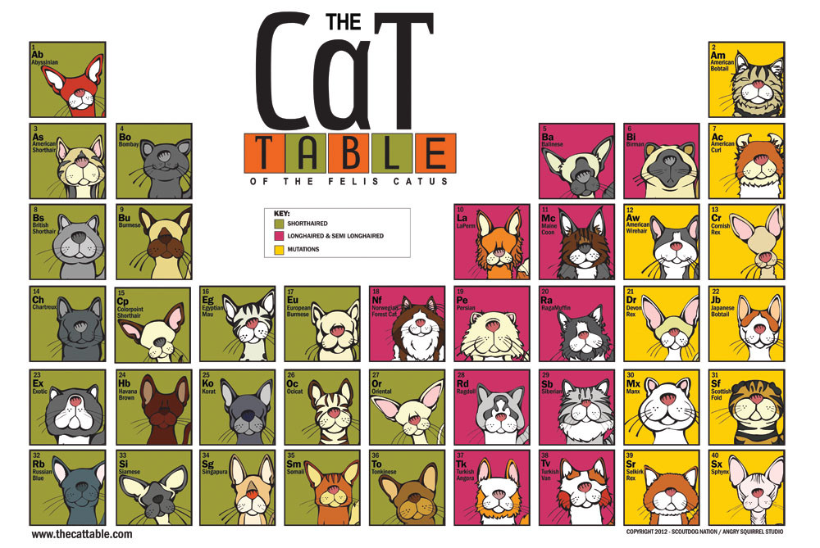
Chemspeak:
Part 2: The Stock Naming Scheme (Lab)
Using the Periodic Table to Classify and Name Inorganic Compounds
Non-metals (NM)+Non metals (NM)
Metals (M) + NM
Transition metals (TM) + NM
M and TM with
Oxyanions (OXY)
replacing (NM)

Slide 17

Reading about Naming Schemes
Pages 85-89 of your text (section 3.3)

Slide 18
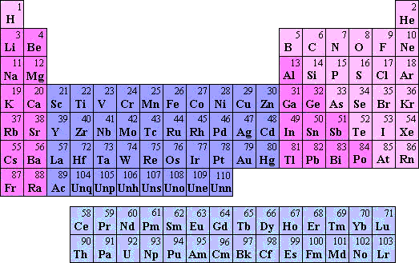
Naming Inorganic compounds: in-class practicing
metals
Non-metals
Transition metals
Lanthanides
Actinides

