Slide 1

Exam 1 next Friday
Homework 3 due today

Slide 2
EXAMPLES OF THE FEROCITY OF IONIC COMPOUND FORMATION combining Na and Cl
2Na(s) + Cl₂ (g) → 2NaCl (s)
https://www.youtube.com/watch?v=Ftw7a5ccubs
`salts’
Combining Al with Br
2Al(s) + 3Br₂(g)→ 2AlBr₃(s)

Slide 3
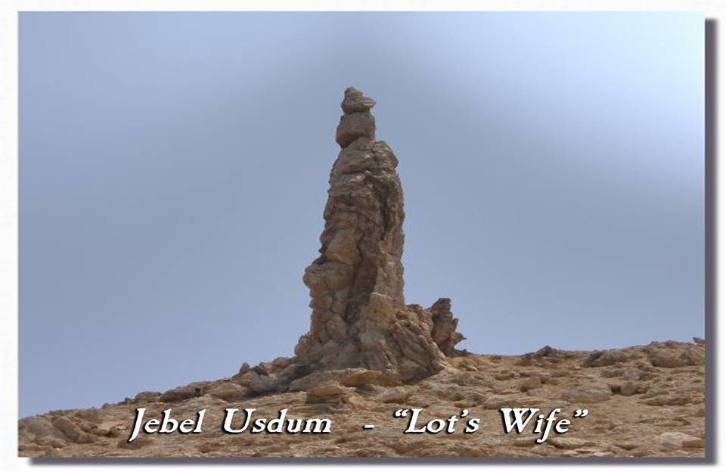
Salts have long been known to be `the end of road
….They exhibit extreme stability

Slide 4
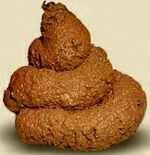

organic stuff
Features `covalent’ bonds
(electrons shared equally)

Slide 5
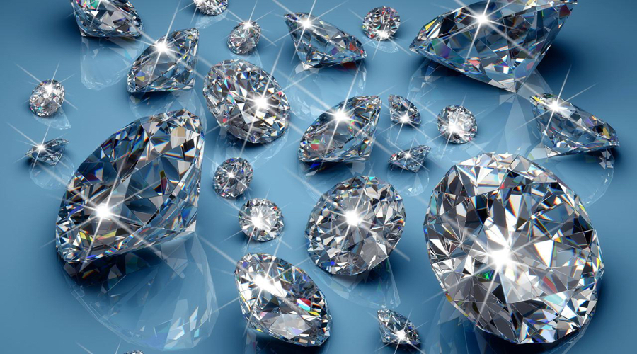
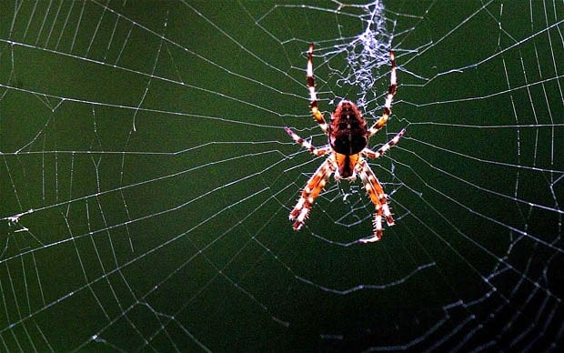
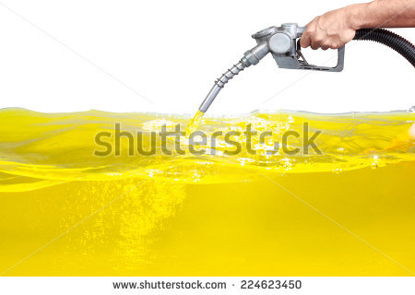
Covalently bonded materials have an extreme range of properties

Slide 6
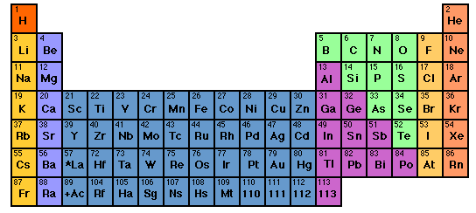
Elements who bond `covalently’ with each other

Slide 7
Examples of covalent bonding between simple molecules: diatomic gases…the octet rule with dots and the shared electron pair bond. (see also: text, page 90)
F₂
O₂
N₂

Slide 8
Lewis rules for covalent bonding of larger compounds : octet rule
1) All bonds (lines between atoms) hold 2 valence electrons
2) The number of electrons binding the atoms =
the sum of the atoms’ valence electrons
3) The element most in the middle of the Periodic Table
goes in the middle of the compound
4) Distribute bonds and/or lone pairs around each atom so
that each atom `sees’ 8 electrons (done via trial and error)

Slide 9
Board practice drawing covalently bonded molecules that obey the octet rule

Slide 10
The Organic `Big’ 4 elements: why Organic Chemistry is simple: the HONC bonding rule
The Big 4
Bonds to…
H
O
N
C
1
2
3
4

Slide 11
Board work drawing organic structures
identifying `good’ organic compounds
counting electrons
examples of 3D organic structures in the “flesh”
(models and pix)

Slide 12
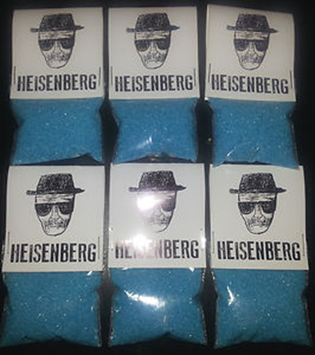
Crystal meth

Slide 13
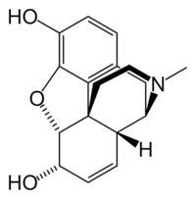
morphine

Slide 14
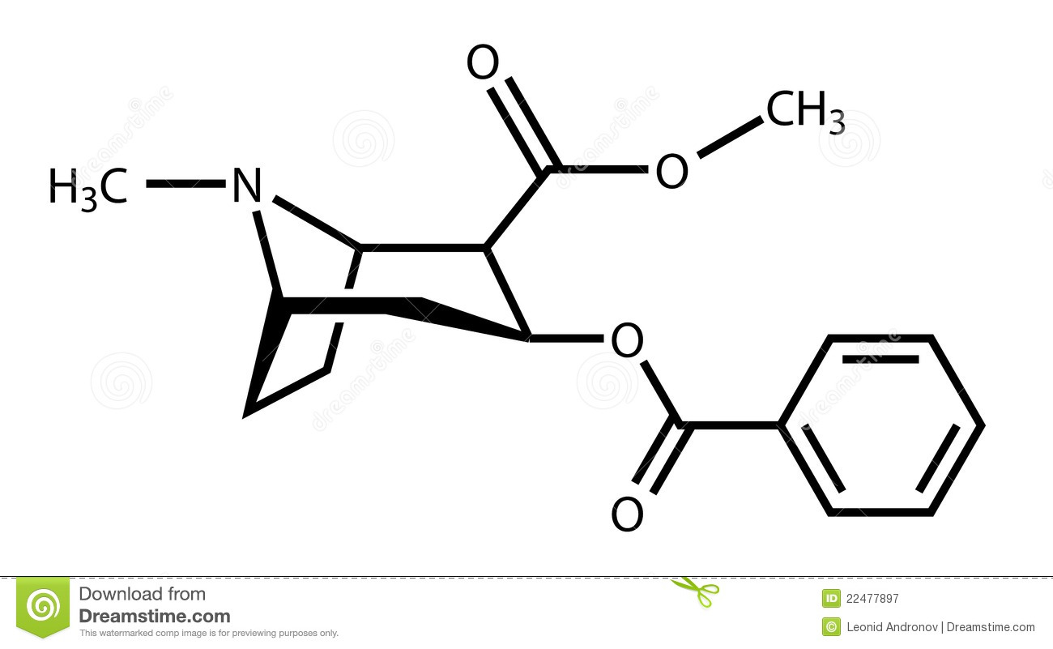
Heroin

Slide 15
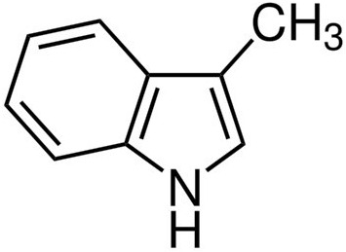
skatole
………poop smell

Slide 16
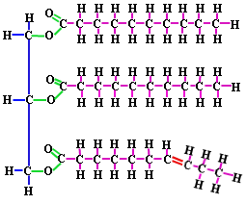
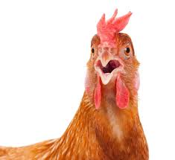
Chicken fat

