Slide 1
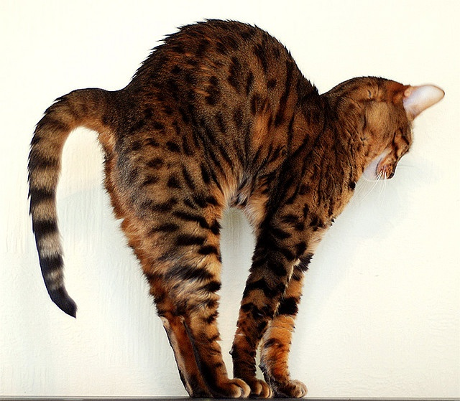
Homework 3 due this Friday
It’s hump day !!! Two days till the 4rd week is over !!

Slide 2
CHEMICAL VS PHYSICAL
CUTTING PAPER
ICE MELTING
DISSOLVING SALT IN WATER
BURNING PAPER
ACID + BASE
POTASSIUM IN WATER
PHYSICAL
PHYSICAL
PHYSICAL
CHEMICAL
CHEMICAL
CHEMICAL

Slide 3
What is the correct Lewis dot structure for B?
:B
:B:
:B.
B.

Slide 4
How many valence electrons does F have?
7
6
5
4
none

Slide 5
What is the correct Lewis structure for Ca ?
Ca.
Ca:
.Ca:
:Ca:

Slide 6
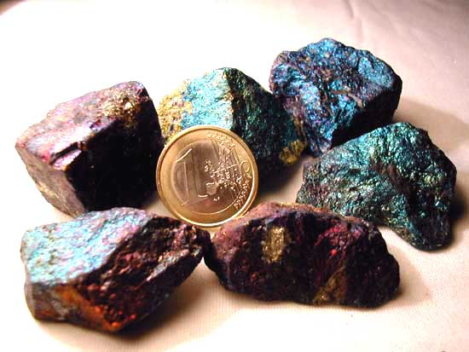
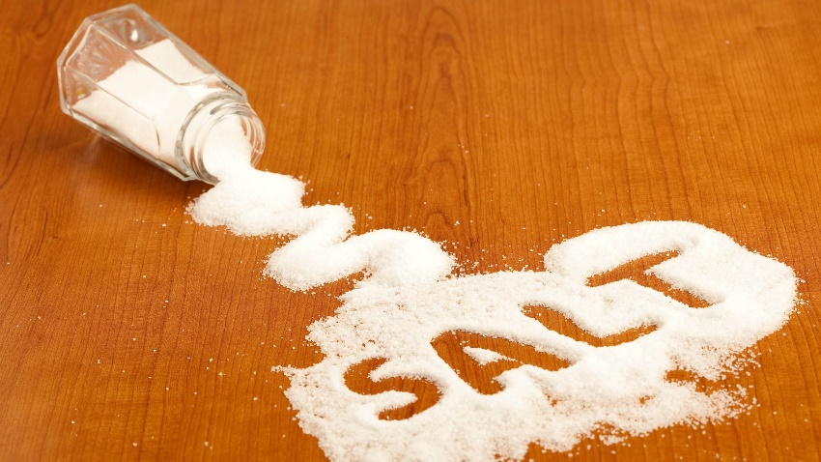
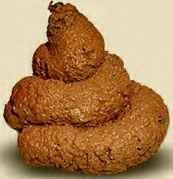

Dividing up the chemicals: Organic vs. Inorganic
Inorganic stuff
organic stuff
Features polar covalent bonds (unequal sharing
of electrons)
Features ionic bonds (givers and takers of electrons)
Features `covalent’ bonds (equally shared electrons)

Slide 7
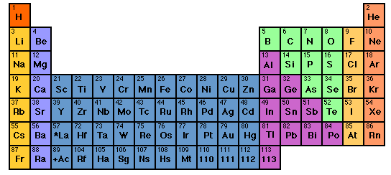
Predicting Ionic compound formulas: the Periodic Table rules again-assigning preferred element charges (write down on your Periodic tables
ORGANIC MOSTLY
+1
+2
-3
-2
-1
0
Transition metals. Lots of possible + charges…put them on ignore for now

Slide 8
Given stable charges for elements, we can predict neutral ionic compound formulas formed from `+’ and `-’ species
Example:
Crossing the charge trick
Stable ions of Na and O
Na⁺¹
O²⁻
2
1
Neutral compound formed
Na₂O₁ = Na₂O
2 x (+1 ) + 1 x (-2) =
2 - 2 = 0

Slide 9
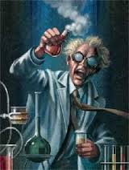
In-class Exercise building
Stable ionic compounds

Slide 10
Alternative `pictorial’ approach with Lewis dot structures: stripping atoms to their `core’-
Board pix (see also: section 3.2 of text)
Practice in class drawing alternative ionic pictograms using abbreviated electron configurations

Slide 11
EXAMPLES OF THE FEROCITY OF IONIC COMPOUND FORMATION combining Na and Cl
2Na(s) + Cl₂ (g) → 2NaCl (s)
A mineral or `salt’
Combining Al with Br
2Al(s) + 3Br₂(g)→ 2AlBr₃(s)

Slide 12
organic stuff
Features `covalent’ bonds
(electrons shared equally)

Slide 13
Examples of covalent bonding between simple molecules: diatomic gases…the octet rule and the shared electron pair bond.
(see also: text, page 90)
F₂
O₂
N₂

Slide 14
Elements who bond `covalently’ with each other

Slide 15
The Organic `Big’ 4 elements: why Organic Chemistry is simple: the HONC bonding rule
The Big 4
Bonds to…
H
O
N
C
1
2
3
4

Slide 16
Board work drawing organic structures
identifying `good’ organic cmpounds
counting electrons
examples of 3D organic structures in the “flesh”

