Slide 1

Mini-Quiz 6: You can use the Periodic Tables you marked up last Friday with s, p…
Homework 3 due Friday
Welcome to Week 4 and another Monday

Slide 2
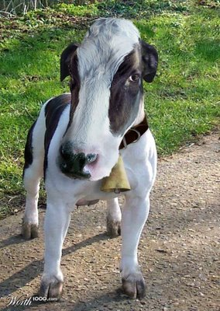
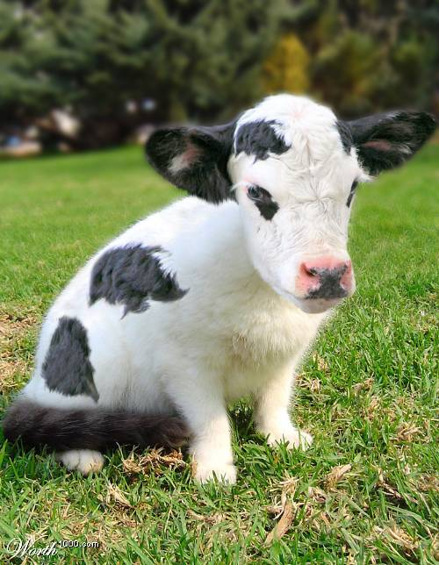
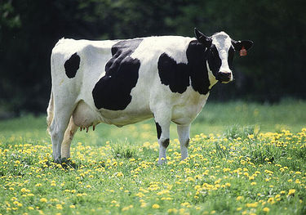
The specific combo of orbits creates the unique chemistry of an element
Be= [He]2s²
Cl=[Ne]3s² 3p⁴
Ti = [Ar] 3d²4s²
100% cow
33% cow+66% kitty
50% cow +50% dog

Slide 3
Electronic configurations reviewed and a new `twist’
Complete electronic configuration of Ca
1s²
2s²
2p⁶
3s²
3p⁶
4s²
Which are `core’ and which are valence ?
core
Valence
Which does `chemistry’, core or valence ?
valence
write the abbreviated electronic configuration of Ca:
[Ar] 4s²
The new ‘twist’: Lewis dot equivalent of abbreviated configuration of Ca- electrons in picture form
Ca :
In class practice counting valence electrons, IDing elements and writing Lewis dot structures (2.5)

Slide 4

Finally, we’re done with this long preface about atoms and……
NOW…(WAIT FOR IT)…
TIME FOR CHEMISTRY!

Slide 5
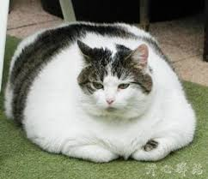
Chemistry…the big picture: Chapter 3

Slide 6
CHAPTER 3.1 : Chemistry- the Big Picture-pt 1
“Hook up”
In whole #
ratios
Atoms of different elements
…to form molecules

Slide 7

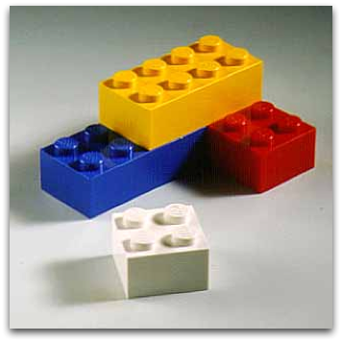
Big Picture pt 1 seen in terms of Legos
Molecules…any combo of different elements
Atoms …irreducibly different element(al) pieces

Slide 8
CHAPTER 3.1 : Chemistry- the Big Picture-pt 2
+
+
Different molecules ( or the same molecules) can trade atomic partners
i.e. they react to form new molecules

Slide 9
CHEMICAL VS PHYSICAL
CUTTING PAPER
ICE MELTING
DISSOLVING SALT IN WATER
BURNING PAPER
ACID + BASE
POTASSIUM IN WATER
PHYSICAL
PHYSICAL
PHYSICAL
CHEMICAL
CHEMICAL
CHEMICAL

Slide 10
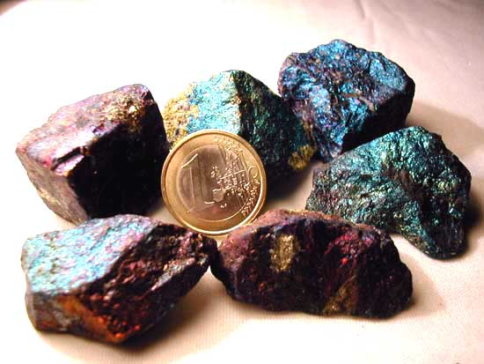
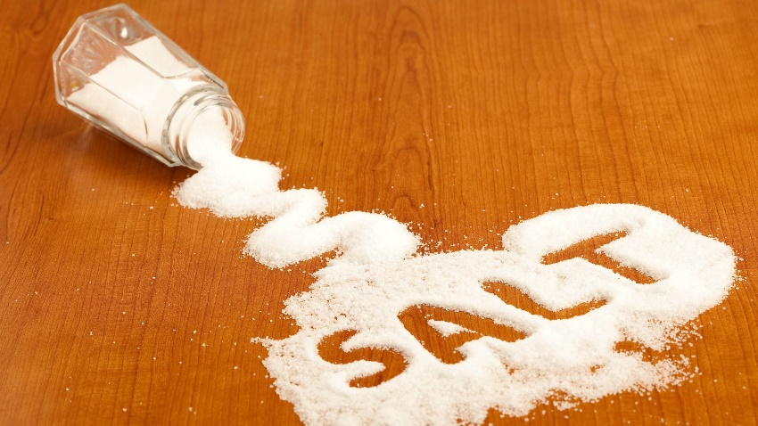


Dividing up the chemicals: Organic vs. Inorganic
organic stuff
Inorganic stuff
Features polar covalent bonds
Features ionic bonds
Features `covalent’ bonds

Slide 11
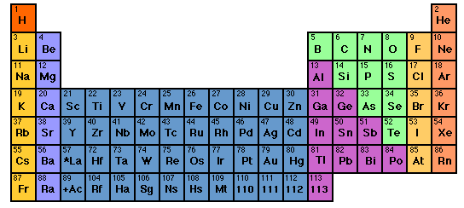
Predicting Ionic compound formulas: the Periodic Table rules again-assigning preferred element charges (write down on your Periodic tables
ORGANIC MOSTLY
+1
+2
-3
-2
-1
0
Transition metals. Lots of possible + charges…put them on ignore for now

Slide 12
Given stable charges for elements, we can predict neutral ionic compound formulas formed from `+’ and `-’ species
Example:
Crossing the charge trick
Stable ions of Na and O
Na⁺¹
O²⁻
2
1
Neutral compound formed
Na₂O₁ = Na₂O
2 x (+1 ) + 1 x (-2) =
2 - 2 = 0

Slide 13
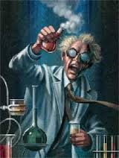
In-class Exercise building
Stable ionic compounds

Slide 14
Alternative `pictorial’ approach with Lewis dot structures: stripping atoms to their `core’-
Board pix (see also: section 3.2 of text)
Practice in class drawing alternative ionic pictograms

Slide 15
EXAMPLES OF THE FEROCITY OF IONIC COMPOUND FORMATION combining Na and Cl
2Na(s) + Cl₂ (g) → 2NaCl (s)
A mineral or `salt’
Combining Al with Br
2Al(s) + 3Br₂(g)→ 2AlBr₃(s)

