Slide 1
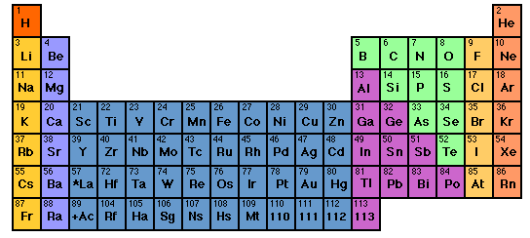
s d p
He is s not p
3d
4d
5d
6d
IN-CLASS EXERCISE 1:
COMPLETE ELECTRONIC CONFIGURATIONS

Slide 2
IN EXERCISE #1 CHEM 1114
1. Write the complete electron configuration for the elements below
Cl
K
c) Mn
d) Se
1s² 2s² 2p⁶ 3s² 3p⁵
1s² 2s² 2p⁶ 3s² 3p⁶ 4s¹
1s² 2s² 2p⁶ 3s² 3p⁶ 4s² 3d⁵
1s² 2s² 2p⁶ 3s² 3p⁶ 4s² 3d¹⁰4p⁴

Slide 3
He is s not p
s d p
3d
4d
5d
6d
INERT GAS CORE
IN CLASS EXERCISE 2:
ABBREVIATED ELECTRONIC CONFIGURATIONS

Slide 4
2. Write the abbreviated electron configurations for
the elements below, assuming they are in the
gas phase.
a) Ca
b) Al
c) As
[Ar] 4s²
[Ne] 3s² 3p¹
[Ar] 4s² 3d¹⁰ 4p³

Slide 5
d electron variations
1) s d electron configuration switching
Example: behavior of Mn
From spectra of atomized elements
As it behaves chemically in solution
Mn
[Ar] 4s² 3d⁵
[Ar] 3d⁵ 4s²
Mn ²⁺
[Ar] 3d⁵
Evidenced by fact that all transition metals have a stable 2+ state… => outer 4s² are removed first

Slide 6
2) s and d undergo filled/half-filled/empty rearrangements
d-electron variations (continued)
Cr⁺¹
[Ar] 4s² 3d³
[Ar] 3d⁴ 4s¹
[Ar] 3d⁵ 4s⁰
Periodic Table predicts
RIGHT based on chemistry and spectroscopy
Corrected for chemistry by d-switching
STILL WRONG ☹

Slide 7
Pigeonhole¹ representation of electrons
¹Called orbital diagrams in text
As implied by Table
+ chemical reversal
After fill, half-filled, empty correction
Cr⁺ =
[Ar] 3d⁴ 4s¹
[Ar]3d⁵ 4s⁰
*This final moving around applies only for transition metals
3d
4s
Pigeonhole representation
d rule: s and d electrons in valence shell move around to produce filled, half-filled and/or empty orbitals in order to attain a more stable atom.
Half-filled
empty
Corrected for filled,half-filled, empty rule

Slide 8

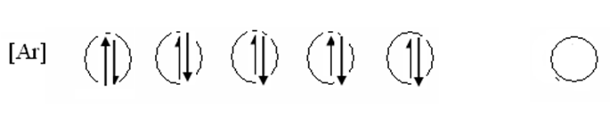

In-Class Exercise: Write the correct, pigeonhole diagrams for the transition metal species below
Write the correct, pigeonhole diagrams for the transition
metal species below
a) Cr
Ni
Ag⁺
remember…rule is applied ONLY with the s & d electron combos
(e.g. transition elements only)

Slide 9
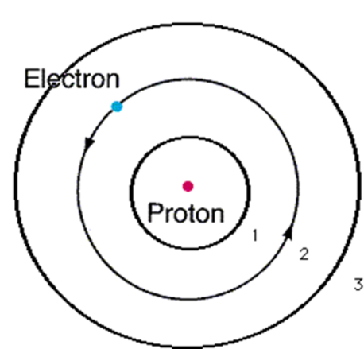
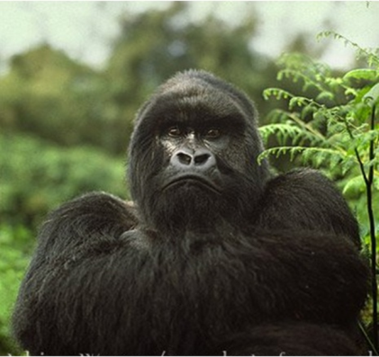
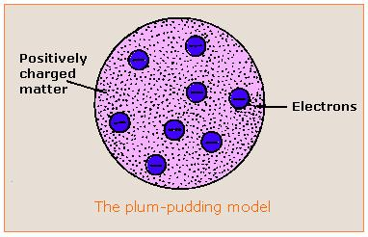
Evolution of the atomic model ….
4) Experimental
Spectroscopy Rules
~ 1930
3) Bohr Model
1913
2)Rutherford Model
1911
1) Thomson Model
1897
1s²2s²2p⁶….
Philosophical
Magazine Series 6
26. 1-25 (1913)
Philosophical
Magazine Series 6,
21, 669-688 (1911)
My way or the highway…
Philosophical Magazine
44, 295 (1897)

Slide 10


Model 5: the `final’ solution for the H atom (pp. 73-80):
Erwin Schrödinger’s Equation and Modern Quantum Theory
His theory in a nutshell:
Find ψ & E by solving the `eigenvalue’ problem:
Text p. 74
Schrödinger’s equation
2) ψ*(x)ψ(x)dx = P(x)
P(x) =probability of e⁻ being at x=> shape of orbitals

Slide 11
What P(x)=ψ*(x)ψ(x)dx means:
Electrons are now you see it, now you don’t bits of atomic popcorn
Electron here t=t₁
Electron has P(x) chance to `pop out’ at x=distance from nucleus.
It must be somewhere at all times…just can’t say where…
Electron
here at t=t₃
Electron starts here, t=0
Nucleus magnified 100,000X
Electron
here t=t₂
Electron
Here t=t₄….

Slide 12
Model 5: the `final’ solution for the H atom (pp. 73-80):
Erwin Schrödinger’s Equation and Modern Quantum Theory
His theory in a nutshell (continued): …The really important bit for chemists:
3) The possible states of the e⁻ turn out to depend on 4 quantum numbers: n, L, m_{L} and m_{s} which are connected by some simple counting rules
(See text tables 2.1 and 2.2 pp 76-7)

Slide 13
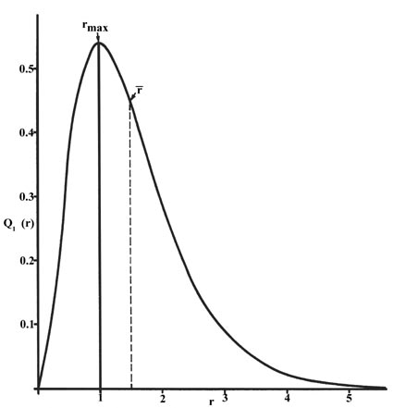
Schrödinger’s prediction of 1s electron’s Probability of being in a thin shell at distance r from H nucleus:
See also: text p. 75 Fig. 2.13
predicts effects of magnets (m_{L})
E_{H} (1s) =-13.6 eV (predicted)
E_{H} (1s) =-13.6 eV (observed)
0.52 nm (Schrödinger prediction)
0.52 nm = observed effective radius of
ground state H atom

Slide 14


The even better news: Schrödinger’s methods can be extended with success (and some reasonable approximations) to explain the rest of the elements’ spectra.
..so are theoreticians (sort of)
The spectroscopists are happy

Slide 15



the quantum cat dilemma-one consequence of
Schrodinger’s ψ
Kitty state =ψ = f₁ ϕ₁ + f₂ϕ₂
(According to Schrodinger’s physics)
f₁ ~ 1, but not quite f₂ ~ 0 but not quite

Slide 16

Another animated,
Abused quantum cat-in-a-box
story….

Slide 17
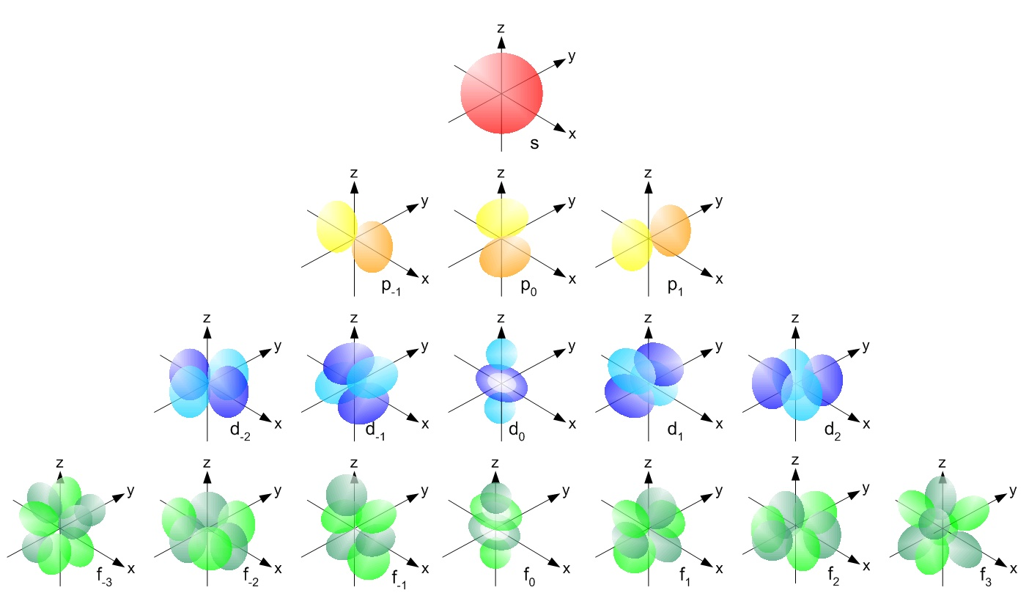
A new wrinkle from Schrödinger: orbital shapes are tied to new quantum numbers (see also: figures 2.14-2.18 pp. 77-79 of text)
HIGHER
ENERGY
Low E→ high E in magnetic field
L=0=>s
0
m_{L}= -L,(-L+1)… +L
L=1=>p
-1
0
+1
L=2=> d
L=3=> f
-2
-1
0
+1
+2
-3
-2
-1
0
+1
+2
+3
HIGHER

Slide 18
Counting Rules for assigning atomic electrons to:
n, L,m_{L} and m_{s} (see also: Table 2.2 p. 77)
Lower quantum numbers => lower energy
n=1,2,3…
=Principal quantum numbers (Bohr’s old quantum number for shells)
Given n:
L =n-1,n-2…0
Given L:
m_{L}= -L, (-L+1), (-L+2)…0, 1,2…+L
Any specific n,L,m_{L} has two possible `spin states’:
m_{s}= ½ or – ½

Slide 19
Each electron in the Schrödinger model gets a unique set or `address’ made of 4 quantum numbers: n, L, m_{L} and m_{s}
[n L m_{L} m_{s}]
The atomic electron’s `social security number’
(or apartment address)

Slide 20
Examples of allowed, one electron `addresses for n=2 from Schrödinger model (low→ high E)
n L m_{L} m_{s}
Low E
2 0 0 -1/2
2 0 0 +1/2
2 1 -1 -1/2
2 1 -1 +1/2
2 1 0 -1/2
2 1 0 +1/2
2 1 1 -1/2
High E

Slide 21
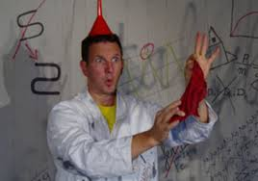
Schrödinger’s quantum number counting rules ~recreate the structure of the Periodic Table !
…A BRIEF IN -CLASS EXPOSITION

Slide 22
IN-class practice using the rules and language described on pp. 73-80
Problem 77 page 105:
How many orbitals in an atom can have the designation:
5p
3d_{z2}
4d
n=4
3
1
5
16

Slide 23
IN-class practice using the rules and language described on pp. 73-80 (continued)
Problem 79 page 105:
Give the maximum number of electrons that have these quantum numbers:
n=4
b)n=5, m_{L}=+1
e)n=2, L=1
32
8
6

