Slide 1
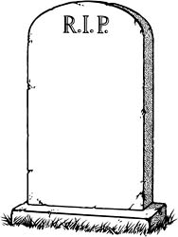

The Bohr Model dies…1930
1930
Bohr theory
The experimental chemists and spectroscopists say “fugetabout” it.
“typical” experimental spectroscopist/chemist
Experimentalist’s attitude towards theoreticians:
“If I want your opinion, I’ll give it to you…”

Slide 2


Bohr’s little Problem…
1930
Bohr theory
Spectroscopists find
Na-`D’ line
Is yellow
Even worse..
Spectroscopists observe….
Bohr’s prediction: 1 green line
11 lines !!
1≠11
1)Bohr can’t predict anything right except H…the other elements have too many lines, e.g. Na
BOHR
1 line predicted
EXPERIMENT
11 LINES OBSERVED

Slide 3
Bohr model’s failures (continued)
2)…even Bohr’s predictions for H have problems
Can’t predict magnetic `fine’ structure of H, e.g
…magnetize H and even n=1 splits into 2 lines
1 ≠ 2
Turn on magnet near H
☹ Not even the smartest theoretical physicists of the day (Sommerfeld, Planck, Dirac) can make 1=2 or 1=11…. with Bohr’s model

Slide 4
Link to atomic line spectra of elements…none of which Bohr can explain except H
http://chemistry.bd.psu.edu/jircitano/periodic4.html

Slide 5
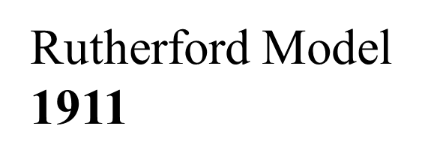

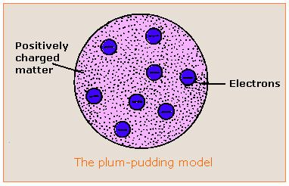
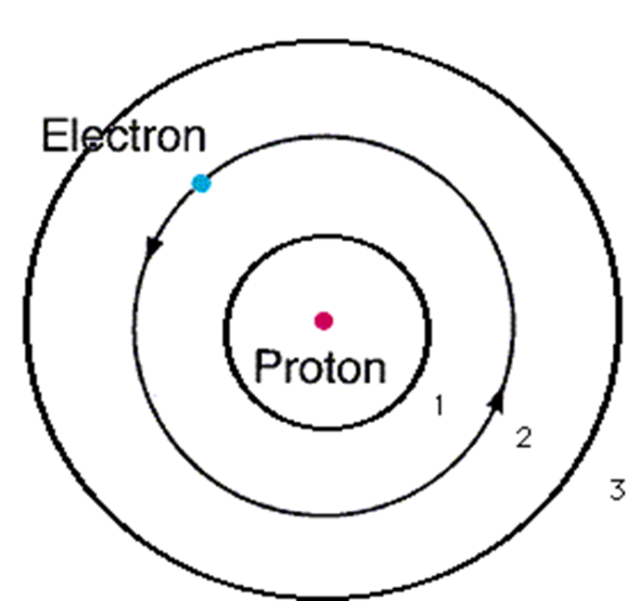
Evolution of the atomic model so far….
Thomson Model
1897
Bohr Model
1913
Philosophical Magazine 44, 295 (1897)
Philosophical
Magazine Series 6,
21, 669-688 (1911)
Philosophical Magazine Series 6
26. 1-25 (1913)

Slide 6
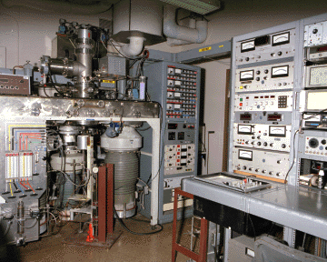

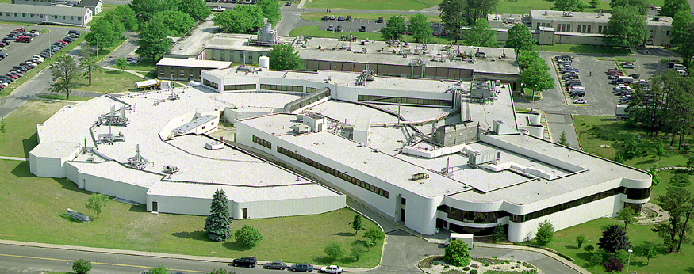
In the land of the spectroscopists: the experimentalists return with a vengeance
Spec 20 bench top spectrometer
National Synchrotron Light Source (Brookhaven National Lab)
2 baseball fields full of spectrometer
Molecular beam mass spectrometer a room full of spectrometer

Slide 7
How spectra tells you the energy levels of atoms
Spectroscopy’s one big IDEA……
1 line=> 1 upper level
2 similar lines => 2 similar upper levels
n(initial)
Emission of light
3 similar lines=> 3 similar upper levels
4 similar lines=> 4 similar upper levels
n(final)
ΔE
Observed line on film
ΔE

Slide 8
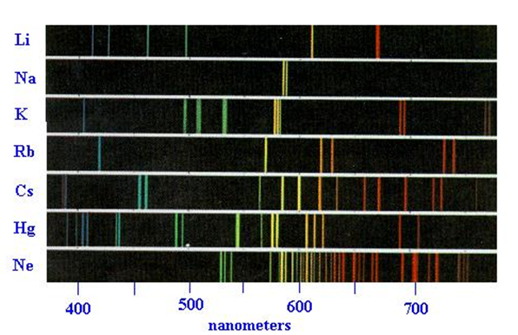
Example of energy level assignments
Low Energy
High Energy
ΔE= hc/λ
Common final state (?)

Slide 9
Four main `line’ types are observed in atomic spectra:
abbreviations
Sharp lines (=> very narrow)
s
p
d
f
2. Principal lines (=> most intense)
3. Diffuse lines (=> weak, broad )
4. Fundamental lines (=> family of lines terminating spectra at high energy)

Slide 10
5
4
4
3
4
d
3
3
The qualitative, general distribution of multi-electron atomic energy levels grouped by line type
2
2
p
n=1
s

Slide 11
4
d
5
s
4
s
OBSERVED ATOMIC ENERGY LEVEL ORDERING SIMPLIFIED
3
d
3
p
p
2
s
n=1
s

Slide 12
4
d
5
s
4
s
3
d
3
p
Describing Carbon’s energy levels
C=1s²
2s²
2p²
p
2
s
C has 6 electrons
n=1
s

Slide 13
4
d
5
s
4
s
3
d
3
p
Describing Fluorine’s energy levels
F=1s²
2s²
2p⁵
p
2
s
F has 9 electrons
n=1
s

Slide 14

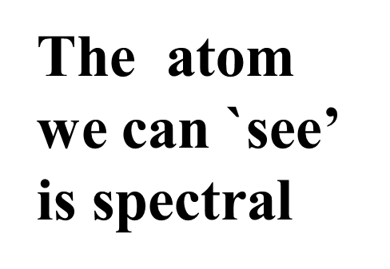
“Model 4: The spectroscopist’s atom
My way or the highway…
…or why we sing the spdf song
The spectroscopists description of what they deduce from observing lines is the `atom’

Slide 15
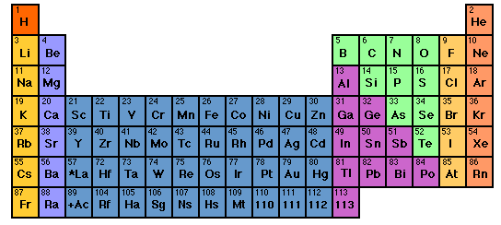

How to sing the spdf song without memorizing the energy levels: electron neighborhoods: s, p, d and f
s
d
p
1
2
3
4
5
6
7
3d
4d
5d
6d
f
4f
5f

Slide 16
Singing the song…what is the complete electronic configuration of….
Will stay in first 5 rows so f orbitals can be dropped
s
p
1
2
3
4
5
6
7
1s² 2s¹
d
3d
4d
5d
6d
f
H =
1s¹
He =
1s²
Li=
1s²
+
2s¹
Be=
1s²
+
2s²

Slide 17
spdf song –continued: YOU complete electronic configuration of:
s d p
H
He
Li
Be
B
C
N
1
2
3
4
5
1s¹
1s²
1s² 2s¹
1s² 2s²
1s² 2s² 2p¹
O
F
Ne
1s² 2s² 2p⁴
1s² 2s² 2p²
1s² 2s² 2p⁵
1s² 2s² 2p³
1s² 2s² 2p⁶

Slide 18
s d p
He is s not p
3d
4d
5d
6d
IN-CLASS EXERCISE 1:
COMPLETE ELECTRONIC CONFIGURATIONS

Slide 19
IN EXERCISE #1 CHEM 1114
1. Write the complete electron configuration for the elements below
Cl
K
c) Mn
d) Se
1s² 2s² 2p⁶ 3s² 3p⁵
1s² 2s² 2p⁶ 3s² 3p⁶ 4s¹
1s² 2s² 2p⁶ 3s² 3p⁶ 4s² 3d⁵
1s² 2s² 2p⁶ 3s² 3p⁶ 4s² 3d¹⁰4p⁴

Slide 20
s d p
He is s not p
3d
4d
5d
6d
INERT GAS CORE
IN CLASS EXERCISE 2:
ABBREVIATED ELECTRONIC CONFIGURATIONS

Slide 21
2. Write the abbreviated electron configurations for
the elements below, assuming they are in the
gas phase.
a) Ca
b) Al
c) As
[Ar] 4s²
[Ne] 3s² 3p¹
[Ar] 4s² 3d¹⁰ 4p³

Slide 22
d electron variations
1) s d electron configuration switching
Example: behavior of Mn
From spectra of atomized elements
As it behaves chemically in solution
Mn
[Ar] 4s² 3d⁵
[Ar] 3d⁵ 4s²
Mn ²⁺
[Ar] 3d⁵
Evidenced by fact that all transition metals have a stable 2+ state… => outer 4s² are removed first

Slide 23
2) s and d undergo filled/half-filled/empty rearrangements
d-electron variations (continued)
Cr⁺¹
[Ar] 4s² 3d³
[Ar] 3d⁴ 4s¹
[Ar] 3d⁵ 4s⁰
Periodic Table predicts
RIGHT based on chemistry and spectroscopy
Corrected for chemistry by d-switching
STILL WRONG ☹

Slide 24
Pigeonhole¹ representation of electrons
¹Called orbital diagrams in text
As implied by Table
+ chemical reversal
After fill, half-filled, empty correction
Cr⁺ =
[Ar] 3d⁴ 4s¹
[Ar]3d⁵ 4s⁰
*This final moving around applies only for transition metals
3d
4s
Pigeonhole representation
d rule: s and d electrons in valence shell move around to produce filled, half-filled and/or empty orbitals in order to attain a more stable atom.
Corrected for filled,half-filled, empty rule

Slide 25

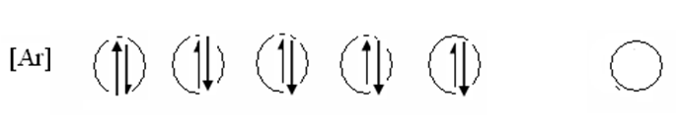

In-Class Exercise: Write the correct, pigeonhole diagrams for the transition metal species below
Write the correct, pigeonhole diagrams for the transition
metal species below
a) Cr
Ni
Ag⁺
remember…rule is applied ONLY with the s & d electron combos
(e.g. transition elements only)

