Slide 1
FOR WEEK 3 (9/9-9/13)
Suggested Homework:*
Page do problem(s)
p. 104 61, 63,65, 71, 73
p. 105 77, 79, 85, 87a,d, 91
p. 106 95,97,99
Reading:
pp. 73-80 (quantum)
pp. 82-98 (spdf song +)
To Do:
Marathon problem 2
Let the punishment fit the crime
Due Monday 16 Sept by 4 PM
*Friday 9/13 quiz will
be problems similar to above

Slide 2
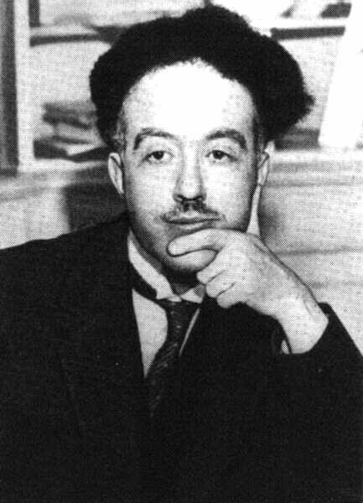
De Broglie’s* hypothesis (pp.63-64)
If light acts `particle-like’ ….
then matter can act `wave-like.’
*Louis-Victor-Pierre-Raymond, 7th duc de Broglie

Slide 3
DeBroglie’s basic thinking connecting matter to waves:
Rest energy of matter*
1) Steal from Einstein: E=mc²
energy of light `wave’
2) Steal from Planck: E = hf=hc/λ
3) Combine them and simplify:
E=mc²=hc/λ
mc =h/λ
* Energy you can convert mass m to when it is not moving (at rest), e.g., v=0…source of atomic bombs.

Slide 4
De Broglie’s Hypothesis (continued)
His big idea….assume a similar relationship exists when the mass is moving at a non-zero velocity v.
=> Replace c with v:
mc =h/λ
mv =h/λ
Rearrange…to define the wavelength of a mass m moving at velocity v
=>DeBroglie’s equation:
λ = h/mv

Slide 5
E= hf
Planck’s Law explains
Photoelectric effect
λ = h/mv
DeBroglie’s equation
connects matter to a hypothetical λ
How do these fix the problems with Rutherford’s atom ?????

Slide 6
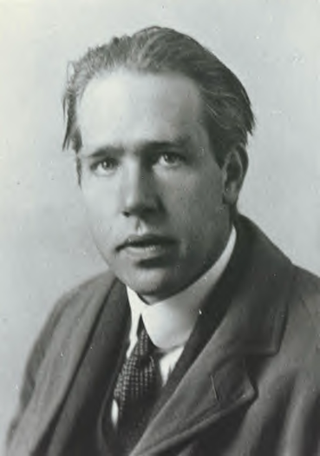
Ask him !
(see also pp. 68-72)
Niels “the kid” Bohr at 27 soon after he makes
his big theoretical breakthrough.

Slide 7
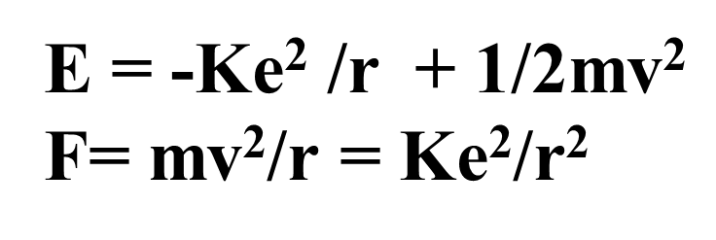
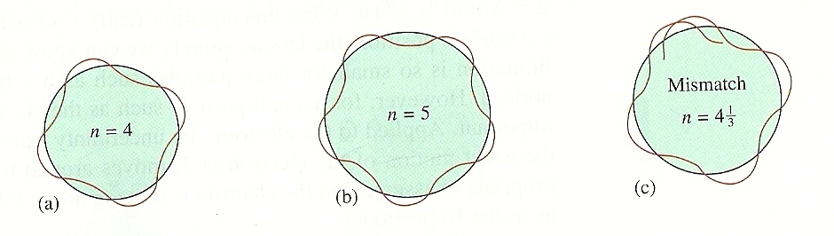
What the `kid’ does:
Takes a dollop of Old School physics
Mixes in New School Planck and DeBroglie equations:
E= hf
λ = h/mv
Forces the wavelength to fit a circular orbit around the nucleus:
see Figure 2.11 pg. 73

Slide 8
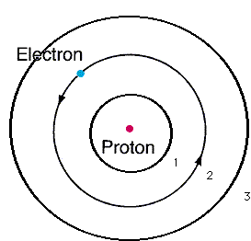
From pure theory Bohr derives the Energy, E_{H}, of the electron around Hydrogen and proposes the Bohr model of the atom:
n=3
n=2
Eq. 2.1 of text
n=1
E_{H}(J)=-2.178*10⁻¹⁸
n²
n=1,2,3…are integers defining circular orbits around positive nucleus

Slide 9
Bohr Model Predictions vs. Experiment
obs λ
434
486
656
Calc λ_{theory}
n_{i} n_{f}
434
486
656
5 2
4 2
3 2
n=5
1
4
2
3
0% error between observed and calculated !!!
Observed H line (sun) spectrum (Balmer series)
5→2
4→2
3→ 2
Bohr’s `explanation of H spectrum’: quantum transitions between levels
λ = 434 486 656 nm

Slide 10
Bohr Model Predictions vs. Experiment (continued)
Theoretical Computed radius of first H orbit:
5.20 nm
Experimentally measured ground state radius of H:
0% error between observed and calculated (again) !!!
5.20 nm

Slide 11
Bohr’s Quantum jump pix
Mr. electron sez FU…hell no
I won’t go
Light with different energy than E₁₂ (even if a tiny, tiny bit smaller)
n=2
n=1
Light with exactly energy E₁₂
Magic happens
E₁₂

Slide 12
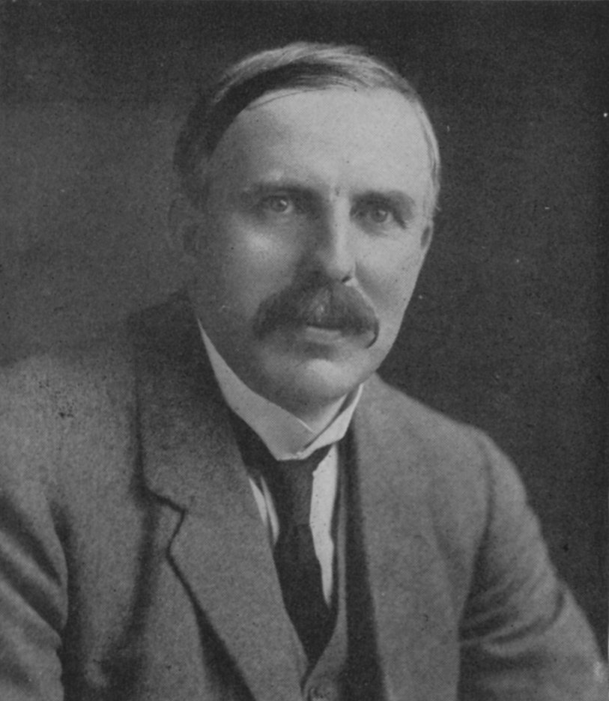
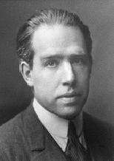

How Bohr’s new way of thinking about matter bails out Rutherford
1)Why don’t the p⁺ and e⁻ attract and come together ??? (or…why isn’t Earth the size of a golf ball?)
help
???
Electrons exist exclusively in defined circular paths at fixed distances from the nucleus

Slide 13
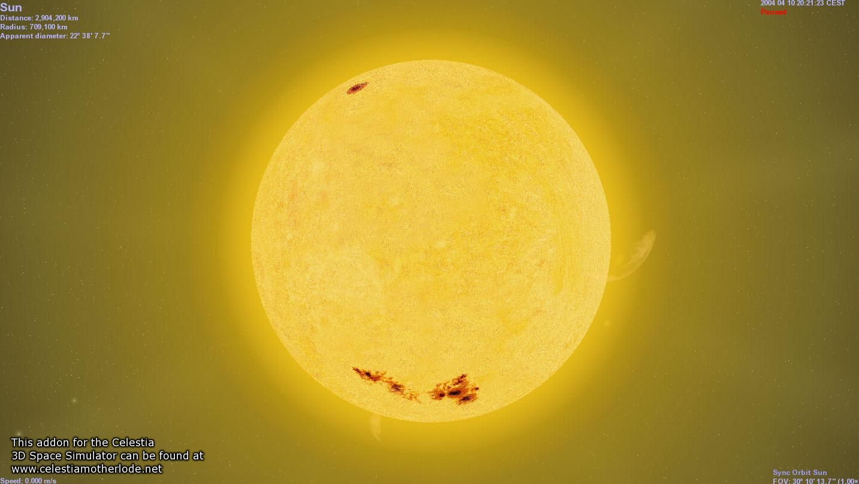


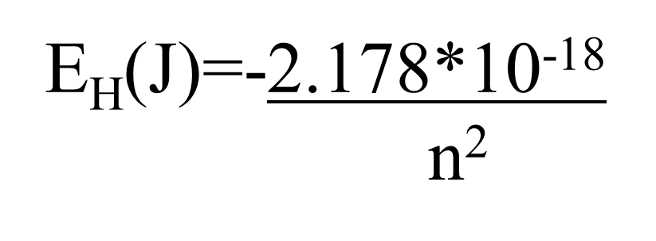
2)Why doesn’t the sun show all colors (e.g. show white light) when telescopes record spectrum?
???
help
???

Slide 14
Let’s confirm that n=5→n=2 electron jump predicts λ=434 nm for H using Bohr model:
h=6.63*10⁻³⁴ J s
c=3*10⁸ m/s
h*c= 1.989*10⁻²⁶ J*m

Slide 15

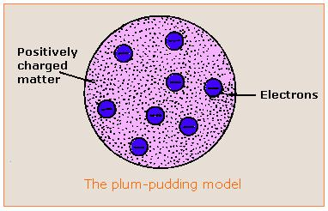

Evolution of the atomic model so far….
Thomson Model
1897
Bohr Model
1913
Philosophical Magazine 44, 295 (1897)
Philosophical
Magazine Series 6,
21, 669-688 (1911)
Philosophical Magazine Series 6
26. 1-25 (1913)

Slide 16

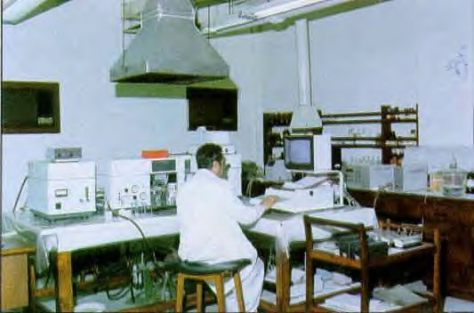

The Bohr Model dies…1930
1930
Bohr theory
The experimental chemists and spectroscopists say “fugetabout” it.
“typical” experimental spectroscopist/chemist
Experimentalist’s attitude towards theoreticians:
“If I want your opinion, I’ll give it to you…”

Slide 17


Bohr’s little Problem…
1930
Bohr theory
Observed
Na-`D’ line
Is yellow
Even worse..
Spectroscopists observe….
Bohr’s prediction: 1 green line
11 lines !!
1≠11
1)Bohr can’t predict anything right except H…the other elements have too many lines, e.g. Na
BOHR
1 line predicted
EXPERIMENT
11 LINES OBSERVED

Slide 18
Bohr model’s failures (continued)
2)…even Bohr’s predictions for H have problems
Can’t predict magnetic `fine’ structure of H, e.g
…magnetize H and even n=1 splits into 2 lines
1 ≠ 2
Turn on magnet near H
☹ Not even the smartest theoretical physicists of the day (Sommerfeld, Planck, Dirac) can make 1=2 or 1=11…. with Bohr’s model

Slide 19
Link to atomic line spectra of elements…none of which Bohr can explain except H
http://chemistry.bd.psu.edu/jircitano/periodic4.html

Slide 20

Evolution of the atomic model so far….
Thomson Model
1897
Bohr Model
1913
Philosophical Magazine 44, 295 (1897)
Philosophical
Magazine Series 6,
21, 669-688 (1911)
Philosophical Magazine Series 6
26. 1-25 (1913)

Slide 21

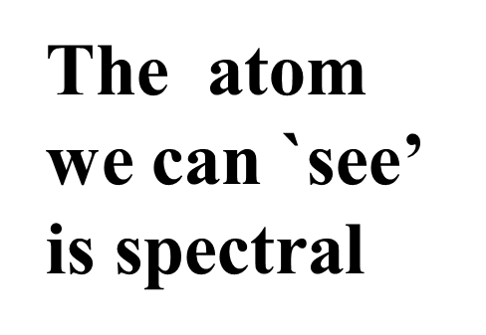
“Model 4: The spectroscopist’s atom
My way or the highway…
…or why we sing the spdf song
The spectroscopists description of what they deduce from observingt lines is the `atom’

Slide 22
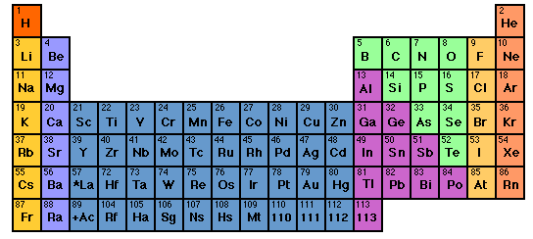

How to sing the spdf song: part 1: electron neighborhoods: s, p, d and f
s
d
p
1
2
3
4
5
6
7
3d
4d
5d
6d
f
4f
5f

Slide 23
Singing the song…what is the complete electronic configuration of….
Will stay in first 5 rows so f orbitals can be dropped
s
p
1
2
3
4
5
6
7
1s² 2s¹
d
3d
4d
5d
6d
f
H =
1s¹
He =
1s²
Li=
1s²
2s¹
Be=
1s²
2s²

Slide 24
spdf song –continued: YOU complete electronic configuration of:
s d p
H
He
Li
Be
B
C
N
1
2
3
4
5
1s¹
1s²
1s² 2s¹
1s² 2s²
1s² 2s² 2p¹
O
F
Ne
1s² 2s² 2p⁴
1s² 2s² 2p²
1s² 2s² 2p⁵
1s² 2s² 2p³
1s² 2s² 2p⁶

Slide 25
s d p
He is s not p
3d
4d
5d
6d
EXERCISE 1:
COMPLETE ELECTRONIC CONFIGURATIONS

Slide 26
IN EXERCISE #1 CHEM 1114
1. Write the complete electron configuration for the elements below
Cl
K
c) Mn
d) Se
1s² 2s² 2p⁶ 3s² 3p⁵
1s² 2s² 2p⁶ 3s² 3p⁶ 4s¹
1s² 2s² 2p⁶ 3s² 3p⁶ 4s² 3d⁵
1s² 2s² 2p⁶ 3s² 3p⁶ 4s² 3d¹⁰4p⁴

Slide 27
s d p
He is s not p
3d
4d
5d
6d
INERT GAS CORE
EXERCISE 2:
ABBREVIATED ELECTRONIC CONFIGURATIONS

Slide 28
2. Write the abbreviated electron configurations for
the elements below, assuming they are in the
gas phase or solids
a) Ca
b) Al
c) As
[Ar] 4s²
[Ne] 3s² 3p¹
[Ar] 4s² 3d¹⁰ 4p³

