Slide 1
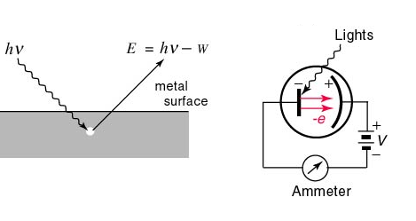
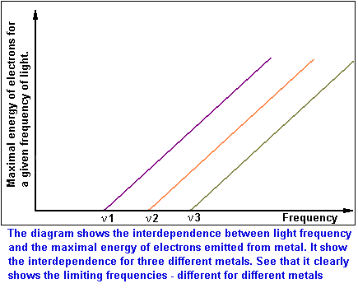
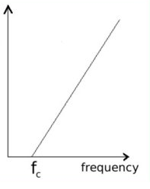
Photoelectric effect: the textbook version
E=Energy of ejected electron from metal
See also p. 62 of text
Threshold frequency for emission varies with metals (f₁=ν₁ for metal 1, f₂=ν₂ for metal 2 etc.)

Slide 2


The usual textbook explanations of the photoelectric effect blur the really bizarre, underlying meaning of the experiment.
The Mickey Mouse alternative:

Slide 3

According to `common’ sense, which wave capsizes Mickey and the gang ?
High amplitude (A)
Low frequency (f)
Low amplitude (A)
high frequency (f)
Let Mickey and friends be electrons in a metal

Slide 4
What actually happens in the photoelectric effect experiment
High amplitude (A)
Low frequency (f)
Low amplitude (A)
high frequency (f)
Let Mickey and friends be electrons in metal

Slide 5
WHAT THE PHOTOELECTRIC EFFECT MEANS: (SEE PAGE 60-61)
1) THE ENERGY, E, OF LIGHT IS NOT
CONNECTED TO AMPLITUDE
Planck’s constant h in J*s
2) E(J) = h*f = 6.63*10⁻³⁴ *f(Hz)
The Planck equation
1 hz = 1 cycle/second
3) LIGHT IS NOT A WAVE !!!!

Slide 6
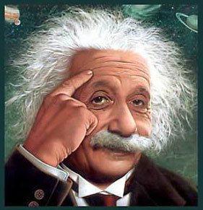
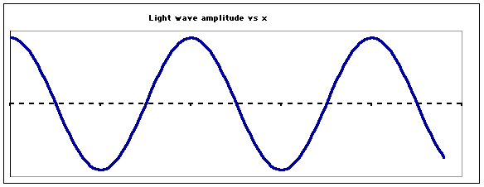
…so what is light if not a wave ??????
Einstein’s image….
LIGHT IS A “PHOTON”
=A MASSLESS BULLET OF ENERGY
OLD
wave
See also Figure 2.5 page 63
NEW
Stream of photons

Slide 7
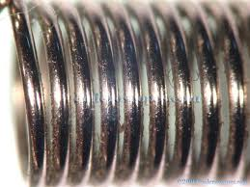
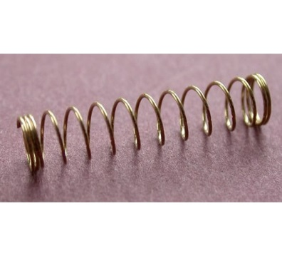
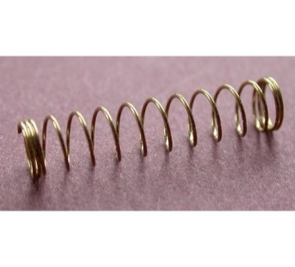

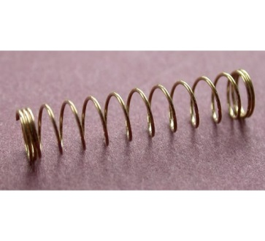
Planck’s equation: hf=E_{photon}
hf
hf
hf
hf
Stream of photons
Doc’s analogy: 1 Photon is like a unit of coiled spring
High frequency(high f)…high energy
tight
low frequency (low f)…low energy
loose

Slide 8
What the `photon’ idea gives us…
Joules=J
h=6.63*10⁻³⁴ Joule *s
E(J)=hf(Hz)
Planck’s Law
Combined with…
c=f*λ
=> f= c λ
Substitute into…
wave equation
∴ E= hc
λ
Energy of light is now connected to the color (wavelength) of light
c=3*10⁸ m/s
λ in meters(m)

Slide 9
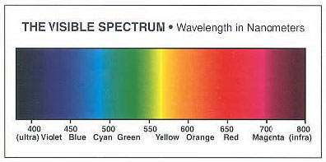
Which is the high energy end of the visible spectrum ?
short wavelengths
long wavelengths
High f
High E
low f
low E
λ Units in 10⁻⁹ m

Slide 10

In-class practice on board:
Planck’s law exercises …
E(J)= hf
=6.63*10⁻³⁴ J*s *f(Hz)
Mole buck opportunities

