Slide 1
The many problems for the Rutherford atomic model re-summarized:
Electrons seem to act like waves and refuse to sit still and be measured.
Rutherford’s atom can’t explain:
Why the electrons and protons don’t collapse into each other in the atom.
Why the sun only gives us a few colors and not all of them.

Slide 2
The way out of this mess arises from two main sources:
1) The photoelectric effect (and Einstein’s explanation for it) see page 62
2) DeBroglie’s hypothesis see page 63-4
Both deal with aspects of waves.

Slide 3
A brief review of the classical theory of light:
Light is a wave
…because light diffracts
Light has no mass (=>no momentum)
…because there is no limit to the intensity and tightness of focus.*
*we can pack any amount of light into arbitrarily small space

Slide 4
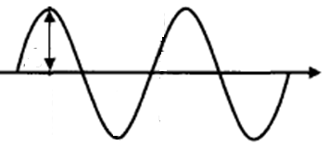
Language of light waves (see also: p 58-60)
λ
A
c
A= amplitude
λ= wavelength (meters)
c= speed of light ~ 3*10⁸ meters/second
υ=f = frequency = # full waves passing a point in a second (cycles/second)
υ pronounced “nu”

Slide 5
λ
Equations of classical light theory (see also:
p 58-60)
A
C
f*λ=c
Wave Energy, E ~ A²
υ=f = frequency
= # full waves passing a point in a second

Slide 6
Units for wave equation
frequency * wavelength = speed of light
f * λ =c
1
seconds(s)
*
meters(m)
= 3.0*10⁸ m
s
Hertz (Hz)
Cycles/second (cps)

Slide 7

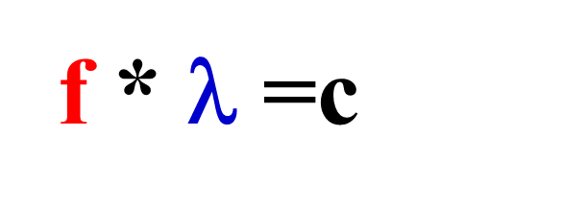
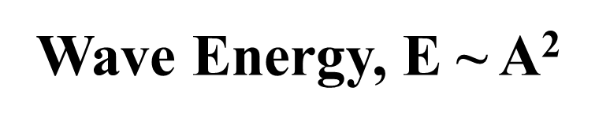
In-class practice on board:
wave theory exercises …
Mole buck opportunities

