Slide 1
Three Common Methods of Exploring Phases recounted:
P-T vaporization curves (Clausius-Clapeyron eq.)
Heating/cooling curves
Phase Diagrams
√
√

Slide 2
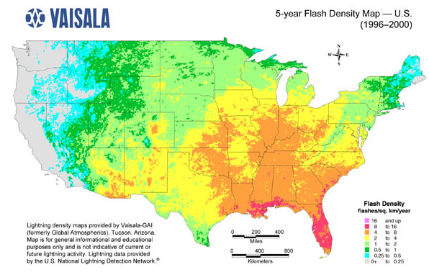
Map reading & Phase diagrams
longitude
(42°16'N, 77°48‘W)
(a,b)
= Alfred, NY
b
latitude
a

Slide 3
Phase diagram map reading (pp. 366-370)
P(atm)
Liquid (l) only
Supercritical region
Solid (s) only
s + l
melting (mp)
l + g
boiling (bp)
Critical pt (cp)
normal line*
1
s + l + g
triple point (tp)
Gas (g) only
*Temperature of LIQ/GAS transition at 1 atm is called the normal boiling point
s + g sublimation (sp)
T (º C)

Slide 4
Pressure is often under appreciated as a factor in phase changes
Cryophorous demo
dramatic visual of phase changes as T, P change

Slide 5
phase diagrams are built from ZILLIONS of heating curves
Heating curve
Phase diagram
T
P
P=1 atm
Heat gas until anything else happens
After melting…watch liquid warm until L-G transition (30 ºC)
Put a big dot here to indicated L-G phase change
S all along the line
Put a big dot here to indicate S-L phase change
+30
Heat up and wait for S-L transition (at 10 ºC)
start
S
L
G
+10
P=1
start
Keep heating and melt…
S
-20
Heat in (J)
-20
+10
+30
T
Liquid all along line after dot
Gas all along line after dot
Keep heating and vaporize

Slide 6
Adding more data at different Pressures, P
P
T
G
L
L/ G
solid
liquid
S
S/L
P₁
P₂
P₁
P₃
S/G*
gas
P₂
Heat in
P₃
* =sublimation
T
Heating Curve
Phase Diagram

Slide 7
Practice Reading the phase map: what state(s) are we in ?
P
Supercritical
phase
S+L
S
L
L+G
G
S+G
S+L+G
T

Slide 8
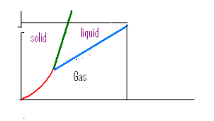


Supercritical behavior:CO₂ example
(see also figure 11.13 pg 432)
5
4
Supercritical region
1
2
3
73 atm
29 ºC
5
Supercritical
1
all solid
2
Solid/liquid
3
All liquid
4
Liquid/gas
Phase line gone

Slide 9
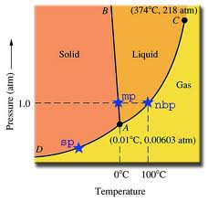
water’s phase diagram explains why ice floats and how we can ice skate

Slide 10
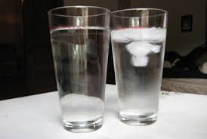
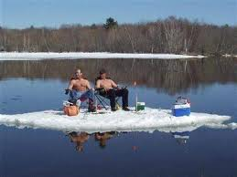
why ice floats…..
The diagram implies that compression at fixed temperature
converts solid to liquid.
∴liquid water is denser than ice

Slide 11
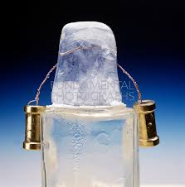
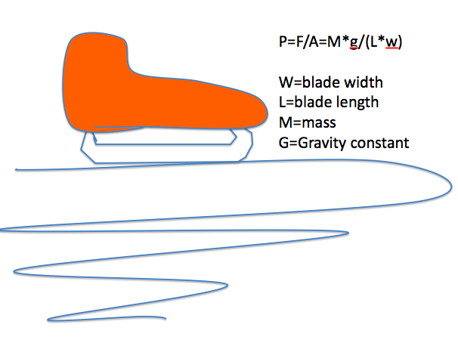
How ice skates work…
Compression under skate converts solid to liquid, creating a lubricant under the skate blade

Slide 12
Like supercritical CO₂, supercritical water is `freaky’
http://www.youtube.com/watch?v=29oy1UCHJIE
Supercritical region for water
Experiment from U-tube (I think) varies P and T and as red arrow indicates

Slide 13
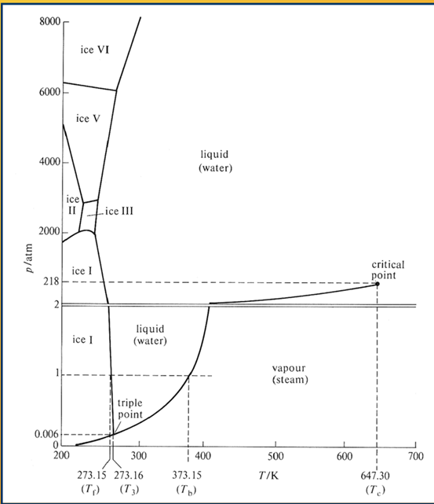
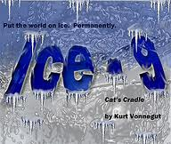
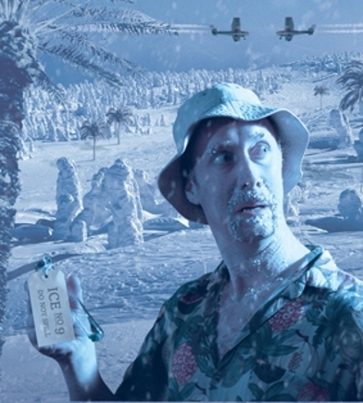
Water’s extended phase diagram
…spawns some science fiction speculations…

Slide 14
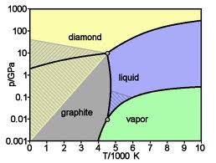
Phase diagram of carbon
1 atm=15 psi~ 0.0001 GPa
7*10⁵ atm
1 atm
Room temp.

Slide 15
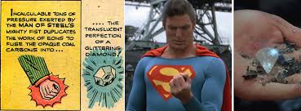
Carbon’ Phase Diagram answers the age-old question:
How much force does Superman exert to turn coal into diamonds ?
7*10⁵ atm = 7*15*10⁵ lb/in² = 1.05*10⁷ lb/in²
=5250 tons/in²

Slide 16
Most diamonds are made industrially by General Electric via the Wentworf approach. They manufacture ~33 tons of diamond dust/year
1 atm~ 0.0001 GPa
http://www.youtube.com/watch?v=2V5Ao-9Z_Pc
R. Wentorf, GE
Schenectady (1955)
2*10⁵ atm
1 atm
original GE process operated here (2100 C)
Room temp

Slide 17
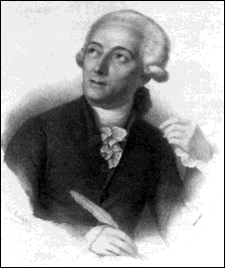
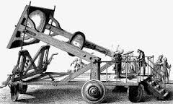
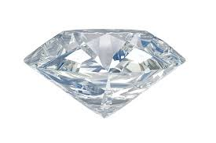
Chemistry comes full circle….
Diamond sealed in glass vessel with air
Big lens
Antoine Lavoisier ~ 1770
Father of Modern Chemistry
In Paris, France Lavoisier uses his `diamond’ burning apparatus to show diamonds are made of Carbon (because they burn up into CO₂)
+ O₂→ CO₂
1770

Slide 18
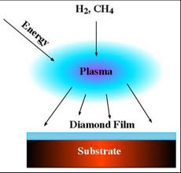
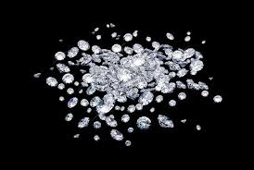
Chemistry comes full circle (continued):
2013: With `pCVD’ (Plasma-based Chemical Vapor Deposition) we can now do the reverse
http://www.youtube.com/watch?v=s8qgE4LkZa4
CH₄ + H₂ →
2013

