Slide 1
Two different `heats’ measured in heating/cooling curves:
for single phase, q= (J/ ºC gram)
for two phases in equilibrium : q= (J/g)
Heat m grams of solid ice (only solid present)
Q_{melt}
Melt m grams of solid ice
to liquid (liquid and solid present
at same time)
T₂
ΔT_{ice}
Q _{ice}
T₁
Energy in cal
q_{ice} =specific heat of solid (single phase)=
q_{melt}= specific heat of fusion=
Joules
g
Q_{ice}
Joules
g * ºC
Q_{melt}
m
* ΔT_{ice}
m

Slide 2
Cooling/heating curves: quantitative analysis
Example: Heating up 10 g of water at P=1 atm
T
Heating ice
Specific heat of ice
=400 J/ (10 º C * 10 g)
=4 J/g ºC
start
0
-10
400 J
All S

Slide 3
Cooling/heating curves: quantitative analysis
Example: Heating up 10 g of water at P= 1 atm
110 ºC
Melting ice
S→L transition
100
Specific Heat of `fusion’ (melting)
=3340/10=334 J/g
Heating ice
0
-10
3340 J
400 J
3740
All S
S + L

Slide 4
Cooling/heating curves: quantitative analysis
Example: Heating up 10 g of water at P=1 atm
110 ºC
Heating liquid water
100
Specific heat of water
= 4184 J/(100 C *10 g)
=4.184 J/C g
100 C
Heating ice
Melting ice
S→L transition
0
-10
4184 J
400 J
3740
7924
All S
S + L
All L

Slide 5
Cooling/heating curves: quantitative analysis
Example: Heating up 10 g of water at P=1 atm
Boiling water
100
Heating water
Melting ice
S→L transition
Heating ice
22217 J
100 C
Specific heat of vaporization
0
=22217 /10
~2222 J/g
-10
400 J
3740
7924
30141
All S
S + L
All L
L + G

Slide 6
Cooling/heating curves: quantitative analysis
Heating steam
Example: Heating up 10 g of water at P=1 atm
110 ºC
100
Heating water
Boiling water
Melting ice
S→L transition
Heating ice
Specific heat of steam
=200 J
10 g*10 C
200 J
0
=2 J
g* C
-10
400 J
3739
7923
30140
30340
ALL G
All S
S + L
All L
L + G

Slide 7
Cooling/heating curves: quantitative analysis summarized
Heating steam
Example: Heating up 10 g of water at P=1 atm
110 ºC
Q_{steam} =2.0 J/gºC
100
Heating water
Boiling water
Melting ice
S→L transition
Q_{vap} =2221 J/g
Heating ice
Q_{liq} =4.18 J/gºC
Q_{fus} =334 J/g
Q_{ice} =4.0 J/gºC
0
-10
400 J
3739
7923
30140
30340
ALL G
All S
S + L
All L
L + G

Slide 8
drill/practice with heating/cooling curve data
400 Joules heats a 2 gram sample of solid from 10 ºC to 30 ºC . What is the solid sample’ specific heat, q_{sp} ?
q_{sp} = Q = 400 =10 J
m*ΔT 2*(30-10) g ºC

Slide 9
More drill/practice with heating/cooling
0.5 gram sample of X
0 ºC
-25 ºC
-45 ºC
(solid)
50 J
150 J
180 J
1) What is X’s melting point?
-25 ºC
2) What is solid X’s q_{sp} (J/g ºC)
50/(0.5*20)=5
3)What X’s specific heat of melting ? (J/g)
100/0.5=200
4)What liquid X’s q_{sp} (J/g ºC)
30/(0.5*25)=2.4

Slide 10
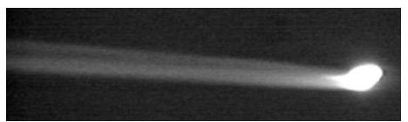

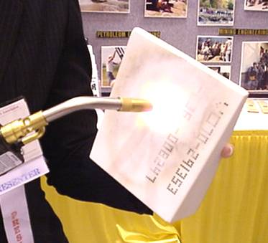
Photo of STS 103 (Space Shuttle)
re-entry
Artist’s conception of heating
Space shuttle tile –
An example of very, very, very, very, very high q_{sp} (specific heat capacity) material

Slide 11
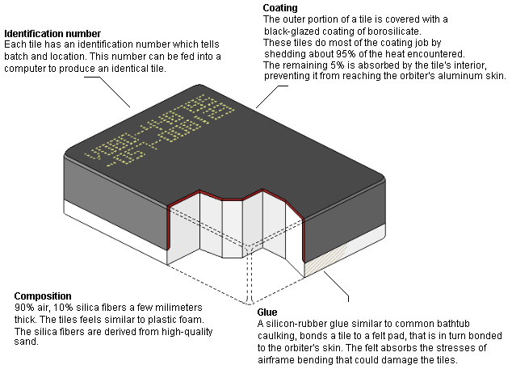
SHUTTLE TILE IN MORE DETAIL

Slide 12
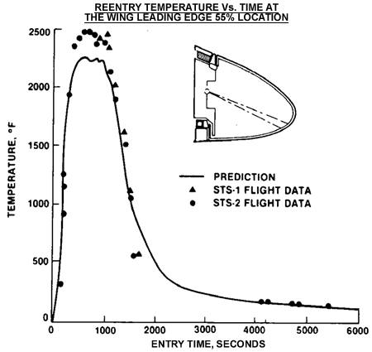
º C= 5/9 º F -32
Temperature across Shuttle nose section during reentry vs time
1357 ⁰ C

Slide 13
Three Common Methods of Exploring Phases recounted:
P-T vaporization curves (Clausius-Clapeyron eq.)
Heating/cooling curves
Phase Diagrams
√
√

Slide 14
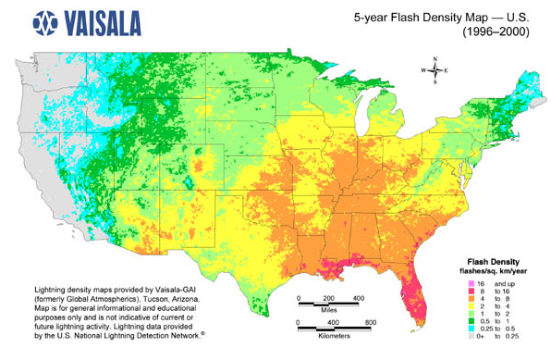
Map reading & Phase diagrams
longitude
(42°16'N, 77°48‘W)
(a,b)
= Alfred, NY
b
latitude
a

Slide 15
Phase diagram map reading (pp. 366-370)
P(atm)
Liquid (l) only
Supercritical region
Solid (s) only
s + l
melting (mp)
l + g
boiling (bp)
Critical pt (cp)
normal line*
1
s + l + g
triple point (tp)
Gas (g) only
*Temperature of LIQ/GAS transition at 1 atm is called the normal boiling point
s + g sublimation (sp)
T (º C)

Slide 16
Pressure is often under appreciated as a factor in phase changes
Cryophorous demo
dramatic visual of phase changes as T, P change

Slide 17
phase diagrams are built from ZILLIONS of heating curves
Heating curve
Phase diagram
T
P
P=1 atm
Heat gas until anything else happens
After melting…watch liquid warm until L-G transition (30 ºC)
Put a big dot here to indicated L-G phase change
S all along the line
Put a big dot here to indicate S-L phase change
+30
Heat up and wait for S-L transition (at 10 ºC)
start
S
L
G
+10
P=1
start
Keep heating and melt…
S
-20
Heat in (J)
-20
+10
+30
T
Liquid all along line after dot
Gas all along line after dot
Keep heating and vaporize

Slide 18
Adding more data at different Pressures, P
P
T
G
L
L/ G
solid
liquid
S
S/L
P₁
P₂
P₁
P₃
S/G*
gas
P₂
Heat in
P₃
* =sublimation
T
Heating Curve
Phase Diagram

Slide 19
Practice Reading the phase map: what state(s) are we in ?
P
Supercritical
phase
S+L
S
L
L+G
G
S+G
S+L+G
T

Slide 20
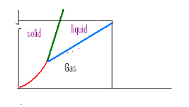


Supercritical behavior:CO₂ example
(see also figure 11.13 pg 432)
5
4
Supercritical region
1
2
3
73 atm
29 ºC
5
Supercritical
1
all solid
2
Solid/liquid
3
All liquid
4
Liquid/gas
Phase line gone

