Slide 1
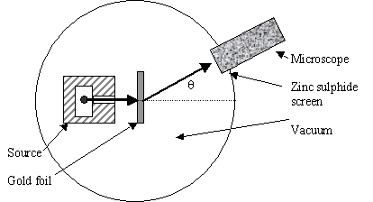
Atomic structure: testing Thomson’s Plum Pudding atomic model (continued)
Schematic of Rutherford’s `gold foil’ apparatus
Microscope
Rotated to detect scintillations
Alpha (α) particles=He⁺
ZnS screen is a scintillating surface
Gold Foil Experiment lore
Marie Curie supplied the radon =α source.
It required ~ 1 hour sitting in absolute dark to condition eyes.
You could only observe scintillations for 1-2 minutes before
desensitizing.

Slide 2
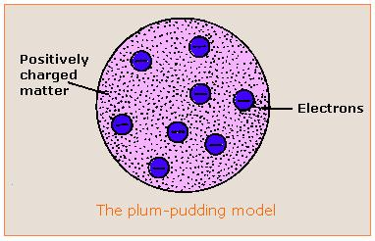
Atomic structure: testing Thomson’s Plum Pudding Model (continued):
Reminder of the Plum Pudding Model being tested

Slide 3
Your 4th critical thinking challenge:
Given the three facts about gold leaf experiment:
α particles are moving crazy fast
α particles are enormously heavier compared to all electron mass in gold atom.
Gold film is impossibly thin (1/3000 of toilet paper)
What should happen to the α particles as they are shot at the gold leaf if the gold atoms are as Thomson proposes ??
Notes:
Capture student thoughts on board. Let them speculate…make sure their reasoning is sensible.

Slide 4
Plum Pudding model predicts that all the massive α particles will pass ~un-deflected through gold foil made of diffuse matter
α particles

Slide 5
What actually happens…
Rutherford’s observations mostly agree with above.
But sometimes a few curve off significantly…
And once and in a great while, one bounces back. !
Gold foil

Slide 6
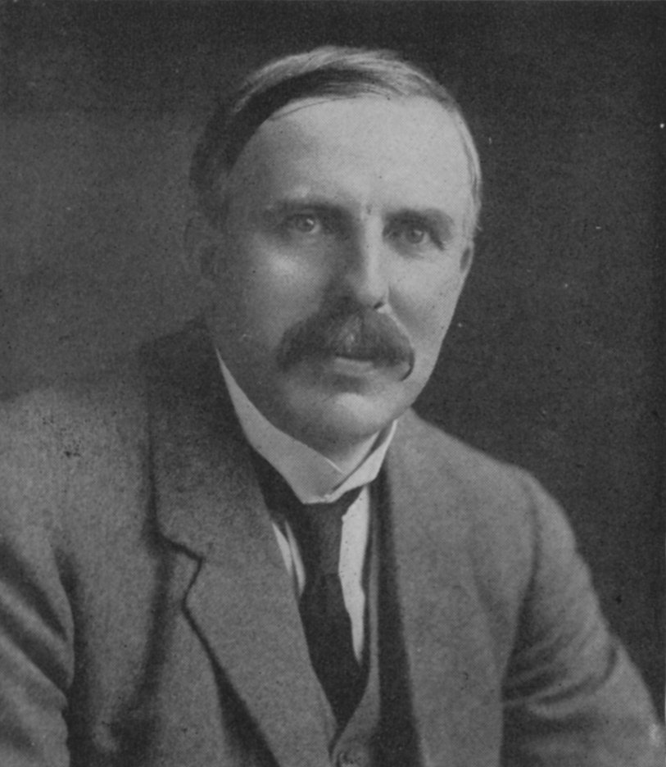
Atomic structure: testing Thomson’s Plum Pudding Atomic Model(continued)
Rutherford’s famous `take’ on Marsden and Geiger’s results:
“Like firing a howitzer at tissue paper and having the shell bounce back !!”

Slide 7
Your 5th critical thinking challenge:
Given the results of Rutherford’s (Geiger & Marsden’s) experiment, which model of the atom makes most sense and why ?:
A)Electrons in ring outside;
Positives in thin ring inside
C)Electrons in ring outside;
Positives in large ball inside
B)Electrons in diffuse cloud outside;
Positives in tiny ball inside
Notes:
Capture student thoughts on board. Let them speculate…make sure their reasoning is sensible.

Slide 8
Atomic structure: Rutherford’s Atomic Model
Rutherford’s Atom:1911
The Second Experimentally-Based Model of the Atom v.2.1
Electrons in diffuse cloud around tiny (but massive) positive charged nucleus.
E. Rutherford, F.R.S. The Scattering of α and β Particles by Matter and the Structure of the Atom
Philosophical Magazine Series 6, vol. 21, p. 669-688 (1911)

Slide 9
Dimensions of Rutherford atomic model*
*derived from statistics of gold leaf scattering experiment
Nuclear radius ~10⁻¹⁵ meters
Electronic cloud radius ~ 10⁻¹⁰ meters
Electronic radius/Nuclear radius ~ 10⁺⁵
Masses of subatomic pieces**
Subatomic piece | Mass (g) | Relative mass
proton
1.67*10⁻³⁰
1
neutron
1.67*10⁻³⁰
1
electron
9.11*10⁻³⁴
0.0005
** from J. Aston development of mass spectroscopy at Cavendish Labs (w/Rutherford as its’ new Director)

Slide 10
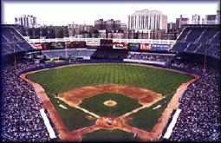
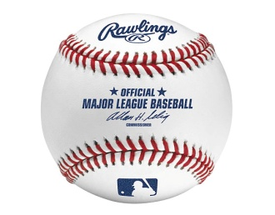

Atom dimensions in familiar terms: Metaphor 1
Electrons start here (~2.4 miles past cheap seats)
3”
Baseball as nucleus
Old Yankee Stadium, the Bronx
Notes:
Show how calculation was done on board

Slide 11

Nucleus(+)
~ dimension of Rutherford’s electronic cloud (-) (2.4 mile radius from baseball nucleus)
Notes:
Stadium at 1. E. 161st st., Bronx NY 14051

Slide 12
Metaphor 2:
pencil dot and string
Pencil dot = nucleus
~ 0.02 cm radius
Electron orbit is 100,000X nuclear radius
Electron orbit radius =??
0.02 cm * 100,000 = 2000 cm
(for us `dumb’ Americans, that’s ~ 66 ft
66 ft of string= electron radius

Slide 13
Metaphor 3:
scissor and paper
20 cm (~ 1 envelope length)
Your 6th Critical thinking challenge:
How would you figure out how many times we must we cut an envelope in half to get to :
Electronic diameter (2*10⁻¹⁰ m=2*10⁻⁸ cm)
Nuclear diameter ( 2*10⁻¹⁵ m= 2*10⁻¹³ cm)

Slide 14

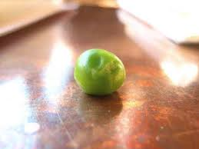
Volume comparison
The electron cloud volume is 10¹⁵ times bigger than the nuclear volume
Electron cloud volume ~ volume of water in Honeoye Lake, NY (10¹⁵ times pea volume)
Nuclear volume=
1 pea (~0.065 cm³)

Slide 15
Atomic structure: Rutherford’s Atomic Model
Rutherford’s Atom fleshed out by experiments: 1915
The 2nd Experimentally-Based Model of the Atom v. 2.2
Negative Electrons (e-) in a diffuse cloud milling around tiny (but massive) positive charged nucleus composed of positive protons
10⁻¹⁰ m
10⁻¹⁵ m
#e = #p
#p defines element
p⁺ weighs ~1.7 *10⁻³⁰ g
e⁻ weighs ~9.1*10⁻³⁴ g

Slide 16
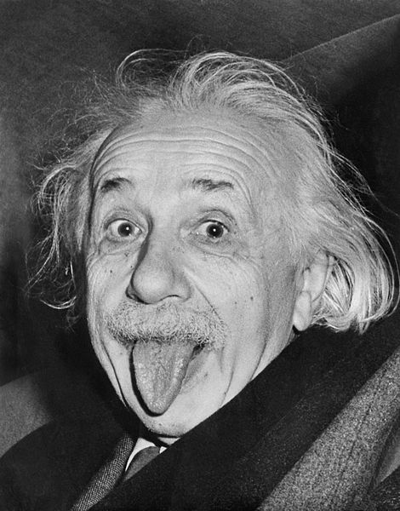
The `spooky trouble’ with electrons…
“Spooky science.”
Davison-Germer electron diffraction effect 1927
The Stern-Gernlach experiment 1922
(neither discussed in text)

Slide 17
`gotta be’ physics: If Individual electrons appear randomly, one at a time moving towards one slit or another, each electron must pass through only one slit.
t₁
t₂ > t₁
What the Davison-Germer Experiment checks…

Slide 18
What really happens….

Slide 19
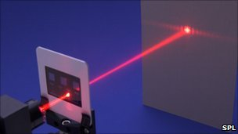
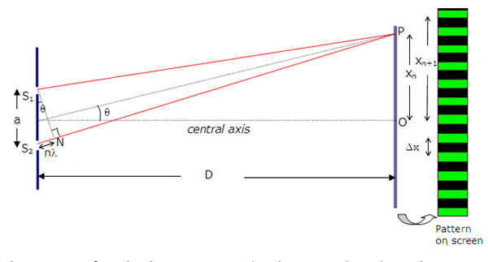
Only light, a massless wave is supposed to diffract
Young’s Double Slit Light Experiment 1801

Slide 20
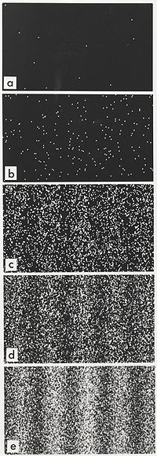
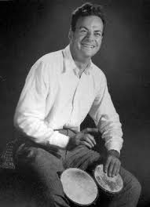
How a particle must go through just one slit but seem to go through both and interfere with itself is called the “Fundamental Quantum Paradox” (coined by R. Feynmann)
Davison-Germer Experimental Result
t₁
t₂
t₃
t₄
t₅
“It doesn't matter how beautiful your theory is, it doesn't matter how smart you are. If it doesn't agree with experiment, it's wrong.” R. Feynmann

Slide 21
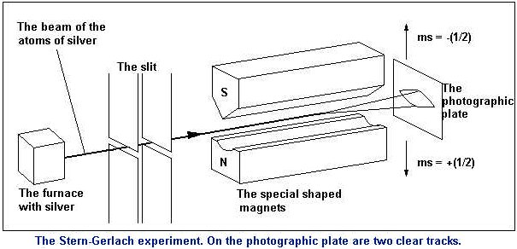

The usual rendition of the Stern-Gernlach Experiment 1922
Proves electrons have two “spin” states (an up and a down )

Slide 22
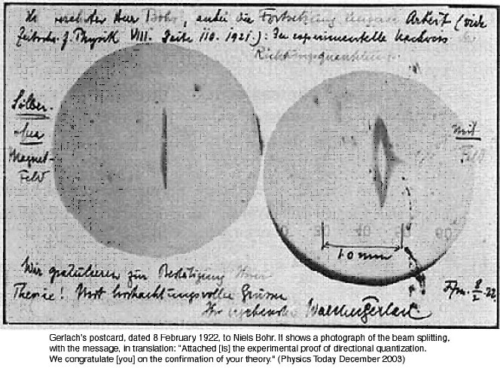
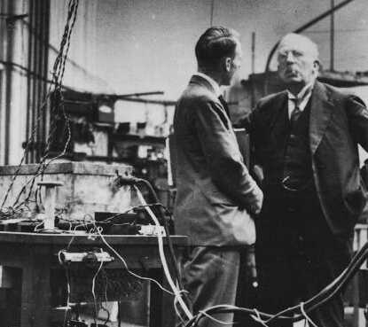
Stern-Gernlach Experiment (continued)
~ one `cute’ chemistry detail: atomic monolayer of Ag ‘developed’ (accidentally) by sulfur in Gerlach’s cheap cigar

Slide 23
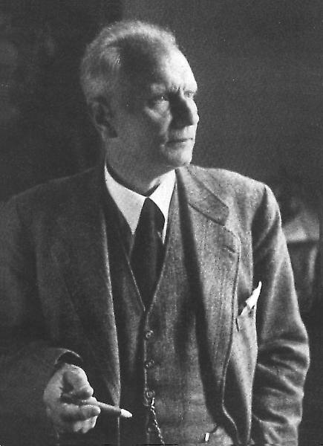
Gerlach again…
with a fresh cigar

Slide 24


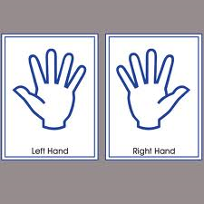
The rest of the Stern-Gernlach experiment:
Electrons respond with independent +/- spin states for two magnetic field directions: z and x
z
x

Slide 25
=> Electrons have 4 independent flavors in response to x and z field
 | Left Hand (L) | Right Hand (R)
Male (M) | (M,L) | (M,R)
Female (F) | (F,L) | (F,R)

Slide 26
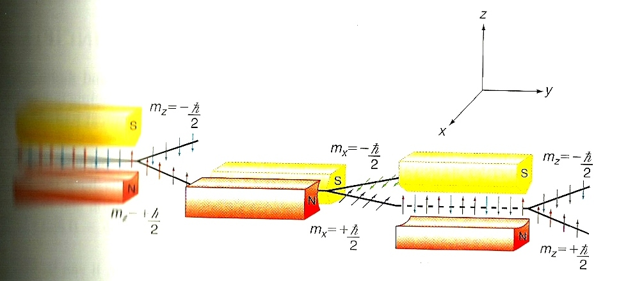


The rest of the Stern-Gernlach experiment:
2) Magnetic Field applied along x
-1/2
L
R
???
+1/2
1)Magnet Field applied along z
3) Magnetic Field re-applied along z
Separates boy lefties from boy righties
Check on whether right hand `boys’ still ‘boys’
Separates boys from girls

Slide 27


The observed result of the Stern-Gernlach `sex’ check…
R
Half the right handed boys have converted to right handed girls just because we checked….

Slide 28
“Spooky science.”
Electrons are …

