Slide 1
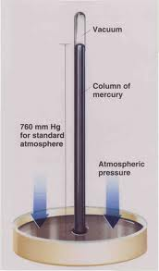
The simple Torricelli Mercury Barometer
reviewed
Chem Factoid:
At room temperature, mercury has virtually no vapor pressure

Slide 2
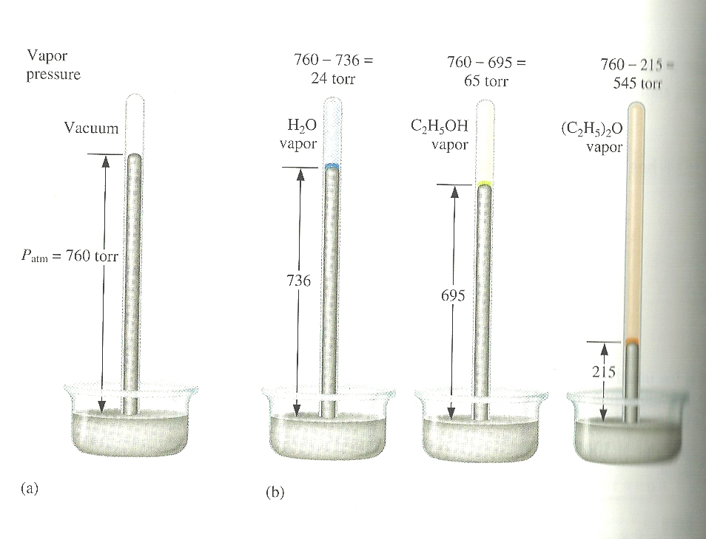
Variation of vapor pressure of selected materials at room temperature (see figure 8.40, p. 360)
760-736=
24 mm
760-695=
65 mm
760-215=
545 mm
760 mm
736 mm
695 mm
215 mm
Mercury (reference 0)
water
ethanol
ether

Slide 3
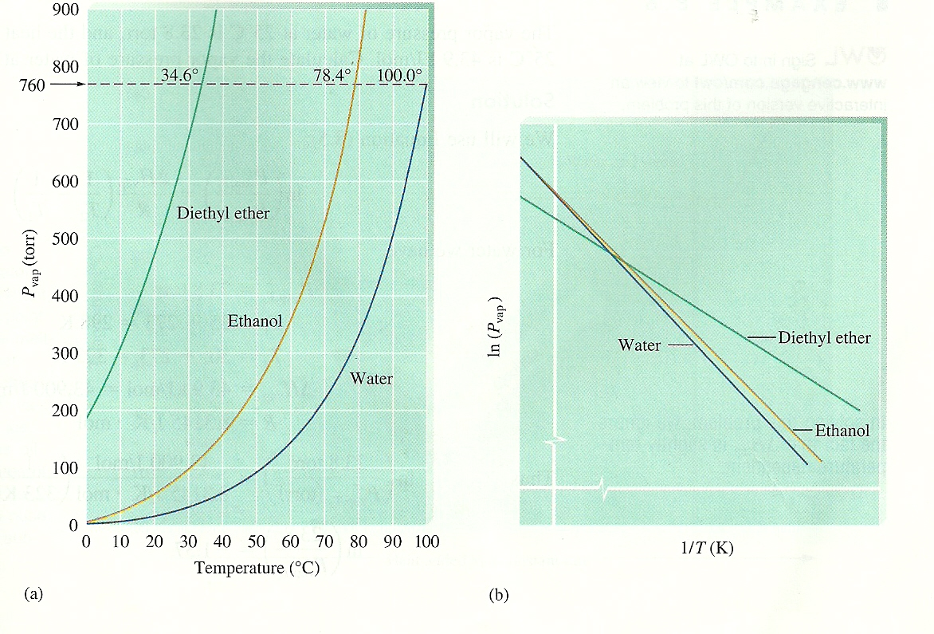
The vapor pressure of materials (duh…) varies with temperature
P(mm Hg) vs T
Common sense says: the sharper the pressure rise, the less strongly the liquid is bound (…e.g. it’s easier to escape as a gas)
760 mm
Ln P(mm Hg) vs T
ether
ethanol
ether
water
water
ethanol

Slide 4
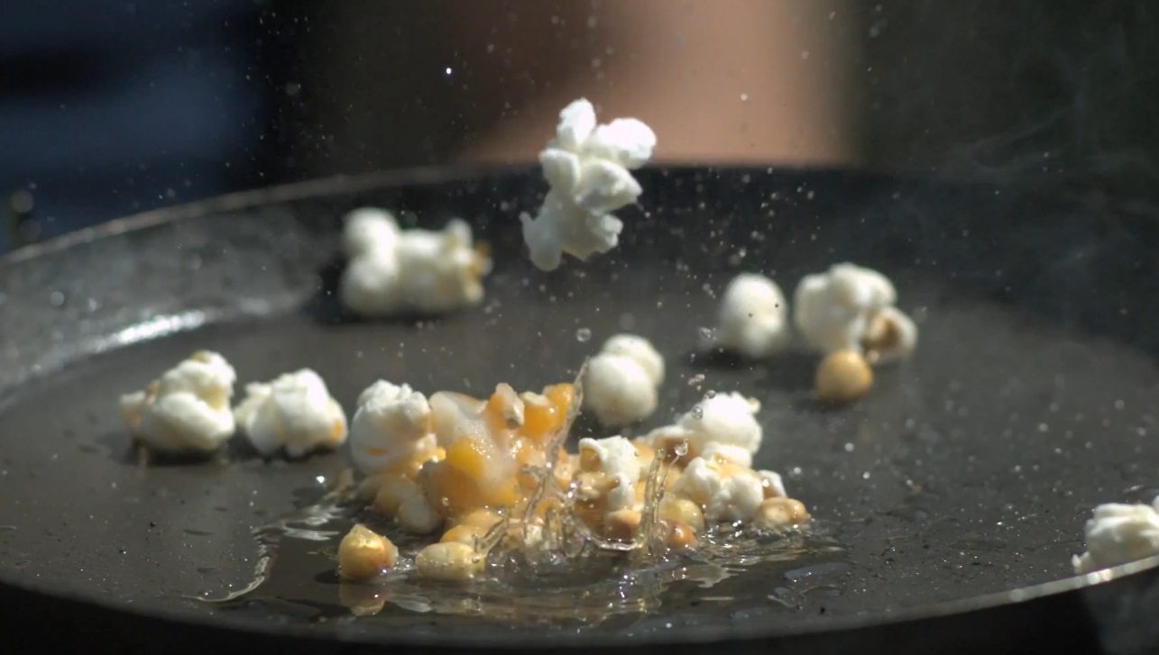
A brief look at the basics of `boiling’
http://www.youtube.com/watch?v=fLbfuQ4G0ag
Vaporization behavior is like popcorn popping in a frying pan…it’s a random process as to whether the popcorn (GAS) escapes the pan (LIQUID) or not

Slide 5
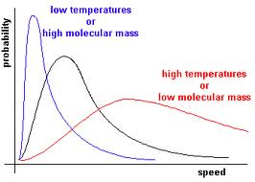
The odds of escape depend on temperature and the molecular size of the molecules
Number of molecules
SEE ALSO: p. 361 of text
Minimum velocity to break free of intermolecular forces
v_{escape}

Slide 6
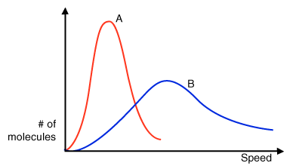
intermolecular interactions also affect velocities
H₂0
MW 18
Ne
MW=20

Slide 7
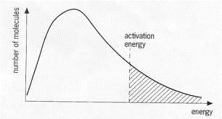
N(v_{i}) ∝ ge^{-E(i)/RT}
=>N_{escape} (v_{esc} ) ∝ e^{-E(esc)/RT}
P ~ N_{escape} RT/V
E(esc) =Activation Energy ~ΔH_{vap} for escape as gas
Number of molecules N_{i}
Effect of g= degeneracy
~ e^{-E(i)/RT}
∴at constant T,V
P = constant*e^{-ΔH(vap) /RT}
Energy, E_{i}

Slide 8
P = constant*e^{-ΔH(vap) /RT}
Ln P = A - ΔH_{vap}
RT
ether
alcohol
water

Slide 9
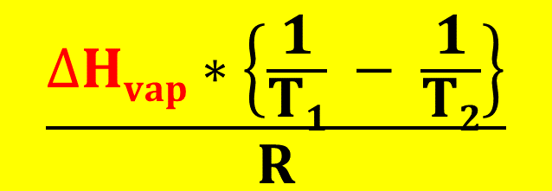
Development of the Clausius-Clapeyron equation (see text pg. 362)
Ln P = A - ΔH_{vap}
RT
Ln P₁ = A - ΔH_{vap}
RT₁
Ln P₂ = A - ΔH_{vap}
RT₂
Ln P₂ – Ln P₁ = - ΔH_{vap} – (-ΔH_{vap})
RT₂ RT₁
Ln P₂
P₁
$$\frac{∆Hvap∗\left\{\frac{1}{T1} − \frac{1}{T2}\right\}}{R}$$
=
Clausius-Clapeyron equation

Slide 10
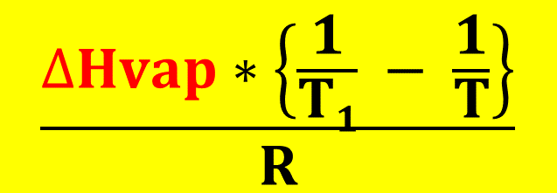
Ln P
P₁
$$\frac{∆Hvap∗\left\{\frac{1}{T1} − \frac{1}{T}\right\}}{R}$$
=
Using units of atmosphere, we set P₁=1 and T₁= T_{bp} (at 1 atm) and the Clausius-Clapeyron equation becomes:
Ln P = C - ΔH_{vap}
RT
C = - ΔH_{vap}
RT_{bp}(K)

Slide 11
How Clausius-Clapeyron equation morphs into a straight line plot
Clausius –Clapeyron equation
Ln P(atm) = C - ΔH_{vap} C= ΔH_{vap}
RT RT_{bp}
Y= Ln P X=1/T(K)
m=-ΔH_{vap} b=C= ΔH_{vap}
R RT_{bp}
R=8.314 J/K mol
=> Y = b + mX

Slide 12
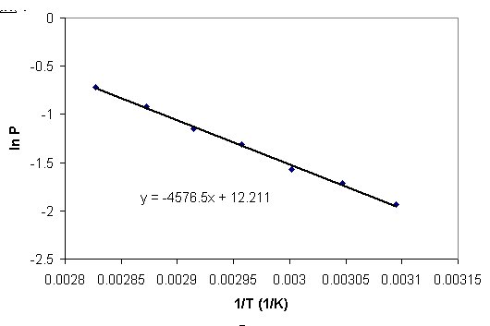
Y = b + mX
Y= ln P X=1/T
m= -ΔH_{vap} b=C= ΔH_{vap}
R RT_{bp}
R=8.314 J/K mol
Vaporization of water data
We-Do-It: What are the values of ΔH_{vap} and T_{bp} for water based on least squares fit of data
ΔH_{vap}=38.045 kJ
T_{bp} =374 K
Y= 12.211 -4576.5X

Slide 13
Three Common Methods of Exploring Phases recounted:
P-T vaporization curves (Clausius-Clapeyron eq.)
Heating/cooling curves
Phase Diagrams
√

Slide 14
ice melting- the Movie-frame by frame : heating/cooling curves
Heating up a block of ice ( see also-fig 8.44 p 363)
T ( ºC)
Water heats
Water boils
100
Steam heats
Ice
Heats
Ice melts
START
HERE
S
S + L
L
L + G
G
0
-10
Heat Energy in

Slide 15
Two different `heats’ measured in heating/cooling curves:
for single phase, q= (J/ ºC gram)
for two phases in equilibrium : q= (J/g)
Heat m grams of solid ice (only solid present)
Q_{melt}
Melt m grams of solid ice
to liquid (liquid and solid present
at same time)
T₂
ΔT_{ice}
Q _{ice}
T₁
Energy in cal
q_{ice} =specific heat of solid (single phase)=
q_{melt}= specific heat of fusion=
Joules
g
Q_{ice}
Joules
g * ºC
Q_{melt}
m
* ΔT_{ice}
m

Slide 16
Cooling/heating curves: quantitative analysis
Example: Heating up 10 g of water at P=1 atm
T
Heating ice
Specific heat of ice
=400 J/ (10 º C * 10 g)
=4 J/g ºC
start
0
-10
400 J
All S

Slide 17
Cooling/heating curves: quantitative analysis
Example: Heating up 10 g of water at P= 1 atm
110 ºC
Melting ice
S→L transition
100
Specific Heat of `fusion’ (melting)
=3340/10=334 J/g
Heating ice
0
-10
3340 J
400 J
3740
All S
S + L

Slide 18
Cooling/heating curves: quantitative analysis
Example: Heating up 10 g of water at P=1 atm
110 ºC
Heating liquid water
100
Specific heat of water
= 4184 J/(100 C *10 g)
=4.184 J/C g
100 C
Heating ice
Melting ice
S→L transition
0
-10
4184 J
400 J
3740
7924
All S
S + L
All L

Slide 19
Cooling/heating curves: quantitative analysis
Example: Heating up 10 g of water at P=1 atm
Boiling water
100
Heating water
Melting ice
S→L transition
Heating ice
22217 J
100 C
Specific heat of vaporization
0
=22217 /10
~2222 J/g
-10
400 J
3740
7924
30141
All S
S + L
All L
L + G

Slide 20
Cooling/heating curves: quantitative analysis
Heating steam
Example: Heating up 10 g of water at P=1 atm
110 ºC
100
Heating water
Boiling water
Melting ice
S→L transition
Heating ice
Specific heat of steam
=200 J
10 g*10 C
200 J
0
=2 J
g* C
-10
400 J
3739
7923
30140
30340
ALL G
All S
S + L
All L
L + G

Slide 21
Cooling/heating curves: quantitative analysis summarized
Heating steam
Example: Heating up 10 g of water at P=1 atm
110 ºC
Q_{steam} =2.0 J/gºC
100
Heating water
Boiling water
Melting ice
S→L transition
Q_{vap} =2221 J/g
Heating ice
Q_{liq} =4.18 J/gºC
Q_{fus} =334 J/g
Q_{ice} =4.0 J/gºC
0
-10
400 J
3739
7923
30140
30340
ALL G
All S
S + L
All L
L + G

Slide 22
Three Common Methods of Exploring Phases recounted:
P-T vaporization curves (Clausius-Clapeyron eq.)
Heating/cooling curves
Phase Diagrams
√
√

Slide 23
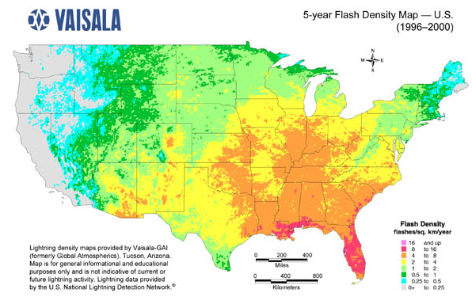
Map reading & Phase diagrams
longitude
(42°16'N, 77°48‘W)
(a,b)
= Alfred, NY
b
latitude
a

Slide 24
Phase diagram map reading (pp. 366-370)
P(atm)
Liquid (l) only
Supercritical region
Solid (s) only
s + l
melting (mp)
l + g
boiling (bp)
Critical pt (cp)
normal line*
1
s + l + g
triple point (tp)
Gas (g) only
*Temperature of LIQ/GAS transition at 1 atm is called the normal boiling point
s + g sublimation (sp)
T (º C)

Slide 25
Pressure is often under appreciated as a factor in phase changes
Cryophorous demo
dramatic visual of phase changes as T, P change

Slide 26
how phase diagrams are built from ZILLIONS of heating curves
Heating curve
Phase diagram
T
P
P=1 atm
Heat gas until anything else happens
After melting…watch liquid warm until L-G transition (30 ºC)
Put a big dot here to indicated L-G phase change
S all along the line
Put a big dot here to indicate S-L phase change
+30
Heat up and wait for S-L transition (at 10 ºC)
start
S
L
G
+10
P=1
start
Keep heating and melt…
S
-20
Heat in (J)
-20
+10
+30
T
Liquid all along line after dot
Gas all along line after dot
Keep heating and vaporize

Slide 27
Adding more data at different Pressures, P
P
T
G
L
L/ G
solid
liquid
S
P₁
S/L
P₂
P₁
S/G*
P₃
gas
P₂
Heat in
P₃
* =sublimation
T
Heating Curve
Phase Diagram

