Slide 1

FOR WEEK 15 (12/2-12/6)
Reading
Chapter 8: 359-371
Vaporization curves, heating/cooling curves &
phase diagrams
Chapter 8: 327-359
Models for what holds liquids and various classes of solids together
Suggested Homework:
Page do problem(s)
378 87 covered on
379 89,91, 95; 99 pp. 359-371
101, 103
375 33, 35, 39
43; 45, 47, 49, covered on
51, 57, 61, 65 pp. 327-359
377 75, 77; 79
To do
Exam 3
Monday 12 December 2013

Slide 2
Snapshot of Exam 3 headers and point distribution
3.1. Extended Lewis Rule Problems (16 pts)
3.2. Resonance (12 pts)
3.3. VSEPR Geometries (6 pts)
3.4. Bond Order (8 pts/2 pts each)
3.5. Hybridization (8 pts/ 2 pts each)
3.6. Specific Heat Calculations (12 pts total) show work !
3.7. Hess Law Calculations (4 pts each, 8 pts total)
3.8. Ideal Gas Computations (14 pts total)
3.9 Phase Changes ( 9 pts)
3.10 Multiple Guess (4 pts)
99 points +1 pt for name

Slide 3
Phase transition…”change of a pure substance from one state to another…”
Experimental ways to examine phase changes
Vaporization curves (360-363)
Heating/Cooling curves (pp 363-366)
Phase diagrams (pp 366-370)
phase | Compressible ?????? | Fills space ??????
gas
liq
solid
yes
yes
~no
Yes, but not like gas
NO
NO

Slide 4
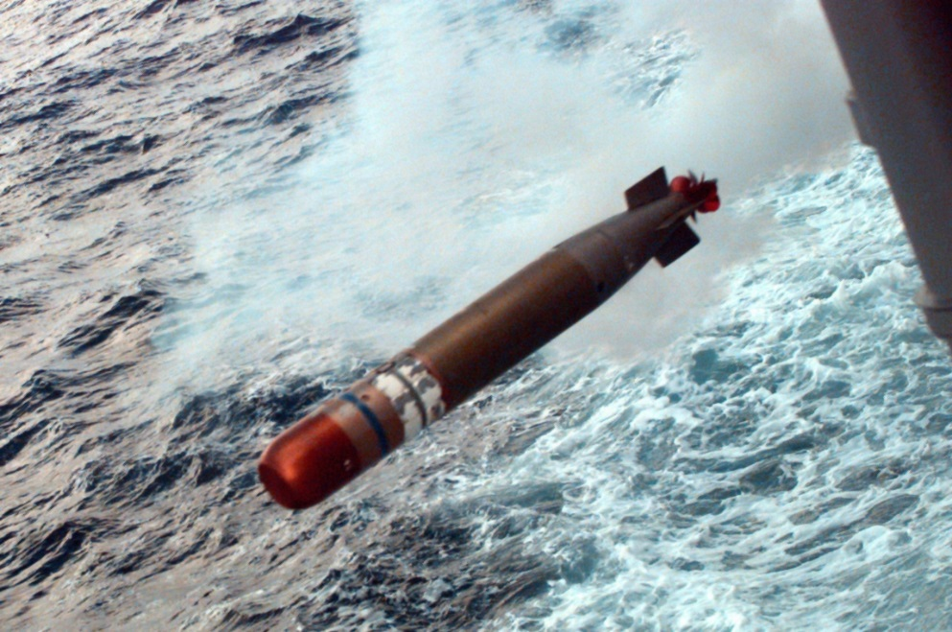
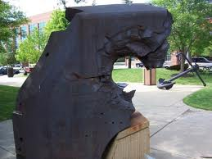
US Mark 26 torpedo
~95 lbs of explosive
26 inch armor plating of Japanese battleship after torpedo strike…the power of water’s incompressibility

Slide 5

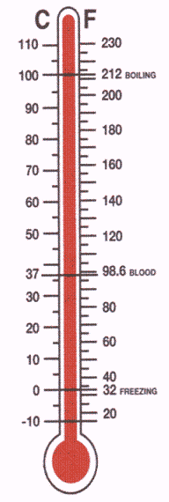
Microscopic view of phase changes: water as
ball- on-an invisible -spring -attached -to -a -wall analogy
T=10 ºC
(liquid)
T= 100º C
The invisible spring breaks and energy goes into breaking the spring, not bouncing against the wall =>
No temperature change
T= 30º C (still liquid)
T= 90ºC
(still liquid)
Increasing energy (J) expressed as the bouncing of a ball is proportional to temperature measured in wall (Boltzmann)
J ∝ m(g)
J depends on breaking point of spring
J ∝ T( ºC)
J ∝ to mass of balls m(g)
J ~ specific heat of transition
m(g) (liquid to steam)
J ~_ specific heat capacity
T(ºC) *m(g) of a phase (liquid)

Slide 6
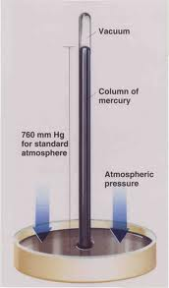
The simple Torricelli Mercury Barometer
reviewed
Chem Factoid:
At room temperature, mercury has virtually no vapor pressure

Slide 7
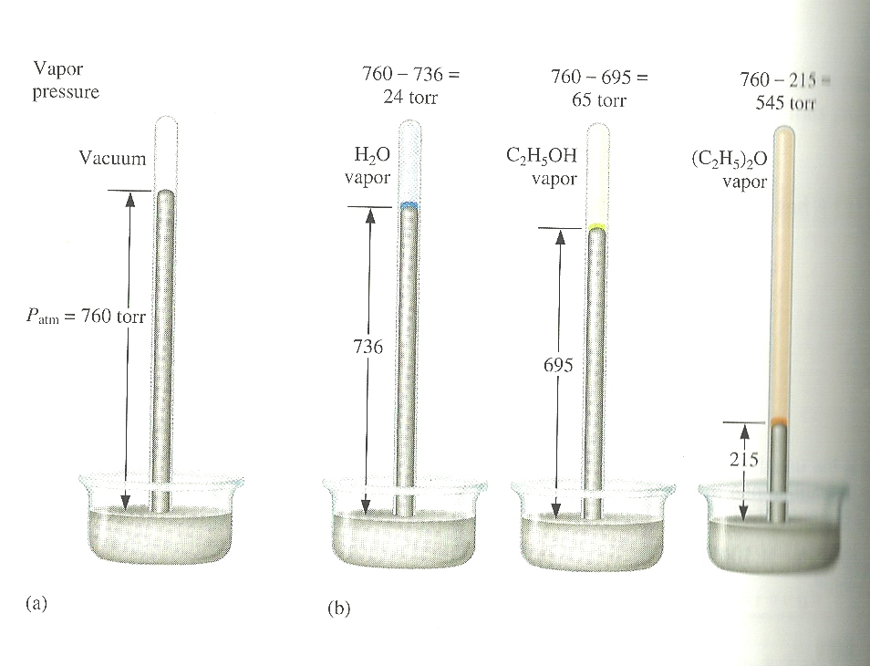
Variation of vapor pressure of selected materials at room temperature (see figure 8.40, p. 360)
760-736=
24 mm
760-695=
65 mm
760-215=
545 mm
760 mm
736 mm
695 mm
215 mm
Mercury (reference 0)
water
ethanol
ether

Slide 8
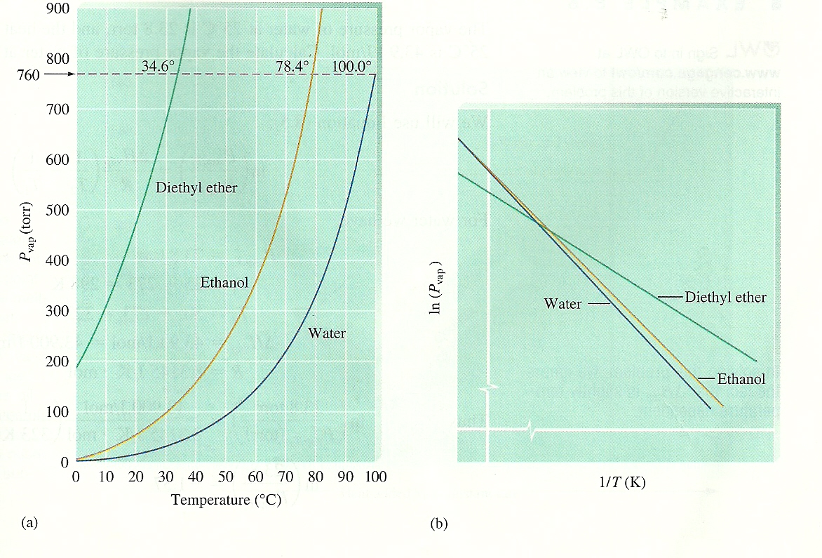
The vapor pressure of materials (duh…) varies with temperature
P(mm Hg) vs T
Common sense says: the sharper the pressure rise, the less strongly the liquid is bound (…e.g. it’s easier to escape as a gas)
760 mm
Ln P(mm Hg) vs T
ether
ethanol
ether
water
water
ethanol

Slide 9
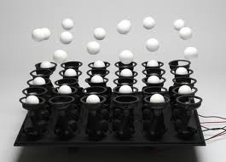
A brief look at the basics of `boiling’
http://vimeo.com/13059978#at=0

Slide 10
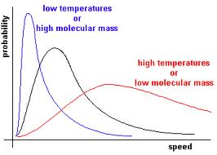
The odds of escape depend on temperature and the molecular size of the molecules
Number of molecules
SEE ALSO: p. 361 of text
Minimum velocity to break free of intermolecular forces
v_{escape}

Slide 11
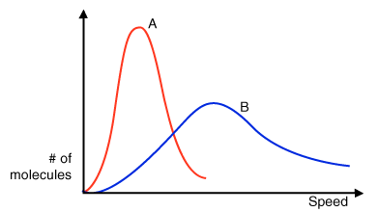
intermolecular interactions also affect velocities
H₂0
MW 18
Ne
MW=20

Slide 12
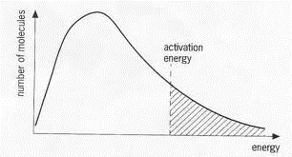
N(v_{i}) ∝ e^{-E(i)/RT}
P_{escape} =N_{escape} RT/V
P = constant*e^{-ΔH(vap) /RT}
Number of molecules N_{i}
Activation Energy (ΔH_{vap}) for escape as gas
Energy, E_{i}

Slide 13
P = constant*e^{-ΔH(vap) /RT}
Ln P = A - ΔH_{vap}
RT
ether
alcohol
water

Slide 14
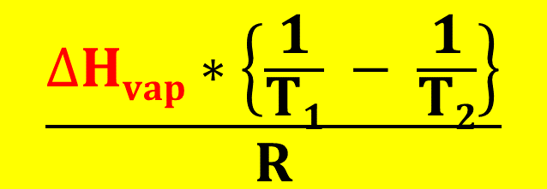
Development of the Clausius-Clapeyron equation (see text pg. 362)
Ln P = A - ΔH_{vap}
RT
Ln P₁ = A - ΔH_{vap}
RT₁
Ln P₂ = A - ΔH_{vap}
RT₂
Ln P₂ – Ln P₁ = - ΔH_{vap} – (-ΔH_{vap})
RT₂ RT₁
Ln P₂
P₁
$$\frac{∆Hvap∗\left\{\frac{1}{T1} − \frac{1}{T2}\right\}}{R}$$
=
Clausius-Clapeyron equation

Slide 15

Ln P₂
P₁
$$\frac{∆Hvap∗\left\{\frac{1}{T1} − \frac{1}{T2}\right\}}{R}$$
=
Using units of atmosphere, we set P₁=1 and T₁= T_{bp} (at 1 atm) and the Clausius-Clapeyron equation becomes:
Ln P = C + ΔH_{vap}
RT
C = - ΔH_{vap}
RT_{bp}(K)

Slide 16
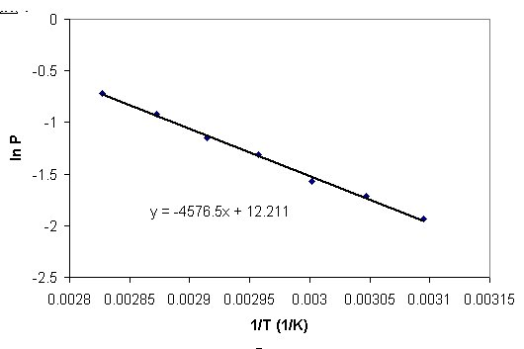
Ln P(atm) = C + ΔH_{vap} C= - ΔH_{vap}
RT RT_{bp}
Y = b + mX
Y= ln P X=1/T
m=ΔH_{vap} b=C= -ΔH_{vap}
R RT_{bp}
ΔH_{vap}=-38.045 kJ
T_{bp} =374 K
Vaporization of water data

Slide 17
ice melting- the Movie-frame by frame : heating/cooling curves
Heating up a block of ice ( see also-fig 8.44 p 363)
Water boils
Steam heats
T ( ºC)
Water heats
Ice
Heats
Ice melts
START
HERE
S
S + L
L
L + G
G
0
-10
Heat Energy in

Slide 18
Two `heats’ measured in heating/cooling curves
for single phase, q= (cal/ ºC gram)
for two phases in equilibrium : q= (cal/ ºC)
Q_{melt}
Heat m grams of solid ice (only solid present)
Melt m grams of solid ice
to liquid (liquid and solid present
at same time)
T₂
ΔT_{ice}
T₁
Energy in cal
Q _{ice}
q_{ice} =specific heat of solid (single phase) ice=
q_{melt} = specific heat of fusion=
Q_{ice}
Calories
g
Calories
g * ºC
Q_{melt}
m
* ΔT_{ice}
m

Slide 19
Cooling/heating curves: quantitative analysis
Heating steam
Example: Heating up 10 g of water
110 ºC
100
Heating water
Boiling water
Melting ice
S→L transition
Heating ice
22217 J
Specific heat of ice
100 C
Specific heat of boiling (condensation)
=400 J/ (10 º C * 10 g)
Specific heat of water
= 4184 J/(100 C *10 g)
=4.184 J/C g
start
=4 J/g ºC
=22217 /10
~2222 J/g
0
Specific Heat of `fusion’ (melting)
=3340/10=334 J/g
-10
3340 J
4184 J
400 J
3739
7923
30140
30340
All S
S + L
All L
L + G
ALL G

Slide 20
Cryophorous demo
dramatic visual of phase changes as T, P change
Super saturation demo…heat during phase change

