Slide 1

The errant video on water splitting and Avogadro’s law…
Avogadro’s Law is what finally let’s us figure out that water is H₂O , not HO.
(equal volumes=> equal moles)
http://www.youtube.com/watch?v=OTEX38bQ-2w&feature=player_detailpage
2 H + 1 O !!

Slide 2
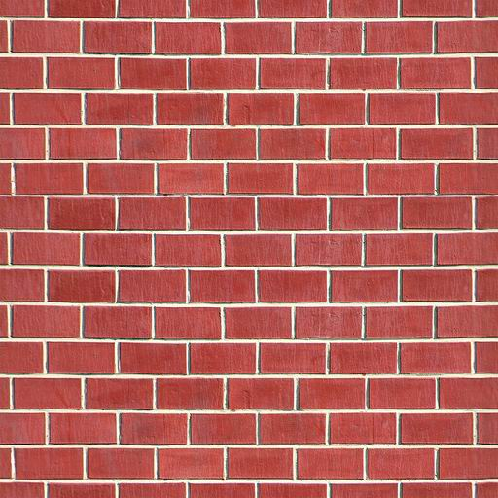
The not-so-obvious meanings of PV=nRT why do they call it the Ideal Gas law ?? (see pp. 299-305)
No dependence on gas velocities….speed vs mass appear to cancel each other’s effects out exactly…(???)
1 mole SF₆ vs 1 mole N₂ vs 1 mol He at 273.15 K in 22.41 L
SF₆
Observed pressure
1.0
1.0
N₂
He
1.0

Slide 3
What relationship between mass (m) and velocity (v) must exist for gas particles big and small to have same pressure even if they move at different velocities? (pg. 305, TEXT)
Physics thinking trip:
energy= E = ½ mv²
SPECULATION: If each gas molecule- irrespective of mass- has same energy then each would hit the wall with same energy:
E₁ = E₂
½ m₁ v₁² = ½ m₂v₂²
⇒ v₁² /v₂ ² = (v₁ /v₂)² = m₂/m₁ .
OR v₁/v₂ = (m₂/m₁)^{1/2} Graham’s law

Slide 4

Graham’s law in pictures¹ see also fig. 722 page 308)
2.46 meter Glass tube
1.46 meter
1 meter
(41% of tube length)
(59% of tube length)
NH₃(g)
m₁ =17 g/mol
NH₄Cl(s) powder forms
Where HCl and NH₃ meet
HCl(g)
m₂=36.5 g/mol
Chemical factoid:
NH₃(g) +HCl(g)→NH₄Cl(s)
a white powder
Testing Graham’s Law:
v₁/v₂ = (m₂/m₁)^{1/2}
=1.46
v(NH₃)/v(HCl) = (36.5/17)^{1/2}
∴Predicts that if HCl travels 1 meter, NH₃ will travel 1.46 meters in the same time
¹See also: Video DEMOhttp://www.youtube.com/watch?v=o7C4lo5n0zU

Slide 5
The not-so-obvious meanings of PV=nRT (cont.)
There is no account of crowding or gas density
….all the volumes V are equal at constant P,T
n= (P/RT) V = const*V equal volumes- equal moles (Avogodro’s law)
SF₆
N₂
He

Slide 6
The not-so-obvious meanings of PV=nRT
(cont.)
There is no time variable in the equation…
PV=nRT implies ball bounces forever without stopping
Your common sense says ball will bounce so…

Slide 7
The ideal part explained:
The kinetic theory of gases (pp. 299-306)
If PV=nRT…gases are ~ ideal particles which are…:
point masses (no volume, just masses-else crowding a problem)
Non-interacting (else they would stick and condense eventually)
hit walls elastically (no loss of energy, else they would start to pile up at the bottom of the closed cylinder)
No dependency on gas identity…all gas particles big and small seem to have same pressure even if they move at different speeds since:
=>Grahams Law seems to apply: (v₁/v₂)² = m₂/m₁

Slide 8
Since assuming all gas molecules have same energy recapitulates Graham’s law for gases, what dictates energy per molecule ?
Big idea: E(gas) ~ nRT
R tells us something fundamental about how gases move and how that movement is connected to T. Also (somehow) whenever any gas hits a wall at T , it receives exactly RT energy and never any more => moving at same speed ???

Slide 9
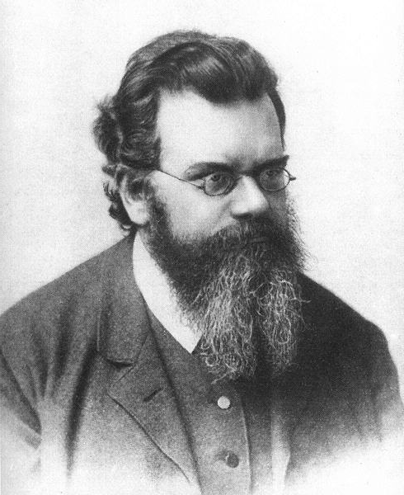
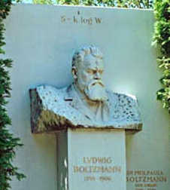
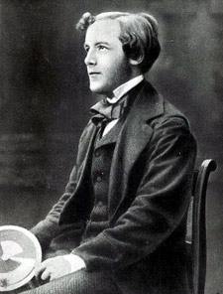

Main Inventors of this improbable kinetic model of ideal gases
Ludwig von Boltzmann (considered a total loon)
publishes his big idea (connected to T~RT)…on his grave
James Clerk Maxwell
(..considered too young to be taken seriously even with 2 doctorates in Physics and Math)

Slide 10
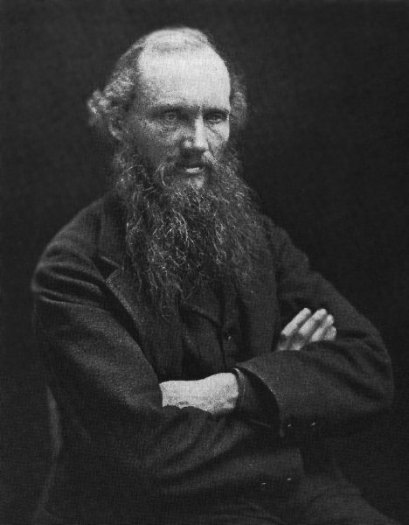
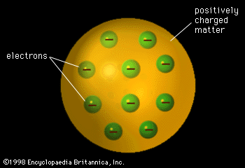
Also partly responsible for the improbable model of ideal gases…another `wacko’…
“X-rays will prove to be a hoax."
“There is nothing new to be discovered in physics now. All that remains is more and more precise measurement." (1896)
"I can state flatly that heavier than air flying machines are impossible."
Lord Kelvin: knighted wacko
“I give you the likely shape of atoms…”

Slide 11
moral
Sometimes crazy and naïve works just fine…
PV = nRT !!
Ludwig von Boltzmann
James Clerk Maxwell
Lord Kelvin

Slide 12
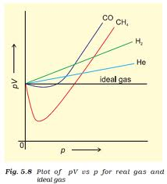
Real Gases: When conditions and reality set in….
For Ideal Gas at constant T and n=1:
PV=RT =constant
Ideal Gas
Real Gas PV vs. P Behavior
constant
PV
p

Slide 13
The Van der Waal Corrections:
Correction #1: V_{ideal} = V_{obs} -nb
b=physical volume taken up by 1 mole gas molecules (real gas fatness)
SF₆
N₂
He

Slide 14
Some Experimentally determined b (fattiness) values for selected real gases
Gas b (L)/mol % of available V occluded at STP
He
Ne
Kr
Xe
O₂
H₂O
CH₄
0.0237
0.0171
0.0322
0.0398
0.0511
0.0318
0.030
0.0428
0.106
0.076
0.144
0.177
0.228
0.142
0.133
0.191
(see also : table 7.2 page 311 of text)

Slide 15
The Van der Waal Corrections (continued)
Van der Waal Correction #2:
All real gases can be condensed to liquids=> assumption of non-interaction is wrong.
∴…all real gases `stick’ to each other a little, hence they slow each other down and reduce the actual observed pressure from the ideal pressure.
P_{obs} = P _{ideal} - a *(concentration of particles)²
P_{ideal} = P_{obs} + a*(n/V_{ideal} )²
Measures real gas “stickiness”

Slide 16
Typical Real Gas b (stickiness) values vs. Observed Normal Boiling Points
Gas a(atm *L²/mol ) Boiling pt (K)
He 0.0341 4
CH₄ 2.25 109
Xe 4.19 165
H₂O 5.46 373

Slide 17
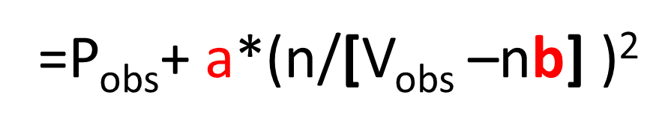
The Van Der Waals Corrections Combined
Correction #1 : real gases have `fatness’:
V_{ideal} = V_{obs} -nb
Correction #2 : real gases have ‘stickiness:’
P_{ideal} = P_{obs} + a*(n/V_{ideal} )²
Combine into modified `Van der Waals’ Gas Law
P_{ideal}V_{ideal} =nRT
=(P_{obs}+ a(n/[V_{obs}-nb]) ² *(V_{obs}-nb)

Slide 18
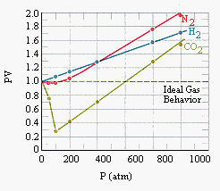
Observed vs. predicted PV vs. P Behavior Using Van Der Waals Equation

Slide 19
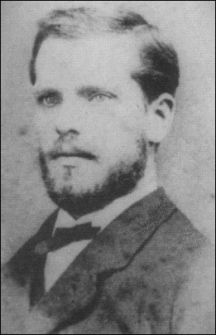
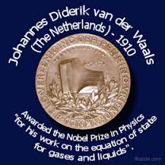
Johannes Diderik van der Waals,

Slide 20

Happy Thanksgiving…and get the !^*!%$ out of Dodge !

