Slide 1
How Boyle, Gay-Lussac and Charles Laws are reflected in the Combined Gas Law (when n is constant)
Conditions
Gas Law Equation
Name of Gas Law
P₁V₁ = P₂ V₂
T₁ T₂
constant
n
Combined Gas Law
constant n,P
P₁V₁ = P₂ V₂
T₁ T₂
Charles’ Law (P₁=P₂)
P₁V₁ = P₂ V₂
T₁ T₂
constant n, T
Boyle’s Law (T₁=T₂)
P₁V₁ = P₂ V₂
T₁ T₂
Gay-Lussac’s Law
(V₁=V₂)
constant n, V

Slide 2
A sample of oxygen gas is expanded from 20 to 50
liters at constant temperature. The final pressure is 4 atm. What was the initial pressure ?
P₁=10 atm
A sample of gas at fixed volume is heated from 300 K
to 600 K. If the initial pressure is 5 atm, what is the
final pressure ?
P₂= 10 atm
The volume of a piston at fixed pressure changes as it is
cooled from 500 ºC to 250ºC. If the final volume is 6.76 L,
what is the initial volume ?
V₁=10 L

Slide 3
4. A child’s balloon originally occupies 5 liters at sea level
(P=1 atm) and room temperature (300 K) . It is released
and is allowed to rise to an altitude where the pressure
is 0.25 atm and the temperature is 150 K.
What is the balloon’s new volume ?
10 L
Autoclaves are essentially pressure cookers. At 1 atm,
steam has a temperature of 100º C. Would you expect the
pressure to double if the autoclave to attains a steam
temperature of 200ºC ?
a) NO…must convert C→ K…ratio is not 200/100
What pressure do you actually expect to reach at 200 ºC?
473.15 =1.73 atm
373.15

Slide 4
Text problem 59 page 322
Stopcock closed
2.00 L H₂ at 0.625 atm
1.00 L N₂ at 0.200 atm
Final P = ???
Stopcock open
0.483 atm

Slide 5
When n varies….Avogadro’s real lesson
Blowing up a balloon
What varies ?
n up ?
=> V up
n, V (1st time n changes)
n down ?
=> V down
=> P and T are constant
Avogadro’s Law (pp. 289-90)
V=an
V
Or: V₁ = V₂
n₁ n₂
n

Slide 6
A hidden insight from Avogadro’s Law
No mention is made of the chemical nature of the gas.
∴ V₁(He) = V₂(O₂) = V₃(N₂)…
n₁ (He) n₂(O₂) n₃(N₂)
If n₁(He) = n₂(O₂) = n₃(N₂)
then V₁ (He) = n₂(O₂) = n₃(N₂)
“ Equal Volumes, Equal Moles”
experimentally: this means we can measure volume to measure moles

Slide 7

Avogadro’s Law is what finally let’s us figure out that water is H₂O
http://www.youtube.com/watch?v=OTEX38bQ-2w&feature=player_detailpage
2 H + 1 O !!

Slide 8
Combining Avogadro and the Combined Gas Laws
Combined Gas Law
n constant
P,V,T variable
P₁V₁ = P₂ V₂
T₁ T₂
Avogadro’s Law
P, T constant
n variable
V₁ = V₂
n₁ n₂
Suggests grand combo equation
n, P, V, T variable
P₁V₁ = P₂ V₂ = const. ?
n₁ T₁ n₂ T₂

Slide 9
From experiment (at high temperatures and modest pressures)
P₁V₁ = P₂ V₂ = 0.08206 atm*L
n₁ T₁ n₂ T₂ K mole
Ideal Gas Equation
PV=nRT
R=0.08206 atm L = Ideal Gas constant
K mole

Slide 10
Gas Problems requiring PV=nRT
An 11 gram sample of a gas occupies 2.0 liters at 2.0538 atm and 200 K. What is the molecular mass of the gas ? (R=0.0821)
n=PV/RT= 2.0538*2/(0.0821*200)=0.250 mol
MW= g/mol =11/0.25=44 g/mol

Slide 11
Gas Problems requiring PV=nRT (cont.)
From your text: problem 57 page 321
7.8 g of solid CO₂ (MW=44 g/mol) is vaporized into a evacuated, 4L volume at 27 ºC (300K) . What is the final P(atm) once the CO₂ sublimes into a gas ?
7.8/44= n=0.177 mol
P=nRT/V= 0.177*00821*300/4=1.09 atm

Slide 12

The not-so-obvious meanings of PV=nRT why do they call it the Ideal Gas law ?? (see pp. 299-305)
No dependence on gas velocities….speed vs mass appear to cancel each other’s effects out exactly…(???)
1 mole SF₆ vs 1 mole N₂ vs 1 mol He at 273.15 K in 22.41 L
SF₆
Observed pressure
1.0
N₂
1.0
He
1.0

Slide 13
What relationship between mass (m) and velocity (v) must exist for gas particles big and small to have same pressure even if they move at different velocities? (pg. 305, TEXT)
Physics thinking trip:
energy= E = ½ mv²
SPECULATION: If each gas molecule- irrespective of mass- has same energy then each would hit the wall with same energy:
E₁ = E₂
½ m₁ v₁² = ½ m₂v₂²
⇒ v₁² /v₂ ² = (v₁ /v₂)² = m₂/m₁ .
OR v₁/v₂ = (m₂/m₁)^{1/2} Graham’s law

Slide 14

Graham’s law in pictures
2.46 meter Glass tube
1.46 meter
(41% of tube length)
(59% of tube length)
1 meter
NH₃(g)
m₁ =17 g/mol
NH₄Cl(s) powder forms
Where HCl and NH₃ meet
HCl(g)
m₂=36.5 g/mol
Chemical factoid:
NH₃(g) +HCl(g)→NH₄Cl(s)
a white powder
Testing Graham’s Law:
v₁/v₂ = (m₂/m₁)^{1/2}
=1.46
v(NH₃)/v(HCl) = (36.5/17)^{1/2}
∴Predicts that if HCl travels 1 meter, NH₃ will travel 1.46 meters in the same time
See FAVORITES LIST FOR DEMO

Slide 15
The not-so-obvious meanings of PV=nRT (cont.)
There is no account of crowding or gas density
….all the volumes V are equal at constant P,T
n= (P/RT) V = const*V equal volumes- equal moles (Avogodro’s law)
SF₆
N₂
He

Slide 16
The not-so-obvious meanings of PV=nRT
(cont.)
The is no time variable in the equation…
Your common sense says ball will bounce so…
PV=nRT implies ball bounces forever without stopping

Slide 17
The ideal part explained
(kinetic theory of gases: )
If PV=nRT…gases are ~ ideal particles which are…:
point masses (no volume, just masses-else crowding a problem)
Non-interacting (else they would stick and condense eventually)
hit walls elastically (no loss of energy, else they would start to pile up at the bottom of the closed cylinder)
No dependency on gas identity…all gas particles big and small seem to have same pressure even if they move at different speeds
=>Grahams Law seems to apply: (v₁/v₂)² = m₂/m₁

Slide 18
Assuming all gas molecules have same energy recapitulates Graham’s law for gases, so what dictates energy value ?
Big idea: E(gas) ~ nRT
R tells us something fundamental about how gases move and how that movement is connected to T

Slide 19
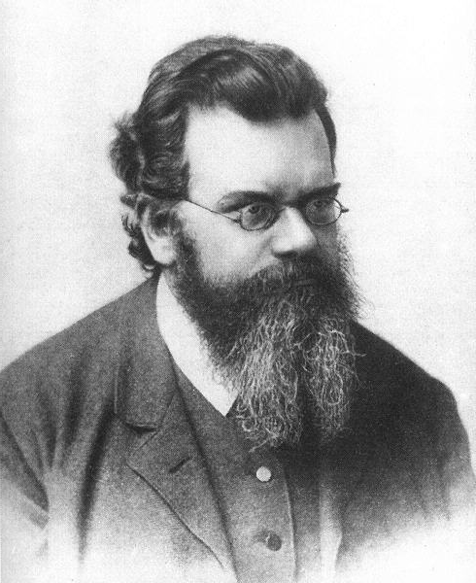
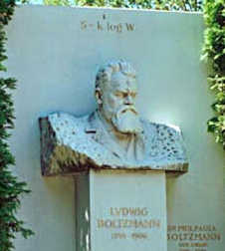
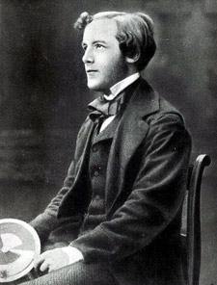

Main Inventors of this improbable kinetic model of ideal gases
Ludwig von Boltzmann (considered a total loon)
publishes his big idea (connected to T~RT)…on his grave
James Clerk Maxwell
(..considered too young to be taken seriously even with 2 doctorates in Physics and Math)

Slide 20
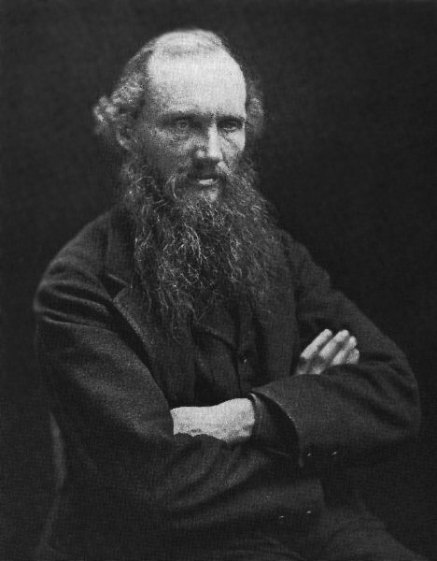
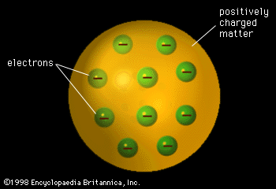
Also partly responsible for the improbable model of ideal gases…another `wacko’…
“X-rays will prove to be a hoax."
“There is nothing new to be discovered in physics now. All that remains is more and more precise measurement." (1896)
"I can state flatly that heavier than air flying machines are impossible."
Lord Kelvin: knighted wacko
“I give you the likely shape of atoms…”

Slide 21
moral
Sometimes crazy and naïve works just fine…
PV = nRT !!
Ludwig von Boltzmann
James Clerk Maxwell
Lord Kelvin

