Slide 1
FOR WEEK 13 (11/18-11/22)
Suggested Homework:
Page do problem(s)
317 1-3
318 12-15
319 17,18,21,23
320 29,31; 35,37,39
41,43,45,47,49,51,53; 57
322 59,61,63; 69,71
323 73, 75,77
Reading
Chapter 7: 281-311
To do
Marathon problem 10
Gas Problem
Due Monday 25 November 2013
by 4 PM (can be submitted electronically)

Slide 2
What the ΔH_{f}º tabulations are good for:
Sum of Product ΔH_{f}º – Sum of Reactant ΔH_{f}º
= Heat of Reaction ΔHº
Reactants
∑ΔH_{f}º
Products
∑ΔH_{f}º
ΔHº
Element reference
See for also: text figures 6.6-6.8

Slide 3
Board examples of calculations using heats of formation to compute heats of reaction
C₆ H₁₂O₆(s) +6O₂ (g)→ 6CO₂(g)+ 6H₂O(l)
glucose
-2802kJ
~3700 kJ/lb glucose
2Al(s) + Fe₂O₃(s) → Al₂O₃ (s)+ 2Fe(s)
`thermite’ reaction
-801 kJ
~7150 kJ/lb Al

Slide 4
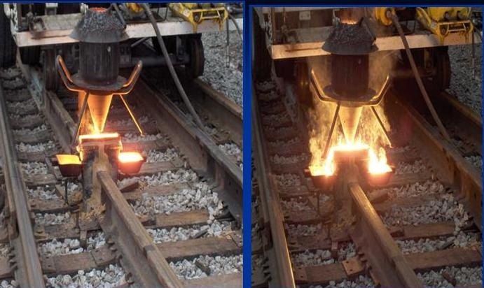
The thermite reaction is used way to weld railroad track

Slide 5
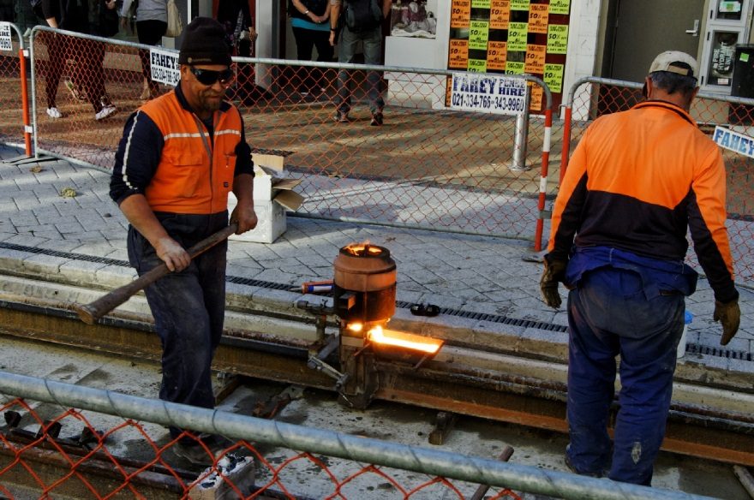
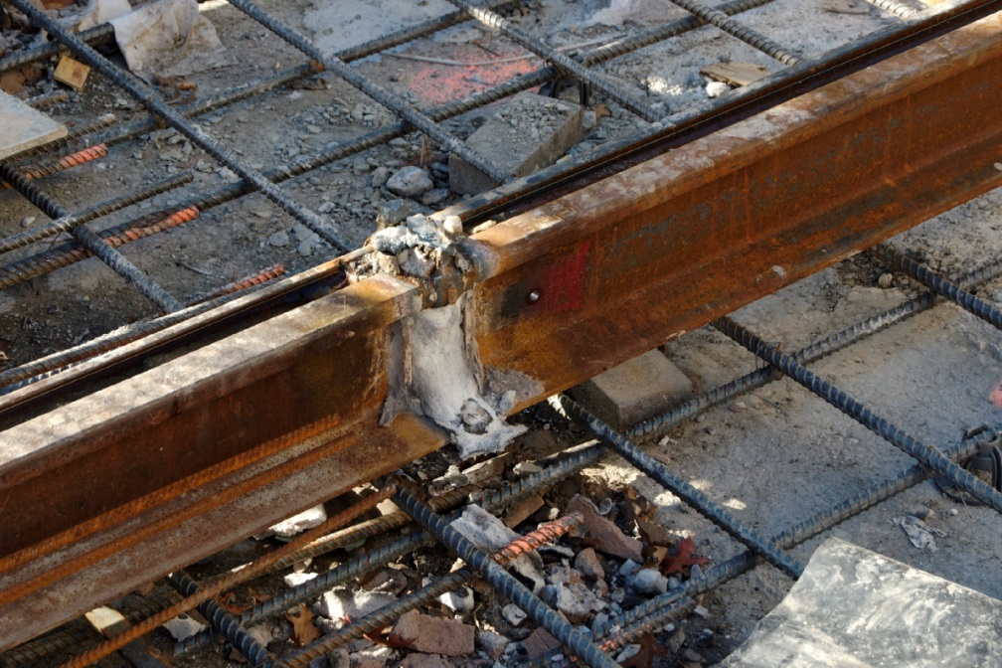

Slide 6

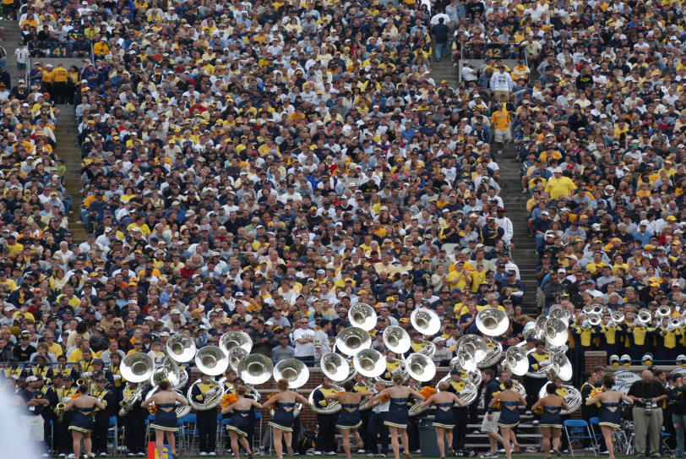
Our Chemistry Road trip so far … mostly individual, isolated molecular/atomic properties
Chapter 7:Gases
(pp. 281-316)
our first exploration of `aggregate’ behavior
Chemistry of the crowd

Slide 7
Pressure (P) concepts & measures in “Physics-speak “(see p 283-4 )
Physics speak
P = Force
Area
Physics units
P = newtons
m²
=kg*m/s²
= kg
m s²
m*m

Slide 8
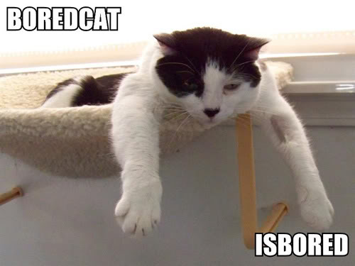
Pressure (P) concepts & measures in “Physics-speak “(see p 283-4 )
∴
1 kg = 1 Pascal (Pa)
m s²

Slide 9

Some lowbrow chem insights
into Pressure
Getting hammered
Bed of nails

Slide 10

Pressure expresses how much a (constant) impressed force is spread out…
MORE AREA, LOWER PRESSURE
LESS AREA, HIGHER PRESSURE

Slide 11
Pressure in `lowbrow’ Chem speak:
barometers ( see p 283)
outer space
Pressure =1 atm at sea level
~20 mile tall
column of air in Earth’s atmosphere creates pressure we all feel
Earth
Edge of Earth’s atmosphere

Slide 12
Pressure in `lowbrow’ Chem speak (continued): barometers ( see p 284)
Evacuated space
External atmospheric pressure, P
P in mm Hg
A Torricelli barometer
Hg

Slide 13
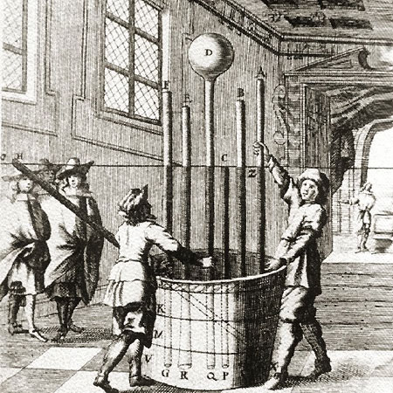
Atmosphere demonstrated the Italian Way (BIG time Torricelli Barometers)
Lesson from 17th century picture
Height of Hg columns is independent of cross-sectional areas of tubes
Vat of mercury (Hg)

Slide 14
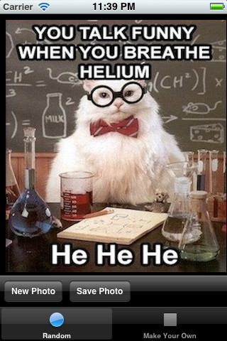
in CHEMISTRY LAND
Pressure units
1 atmosphere =760 mm Hg
= 760 torr
=29.92 inches Hg
Other common measures of an atmosphere
1 atmosphere=10336 mm H₂O
=33.9 ft H₂O
= 20 miles of air
= 15 pounds/in² (psi)

Slide 15


Pressure units in PHYSICS COUNTRY
Physics speak
1 atm = 101.3 kPa
Confusing Compromise
1 bar =100 kPa= 0.986 atm
WE ARE GOING TO STICK WITH ATMOSPHERES (atm) IN THIS COURSE

Slide 16



Empiric gas law derivations: the common sense way
What variables do we follow when describing a gas ???
P, T, V, n
n P
T up ⇒ ??
V up
=> T, V vary
T down⇒ ??
V down
CHARLES’ LAW (p. 287-8)
V
V = bT
V₁ = T₁
V₂ T₂
T
V₁/T₁= V₂/T₂

Slide 17


Empiric gas law derivations: the common sense way (cont.)
n T
V down ?? ⇒
P up
=> P, V vary
V up ??
⇒ P down
P
BOYLE’S LAW (p. 285-6)
P = k/V
P₁ = 1/V₁
P₂ 1/V₂
V
P₁V₁=P₂V₂

Slide 18

Empiric gas law derivations: the common sense way (cont.)
n V
T up⇒ ??
P up
=> T, P vary
T down⇒ ??
P down
P
GAY-LUSSAC’S LAW (not in text)
P = aT
T in K
T₁ = P₁
T₂ P₂
T
P₁/T₁= P₂/T₂

Slide 19
How Boyle, Gay-Lussac and Charles Laws are reflected in the Combined Gas Law (when n is constant)
Conditions
Gas Law Equation
Name of Gas Law
P₁V₁ = P₂ V₂
T₁ T₂
constant
n
Combined Gas Law
constant n,P
P₁V₁ = P₂ V₂
T₁ T₂
Charles’ Law (P₁=P₂)
P₁V₁ = P₂ V₂
T₁ T₂
constant n, T
Boyle’s Law (T₁=T₂)
P₁V₁ = P₂ V₂
T₁ T₂
Gay-Lussac’s Law
(V₁=V₂)
constant n, V

Slide 20
When n varies….
Blowing up a balloon
What varies ?
n up ?
=> V up
n, V (1st time n changes)
n down ?
=> V down
=> P and T are constant
Avogadro’s Law (pp. 289-90)
V=an
V
n

Slide 21
A sample of oxygen gas is expanded from 20 to 50
liters at constant temperature. The final pressure is 4 atm. What was the initial pressure ?
P₁=10 atm
A sample of gas at fixed volume is heated from 300 K
to 600 K. If the initial pressure is 5 atm, what is the
final pressure ?
P₂= 10 atm
The volume of a piston at fixed pressure changes as it is cooled
from 500 ºC to 250ºC. If the final volume is 6.76 liters,
what is the initial volume ?
V₁=10 L

Slide 22
4. A child’s balloon originally occupies 5 liters at sea level (P=1 atm)
and room temperature (300 K) . It is released and is allowed to rise
to an altitude where the pressure is 0.25 atm and the temperature
is 150 K. What is the balloon’s new volume ?
10 L
5. Autoclaves are essentially pressure cookers ( fixed volume and water vapor)
used to sterilize medical and biological tools like scalpels and sample bottles.
At 1 atm, steam has a temperature of 100º C.Would you expect the pressure
to double if the autoclave to attains steam temperature of 200ºC ?
a) NO…must convert C→ K…ratio is not 200/100
What pressure do you actually expect to reach at 200 ºC?
473.15 =1.73 atm
373.15

