Slide 1
Enthalpy, ΔH
the Chemist’s Reaction Energy State Function (see p 251)
By definition: H= E +PV
ΔH =ΔE + Δ(PV)
ΔH =Q+W + Δ(PV)
ΔH =Q-PΔV + Δ(PV)
ΔH =Q-PΔV + (PΔV +VΔP)
At constant P, ΔP=0=>
ΔH_{p} =Q_{p} +VΔP
The heat of reaction at constant P is independent of how you run the reaction: Q_{p}= ΔH_{p} is a state function

Slide 2
      Hess’s Law:
No matter how you arrive at a reaction heat at constant pressure, you get the same answer.
Textbook’s example: pg 252
One step:
N₂(g) + 2O₂(g)→ 2NO₂(g)
ΔH=+68 kJ
Two steps:
1) N₂(g) +O₂(g) → 2NO(g)
ΔH₁=+ 180 kJ
2) 2NO(g) +O₂(g) → 2NO₂(g)
ΔH₂=-112 kJ
ΔH₁₊₂ =+68 kJ
add/ and simplify
N₂(g) +2O₂(g) +2NO(g)→ 2NO(g) +2NO₂(g)

Slide 3
A simple, two equation example of using Hess’s law
Predict ΔH for: N₂ + 2H₂ → N₂H₄
Given:
N₂H₄ + O₂→ N₂ + 2H₂O -622.2 kJ
H₂ + ½ O₂ →H₂O -285.8 kJ
50.6 kJ

Slide 4
Working some text book problems on white board
Problems 44,45,46 page 276

Slide 5
Problem 44: ClF + F₂→ ClF₃ ΔH = ??
2ClF + O₂→Cl₂O + F₂O ΔH=167.4 kJ
2ClF₃ + 2O₂→ Cl₂O +3F₂O ΔH=341.4
2F2 +O₂→2F₂O ΔH= -43.4
-108.7 kJ

Slide 6
Problem 45: NO +O → NO₂ ΔH = ?
1)2O₃ →3O₂ ΔH =-427 kJ
2)O₂ →2O ΔH =+495
3)NO +O₃ → NO₂ +O₂ ΔH =-199
-233 kJ

Slide 7
Problem 46: N₂H₄+O₂→ N₂ + 2H₂O ΔH = ?
1) 2NH₃ + 3N₂O→ 4N₂ + 3H₂O ΔH=-1010 kJ
2) N₂O +3H₂ →N₂H₄ + H₂O ΔH=-317
3) 2NH₃ +1/2 O₂ → N₂H₄ + H₂O ΔH=-143
4) H₂ +1/2 O₂ → H₂O ΔH=-286
Extra credit…+5 pts for correct answer by Wednesday

Slide 8
Standard State Enthalpies of formation: ΔH_{f}º (pp. 256-262)
Reaction conditions at “standard state”
Change vs. …
ΔH_{f}º
…vs. elements (=> a heat of formation)

Slide 9
Standard state definitions (p. 256)
For Compounds
Gas phase
P=1.000 atm (and for most tabulations: T=25^{O} C)
Pure solids & liquids
P=1.000 atm (and for most tabulations: T=25^{O} C)
Solutions
1=Mole substance/L
For Elements
Form the element exists in at P=1.000 atm and 25 ^{O} C

Slide 10
Example of reaction leading to ΔH_{f}º
H₂(g) + 1/2O₂(g)→ H₂O(l)
elements
1 mole of compound
Element reference
ΔH_{f}º(H₂O(l)= -286 kJ/mol
-286 kJ/mol
Compound energy relative to element reference

Slide 11
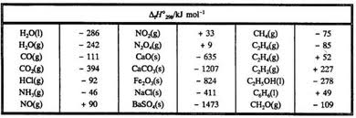
Tabulations of the Standard State Enthalpies of compounds are usually at 25 C = 298 K (see appendix A-20 of text)

Slide 12
What the ΔH_{f}º tabulations are good for:
Sum of Product ΔH_{f}º – Sum of Reactant ΔH_{f}º
= Heat of Reaction ΔHº
Reactants
∑ΔH_{f}º
Products
∑ΔH_{f}º
ΔHº
Element reference
See for also: text figures 6.6-6.8

Slide 13
Board examples of calculations using heats of formation to compute heats of reaction
CH₄(g)+2 O₂(g)→ CO₂(g)+ 2H₂O(l)
-890 kJ
C₆ H₁₂O₆(s) +6O₂ (g)→ 6CO₂(g)+ 6H₂O(l)
-2802kJ
2Al(s) + Fe₂O₃(s) → Al₂O₃ (s)+ 2Fe(s)
`thermite’ reaction
-850 kJ

Slide 14
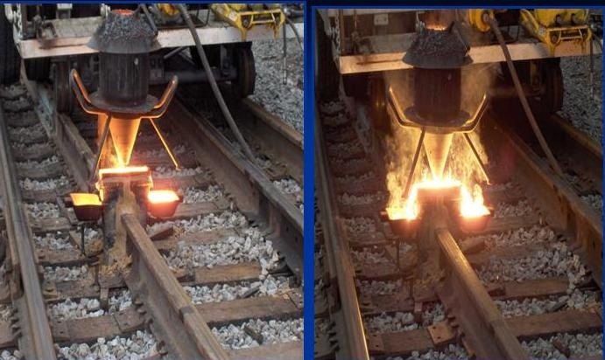
Thermite Reaction is used way to weld railroad track

Slide 15



