Slide 1
FOR WEEK 12 (11/9-11/13)
Suggested Homework:
Page do problem(s)
274 11,13,15,17 new
275 21,23,25,27,29,31,33,35
276 37,39,41,43,45,47
277 49,51,53,57 (new)
478 95,97,99,101,103 (new)
Chapter 10
pp. 466-70 (specific heats)
Chapter 6
pp. 243-262
To do
Marathon problem 9
Text Problem 86, page 279
Due Monday 18 November 2013
by 4 PM

Slide 2
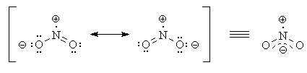
The `odd’ case of NO₂ =nitrogen dioxide
Electron book keeping for NO₂
element valence count
N 5
2 O 2*6
Sum = 17 (odd number)
Odd # valence counts=> one electron must be unpaired=> a `free radical’ (unstable…not paired)
FYI…free radicals are possible `starters’ of cancer…☹

Slide 3
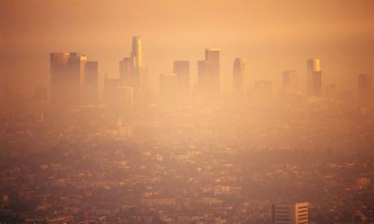
The brownish color of LA smog is NO₂
Stage 3 smog Alert day over Los Angeles

Slide 4
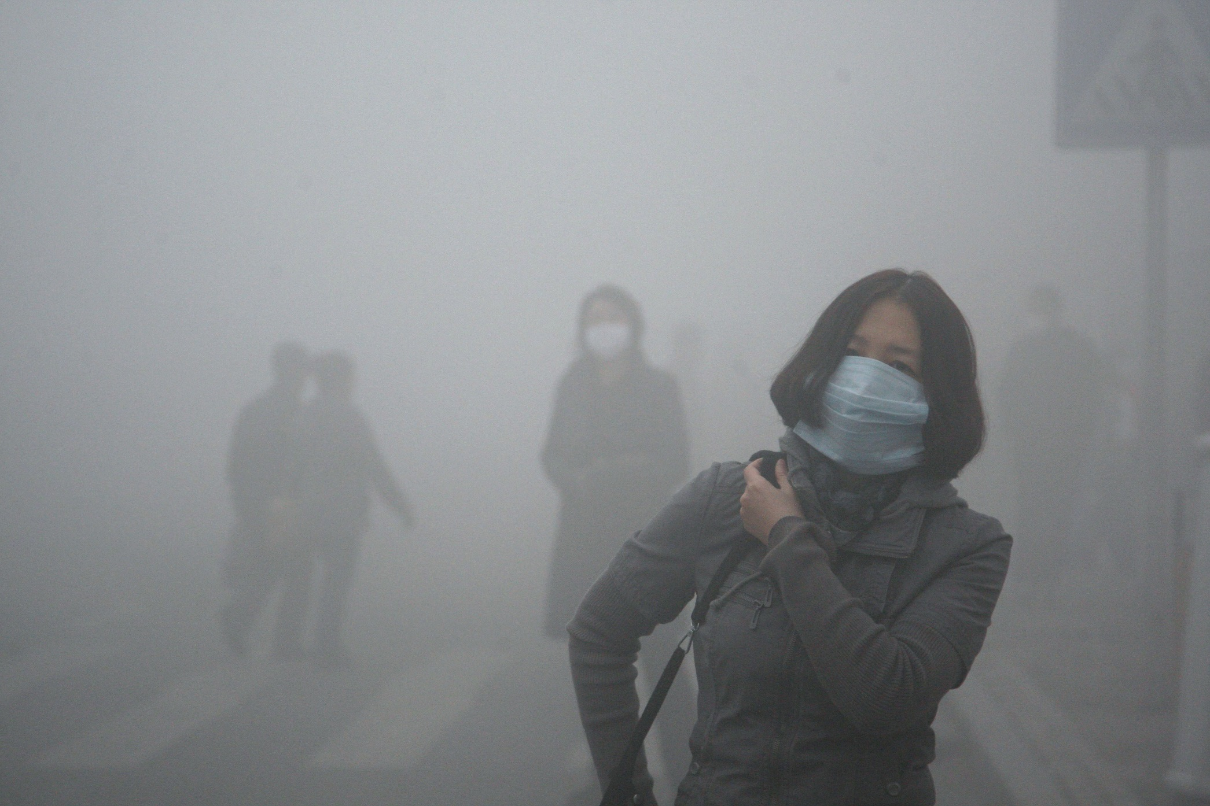
The worst smog is in urban China (too many cars, too many coal-fired power plants, no EPA)
A day way, way, way past stage 3 LA smog Alert status in Beijing

Slide 5
Various expressions of heat capacity (see also: page 466)
If Mass m(g) used to measure amount of stuff
Q(J) = C_{sp} * m(g) * ΔT(ºC)
Q(J) ___ = C_{sp} = specific heat
m(g)* ΔT(º C) capacity (J/g ºC)

Slide 6
expressions of heat capacity (continued)
If moles M used to measure amount of stuff:
Q(J) = C_{M}* M(moles) * ΔT(º C)
Q(J) = C_{M} = Molar heat
M(mol)* ΔT(º C) capacity (J/Mol ºC)

Slide 7
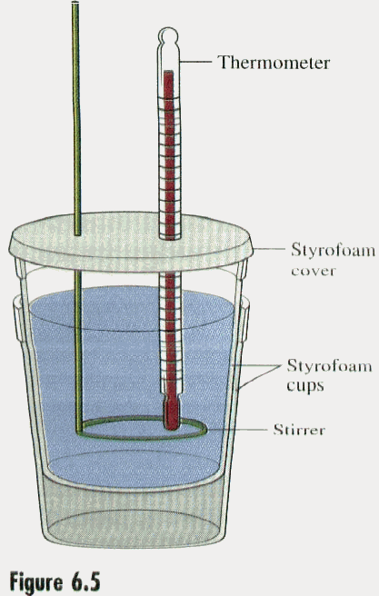
Coffee cup calorimeter
Simple calorimetry equipment for measuring heat flow and C_{sp}
Object being studied for heat content

Slide 8
Two very simple calorimetry word problems (see also problems 95-99 page 478)
A 5.0 gram sample of a metal absorbed 150 J of heat and was heated from 20ºC to 100º C. What is the specific heat, C_{sp} , of the sample ?
150 J = 0.375 J
5 g*(100-20)ºC g ºC
A 10.0 gram sample of Fe (C_{sp}=0.45 J/g ºC) initially at 25 ºC absorbs 1000 J of heat. What temperature T_{f} does the Fe sample reach ?
Q = m(g)*C_{sp}*ΔT
1000 =10*0.45* ΔT=4.5 ΔT=4.5(T_{f}-25)
1000/4.5 =222.2 = T_{f}-25 => Tf= 222.2+25=247.2 ºC

Slide 9
A typical heat transfer problem: (see also- this week’s calorimetry lab)…we do-it on board
A 50.00 gram sample of water in an thick-walled styrofoam cup is initially at 25.00 ºC. A 30.00 gram sample of metal initially at T_{i}= 90.00 C is dropped into the water. The final temperature T_{f} attained by the combined system at equilibrium is 29.15 ºC. Estimate the specific heat, C_{sp} of the metal in J/g ºC.
Assume C_{sp} (water) =4.184 J/g ºC

Slide 10
The Molar Heat Capacities of Metals Are Curiously Similar
Metal | C_{M} (J/mol K) at 25ºC
Mg | 25.3
Al | 24.4
Fe | 26.4
Ni | 26.1
Cu | 24.6
Zn | 25.2
Ag | 25.5
Sb | 25.2
Au | 25.4
Pb | 26.5
Average experimental C_{M}
=25.5±0.7 J/K mol

Slide 11
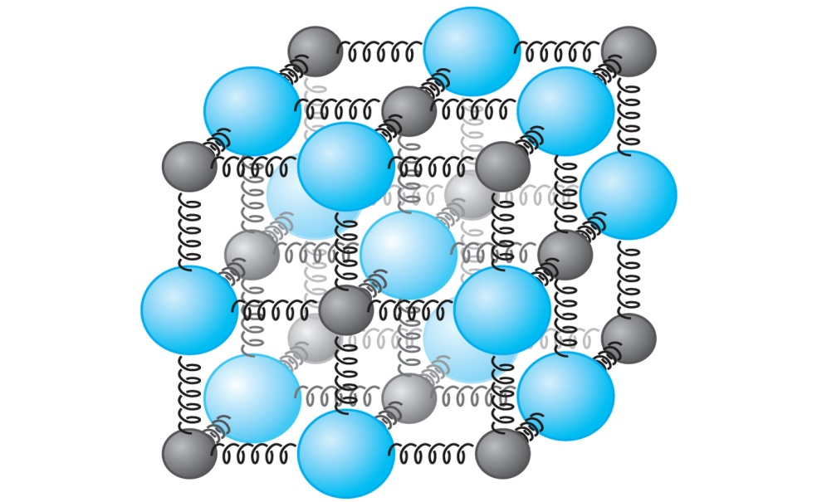
The `Law’ of Dulong and Petit :a classical atomic model that explains the curious constancy of C_{M}
Any crystalline solid (like a metal) has 6 unique ways to vibrate each atom in its lattice.
From the `equipartition theory of energy’ each vibration has heat
energy ε = ½ kT (k=1.38*10⁻²³ J/K)
Q/atom = 6ε= 6* ½ kT=3 kT=4.14*10⁻²³*T
Q /mol= Q_{M} = 6.022*10²³ *E/atom =25.0*T
Q_{M} = C_{M}*(T-0)= C_{M} *T
Average experimental C_{M} =25.5±0.7 J/K mol

Slide 12
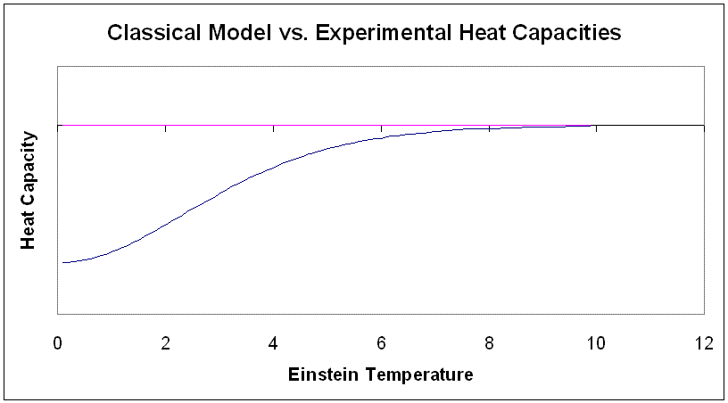
Classical Model
C_{p} ~ kR (Dulong and Petit)
experiment
The divergence of the experiment from classical models from heat capacity measurements leads to superconductors and supercritical phenomena

Slide 13
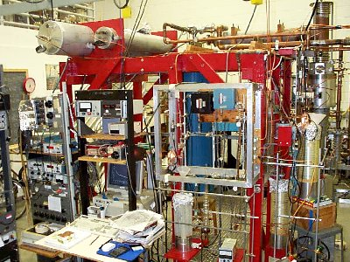
Typical `Rig’ For Modern Low Temperature Calorimetry
Northwestern University Low Temperature Lab

Slide 15
state functions (see p.244)
A state function is a property which is `path independent’.
The internal energy, ΔE, of a system, is a state function

Slide 16
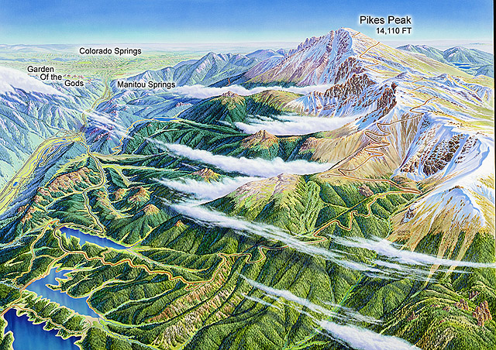
Non- chemical `Path independence’
What change is indifferent to the three trip paths taken ?
Start trip here
Go here
Δy
Your change in elevation (Δy) here is a state function independent of work and sweat of the possible paths

Slide 17
THE BIG PICTURE: the system vs. surroundings model
The ‘surroundings’ are what the system is exchanging heat and work with (outside its’ walls).
More generally:
System walls
EVERYTHING OUTSIDE SYSTEM ARE THE SURROUNDINGS
THE “SYSTEM”

Slide 18
The internal energy, ΔE, of the system is all the energy has gotten from the surroundings-both Work, W, done on it and heat given to it, Q.
ΔE= W + Q
1st Law of thermodynamics
(p. 246)
Sign Conventions:
Q into system from surroundings is + (endothermic)
Q out of system to surroundings is – (exothermic)
W done on system by surroundings is +
W done on surroundings by system is -

Slide 19
Model for exchange of heat and work starts with an ideal gas piston…(see figure 6.4 p. 247)
1)F=mg
P=pressure
2) W=F*d= mg*h
= mg *hA
A
ΔV
∴ W=P ΔV
m
A
Area of piston = A
h
Ideal gas

Slide 20
Assertion:
An ideal gas is a gas whose energy depends only on its temperature T(K). For n moles of gas:
ΔE_{ideal gas} = constant* n*T(K) =>
PV=nRT (Ideal Gas law)
R=8.314 J/K mol
(ideal gas constant)

Slide 21
Board examples illustrating signs and exchange of Q and W in an ideal gas piston
Isothermal compression
Isothermal expansion
Increasing/decreasing T at constant P
Increasing/decreasing T at constant V
Increasing/decreasing V without exchange (adiabatic expansion/compression)

