Slide 1
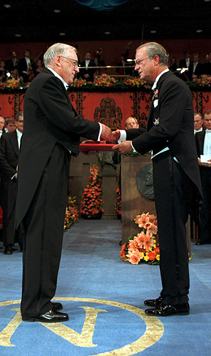

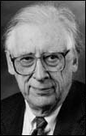
Solve this for c_{ij}
ψ= Σc_{ij} AO_{ij}
<ψ*|Ĥ|ψ> = 0 ∀ c_{ij}
∂ c_{ij}
The Big Kahuna of the general MO approach
His un-named, but critical co-conspirator….
Chem Professor John Pople
Northwestern University:
(1965-2005)
John A. Pople wins the Nobel Prize in Chemistry, 1998 "for his development of computational methods in quantum chemistry".
Aka: the God of Quantum Computation

Slide 2
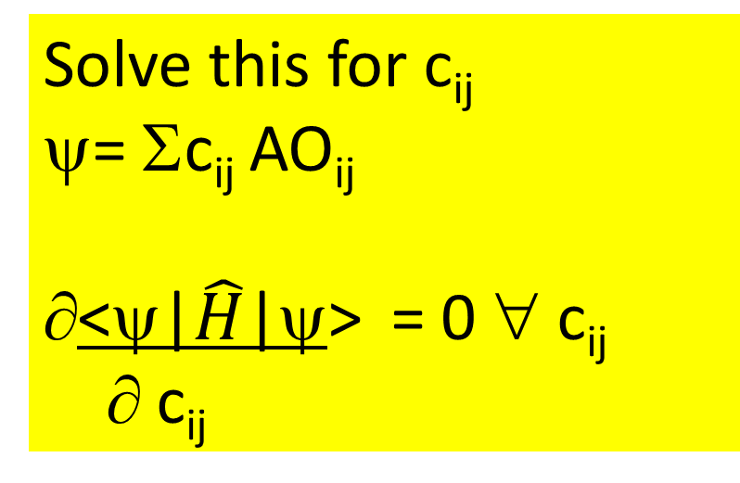
Generalized Molecular Orbital (MO) Theory:
the `final’ solution in more ugly detail
Ex: describing MO for P
Pauling valence bond theory uses just 3s and 3p orbitals
MO theory uses 1s,2s,2p, 3s and 3p orbitals
Solve this for c_{ij}
ψ= Σc_{ij} AO_{ij}
<ψ|$\hat{H}$|ψ> = 0 ∀ c_{ij}
∂ c_{ij}
Solving (eventually)=>
-23.1 eV
-25.2 eV
-25.6 eV
+0.125
+0.125
<ψ*| Ĥ |ψ>=∫ ψ*| Ĥ |ψ dV
-0.25
Ĥ = (for just one electron !!)
-ħ ² {1 ∂ r² ∂ + 1 ∂ sin θ ∂ + 1 ∂² } -e²
2m r² ∂r ∂r r² sin θ ∂θ ∂θ r²sin² θ ∂φ² r
r(O-H)=0.101 nm
∠(H-O-H)=94º

Slide 3
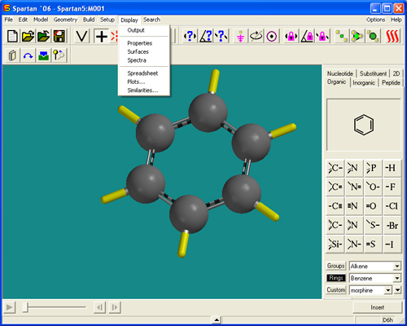
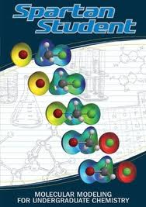
2013: Because of Pople’s heroic efforts….
Molecular Orbital Modeling can be done using `a black box program’ and garden variety laptops
Demo of ASC Spartan 8 `professional’ version

Slide 4
Comparing Experimental Results¹ vs. Modern Quantum Chemical Calculations
Dipole=
δ-
μ=δ*L
Ex. Gas phase H₂O
r
L
θ
δ+
experiment¹
STO-31G Theory
(to energy minimum)
r
0.957 Ǻ
0.969 Ǻ
θ
104.47º
103.98º
μ(Dipole)
1.85 D
2.46 D
¹NIST CCDB 2013

Slide 5
Comparing Experimental Results vs. Modern Quantum Chemical Calculations (continued)
Ex. Gas phase H₂O
E₄
E₃
E₂
E₁
Eo
Electron book keeping
Electron energies ?
O=> 8 e⁻
2H =>2 e⁻
10e-
=>5 MO
(2e⁻ /MO)
experiment¹
STO-31G Theory
(to energy minimum)
E₄
E₃
E₂
E₁
E_{o}
-540
-32.5
-19.8
-15.9
-13.9
-555
-36.0
-18.5
-14.6
-13.0
¹NIST electron spectroscopy data base

Slide 6
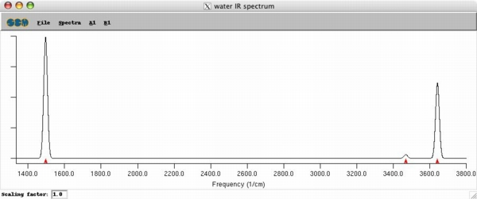
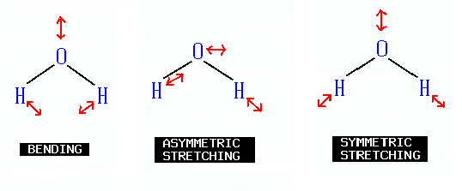
Comparing Experimental Results vs. Modern Quantum Chemical Calculations (continued)
Ex. Gas phase H₂O
Infrared vibrations
Experiment
1595 3657 3756 cm⁻¹
STO 31-G Theory
1839 3806 3902

Slide 7
Take a bow, Chemistry Professor John Pople¹
Northwestern University:(1965-2005)
Not too shabby,
for a dead guy, eh, suckers ?
¹aka…God of Quantum Computation

Slide 8
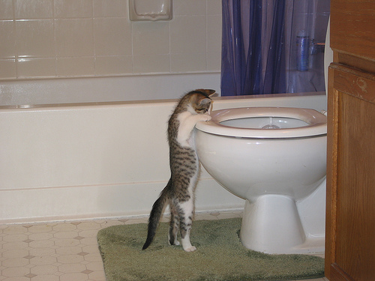
What we’re getting into this week
Specific heat, ΔH=enthalpy=Q_{p}
and Hess’ Law
Reading:
Chapter 10:
pp. 466-470
(do first)
Chapter 6
pp. 243-262
(do second)

Slide 9

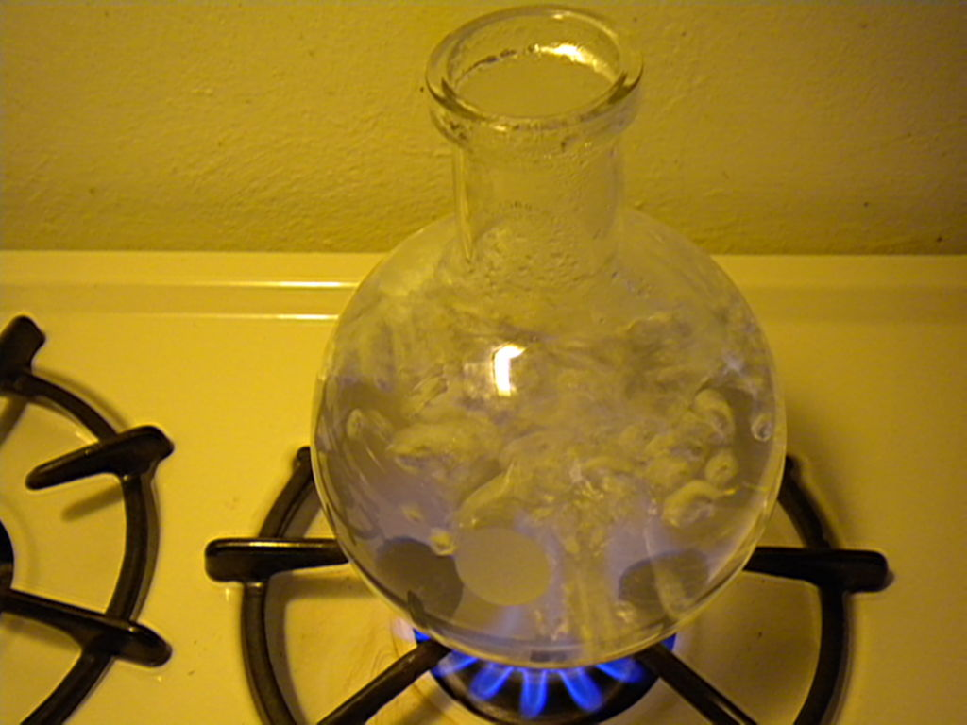
Dumb Doc Question #3451
What does stuff do when we throw heat energy into it ???
Duh…
It gets `hotter’?

Slide 10

What do we mean by `hotter’ ?
Your thoughts first…
?????

Slide 11
Dumb Doc Question #3452
Temperature (T) vs. heat (Q). What’s the difference?

Slide 12
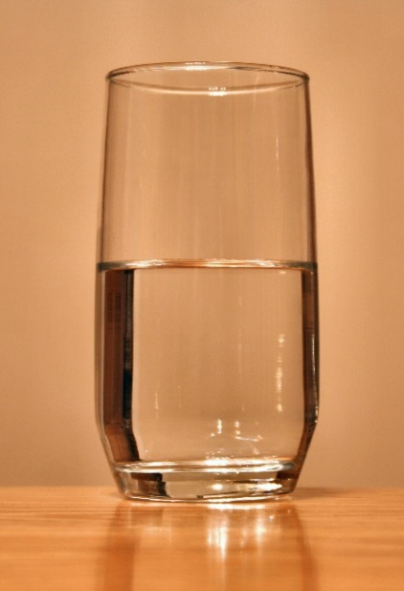
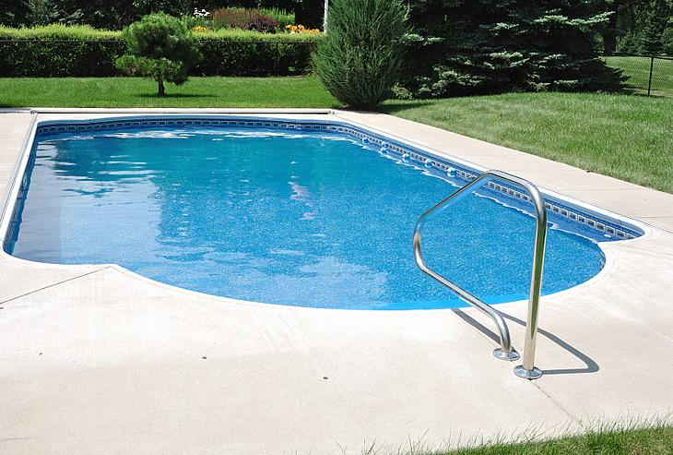
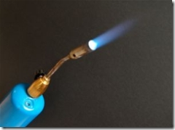
A simple comparison illustrating Q vs. T
√
vs.
25 ºC
25 ºC
Q_{in}
2 minutes
Q_{in}
2 minutes
Which gets ‘hotter’, glass of water or swimming pool of water ?

Slide 13
Change in temperature T = ΔT is the `response’ of `stuff’ to absorbed energy Q.
ΔT response depends on :
How much stuff is being heated/cooled (mass m or moles M)
Heat absorption properties of
the stuff = heat capacity, C

Slide 14
Brief aside on energy measures
Chemistry approach to energy is `operational’:
1.00 calorie ( cal) = amount of energy needed to raise 1.00 gram of water 1.00 ºC
Physics approach to energy arises from Work=F*d:
Work = energy = F*d
= (m*a)* d
Units of energy = (kg* m/s²)* m=kg m²/s²
By definition: 1 kg m²/s² = 1 Joule (J)
4.184 J= 1 calorie

Slide 15
Various expressions of heat capacity (see also: page 466)
If Mass m(g) used to measure amount of stuff
Q(J) = C_{sp} * m(g) * ΔT(ºC)
Q(J) ___ = C_{sp} = specific heat
m(g)* ΔT(º C) capacity (J/g ºC)

Slide 16
expressions of heat capacity (continued)
If moles M used to measure amount of stuff:
Q(J) = C_{M}* M(moles) * ΔT(º C)
Q(J) = C_{M} = Molar heat
M(mol)* ΔT(º C) capacity (J/Mol ºC)

Slide 17
Some common materials’ specific heats, C_{sp}
Material C_{sp}
Water 4.184 J/ºC g
Aluminum 0.89
Graphite 0.71
Iron 0.45
Mercury 0.14

Slide 18
Examples of very high and very low heat capacity materials
1) Low heat capacity example
Melting solder in a bunsen burner
2) High heat capacity example: Space Shuttle Tile

Slide 19
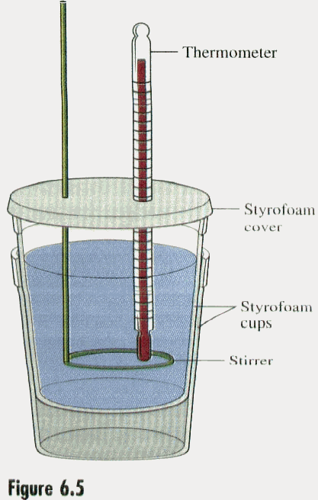
Coffee cup calorimeter
Simple calorimetry equipment for measuring heat flow and C_{sp}
Object being studied for heat content

Slide 20
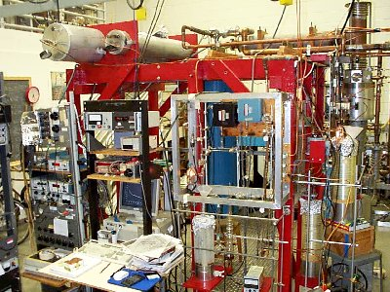
Typical `Rig’ For Modern Low Temperature Calorimetry
Northwestern University Low Temperature Lab

Slide 21
Two very simple calorimetry word problems (see also problems 95-99 page 478)
A 5.0 gram sample of a metal absorbed 150 J of heat and was heated from 20ºC to 100º C. What is the specific heat, C_{sp} , of the sample ?
150 J = 0.375 J
5 g*(100-20)ºC g ºC
A 10.0 gram sample of Fe (C_{sp}=0.45 J/g ºC) initially at 25 ºC absorbs 1000 J of heat. What temperature T_{f} does the Fe sample reach ?
Q = m(g)*C_{sp}*ΔT
1000 =10*0.45* ΔT=4.5 ΔT=4.5(T_{f}-25)
1000/4.5 =222.2 = T_{f}-25 => Tf= 222.2+25=247.2 ºC

Slide 22
A typical calorimetry problem: (see also- this week’s calorimetry lab)…we do-it on board
A 50.00 gram sample of water in an thick-walled styrofoam cup is initially at 25.00 ºC. A 30.00 gram sample of metal initially at T_{i}= 90.00 C is dropped into the water. The final temperature T_{f} attained by the combined system at equilibrium is 29.15 ºC. Estimate the specific heat, C_{sp} of the metal in J/g ºC.
Assume C_{sp} (water) =4.184 J/g ºC

