Slide 1
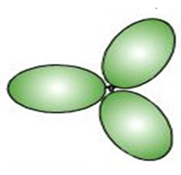
How bonds are formed from Pauling MO hybrids: O₂ example
Lewis model for O₂
Pauling hybrid MO on each O
sp²
sp²
Picture of separated MO

Slide 2
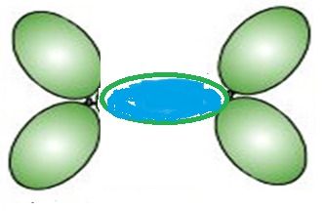
How bonds are formed from Pauling MO hybrids: O₂ example(continued)
Push separated MO together
2 electrons co-mingle/co-habitate in here
**
A sigma=σ (framework) bond

Slide 3

Another damned dumb Doc question
O₂ has two bonds between the O….What about the other one ???

Slide 4
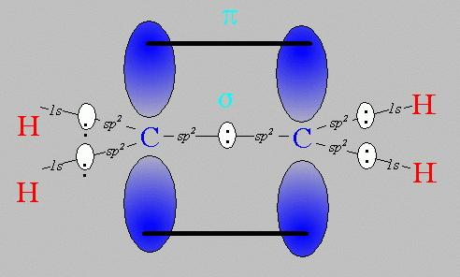
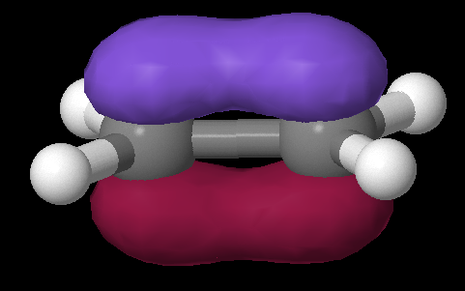
Pi (π) bonds: Pauling’s really great idea to use the `leftovers’
Equivalent Pauling `sigma’ (σ) hybrid structure
Ethene (C₂H₄) Lewis picture
σ
1 leftover p_{z} on each C
sp²
sp²
s+ p_{x} + p_{y}
s+ p_{x} + p_{y}
z
π
x
σ
y

Slide 5
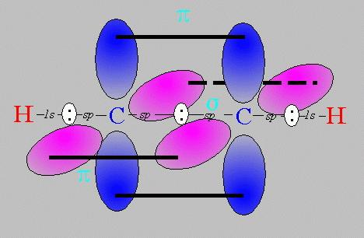
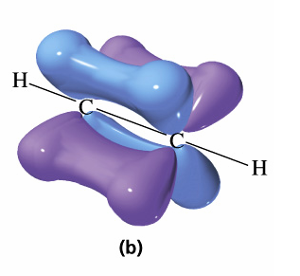
Pi bonds: Pauling’s really great idea to use the `leftovers’ (cont.)
Equivalent Pauling `sigma’ (σ) hybrid structure
Ethyne (C₂H₂) Lewis picture
σ
sp
sp
2 leftover p_{z} on each C
s+ p_{x}
s+ p_{x}
z
π
Z
x
σ
π
x
y
y

Slide 6
Describe the σ hybridization and bond types for the compounds below, given their Lewis structures:
N₂
:N≡N:
sp
sp
1σ + 2π bonds
sp²
NO₂⁻
N=O: 1σ + 1π bond
sp²
sp³
N-O⁻: 1σ bond
CO₂
sp
sp²
sp²
1σ + 1π bond
Also try: CH₄, NH₃, H-C≡C-H if desired

Slide 7
Hybridization beyond s and p combinations (see page 216-217)
5 lobes
6 lobes
sp³d¹= sp³d
sp³d²
Must throw in `3d’ orbitals to describe hybridization
on P, S here:

Slide 8
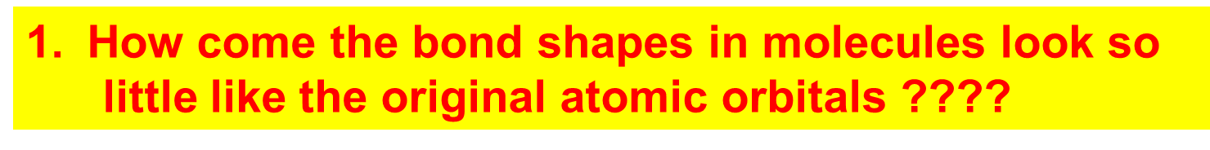
How Pauling’s model `fixes’ the problems with Lewis model
Atomic orbitals (AO) `reorganize’ (hybridize) when individual atoms approach each other such that the number of `links’ predicted by the Lewis model = the number of s, p (and d and f) orbitals combined in the reorganization. The `hybrid’ combinations are called Linear Combinations of Atomic Orbitals (LCAO). The `lobes’ in LCAO on individual atoms overlap and share two electrons between the atoms in a `sigma’ bond (often called a `valence’ or structural linkage bond.)

Slide 9
How Pauling’s model `fixes’ the problems with Lewis model
(continued)
2. How does octet model account for the observed reactivity trend of ethane vs ethene vs ethyne with halogens and ozone ?
`pi’ bonds are far less stable and far more reactive than sigma bonds. (Further out, softer, not between atoms but above and below) Ethane is held together by just `sigma bonds and is thus not very reactive.
Both ethylene and acetylene have pi bonds which are easily reacted. That acetylene is more reactive thane ethylene results because it has two pi bonds while ethylene has only 1 pi bond

Slide 10
How Pauling’s model `fixes’ the problems with Lewis model
(continued)
3. How can you get all those electrons between carbons in double and triple bonds ? Don’t they repel ?
The pi bonds occupy space above and below the sigma bond and thus do not crowd them. The two pi bonds are also on different and perpendicularly aligned planes to minimize pi-pi crowding.

Slide 11
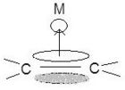
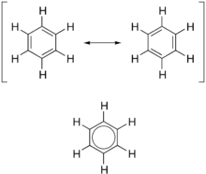
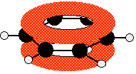
Other cool things the Pauling model provides:
How you can get 6,7 even 8 bonds around an atom:
sp³d , sp³d², sp³d³, sp³d⁴…
2) Why metals stick to ethylene (H₂C=CH₂) and catalyze its reaction with H₂ :
π→σ donation
3) Why are all the C-C bonds in benzene the same ??
Nothing in the way of π electrons above the C sigma plane
benzene

Slide 12
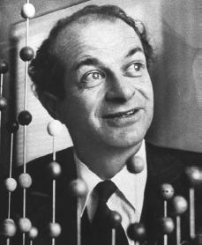
Linus Pauling: An American Chemical Genius
“I am awesome ( and kinda cute in a geeky way…)”
…one of the heroes of Doc’s chemical youth…
Nobel Prize in Chemistry 1954
Nobel Peace Prize 1962
Nearly cracks DNA structure before Watson and Crick without cheating like Watson and Crick, and, with almost no experimental data.
I
PAULING

Slide 13
Keen intuition + mathematical rigor + outside the box thinking +…he’s was a really nice guy and an inspired teacher !
FYI: You are all the great, great grandchildren of Linus Pauling !!!

Slide 14
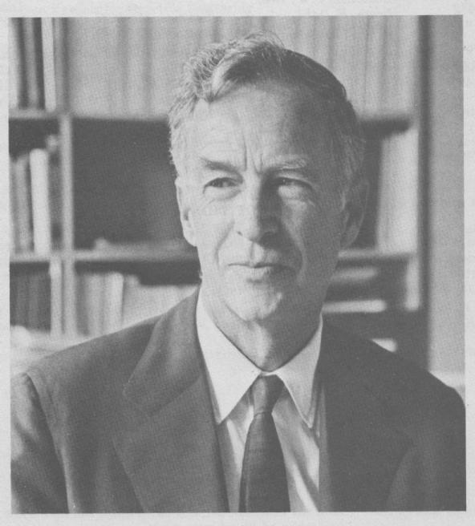
E. Bright Wilson
Harvard University, Chemistry
National Medal of Science 1975
T.W. Richards Endowed Chair
His son (Ken)wins Nobel in Physics (Cornell Univ.)
Linus Pauling
Cal Tech, Chemistry
Nobel Prize in Chemistry 1954
Nobel Peace Prize 1962

Slide 15
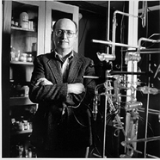
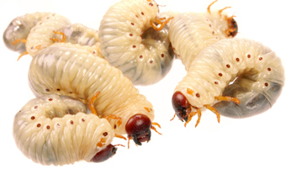
YOU !
‘Doc’ Fong
SUNY Alfred State Chemistry
Director, Forensic Science Technology (and nut case)
R. L. Kuczkowski
University of Michigan, Chemistry Department Chair
Doc’s favorite, best mentor

Slide 16

Problems with Pauling Valence Bond (LCAO) Model
Fails to provide procedure to determine the numeric details of molecular energy and spectra
translation…can’t compute a stinking thing
Doesn’t allow adjustments for changes of atoms bonded to the central atom
Example: can’t distinguish electronic shape or density of CH₄ vs CF₄ except with `electronegativity’ and vague sketches

Slide 17
The “final” solution: Generalized MO theory
Text takes a whack at it:
pp. 218-228 (not covered here)

Slide 18
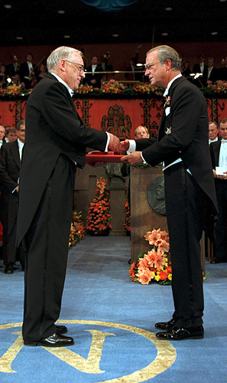
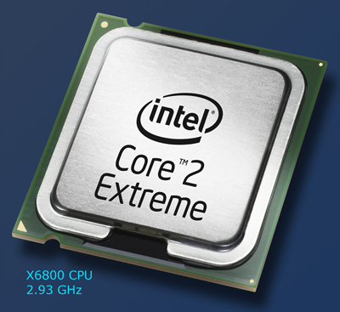
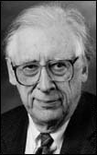
Solve this for c_{ij}
ψ= Σc_{ij} AO_{ij}
<ψ*|Ĥ|ψ> = 0 ∀ c_{ij}
∂ c_{ij}
The Big Kahuna of the general MO approach
His un-named, but critical co-conspirator….
Chem Professor John Pople
Northwestern University:
(1965-2005)
John A. Pople wins the Nobel Prize in Chemistry, 1998 "for his development of computational methods in quantum chemistry".
Aka: the God of Quantum Computation

Slide 19
Generalized Molecular Orbital (MO) Theory:
the `final’ solution
Key features
Uses both valence and core AO
Uses quantum theory (Schrodinger equation) to approximate the best mix of AO that minimizes the molecule’s total electronic energy
Provides numeric estimates of MO shape and energy levels, structural features (bond length, angle) and electronic charge distribution

Slide 20
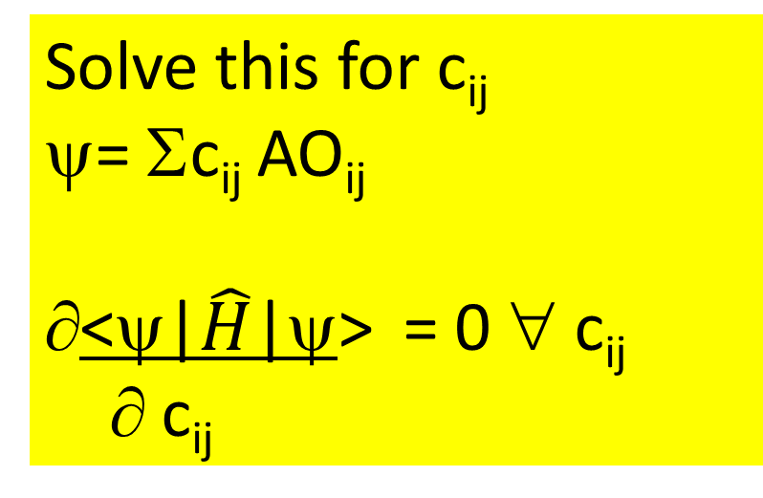
Generalized Molecular Orbital (MO) Theory:
the `final’ solution in more ugly detail
Ex: describing MO for P
Pauling valence bond theory uses just 3s and 3p orbitals
MO theory uses 1s,2s,2p, 3s and 3p orbitals
Solve this for c_{ij}
ψ= Σc_{ij} AO_{ij}
<ψ|$\hat{H}$|ψ> = 0 ∀ c_{ij}
∂ c_{ij}
Solving (eventually)=>
-23.1 eV
-25.2 eV
-25.6 eV
+0.125
+0.125
<ψ*| Ĥ |ψ>=∫ ψ*| Ĥ |ψ dV
-0.25
Ĥ = (for just one electron !!)
-ħ ² {1 ∂ r² ∂ + 1 ∂ sin θ ∂ + 1 ∂² } -e²
2m r² ∂r ∂r r² sin θ ∂θ ∂θ r²sin² θ ∂φ² r
r(O-H)=0.101 nm
∠(H-O-H)=94º

Slide 21
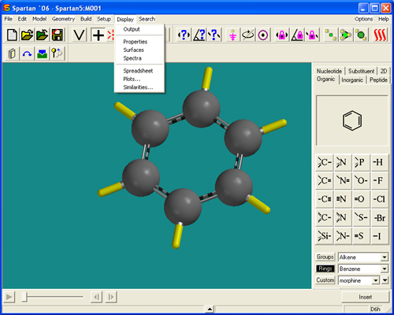
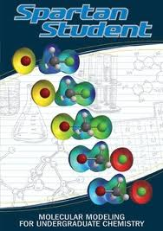
2013: Because of Pople’s heroic efforts….
Molecular Orbital Modeling can be done using `a black box program’ and garden variety laptops
Demo of ASC Spartan 8 `professional’ version

Slide 22
Comparing Experimental Results¹ vs. Modern Quantum Chemical Calculations
Dipole=
δ-
μ=δ*L
Ex. Gas phase H₂O
r
L
θ
δ+
experiment¹
STO-31G Theory
(to energy minimum)
r
0.957 Ǻ
0.969 Ǻ
θ
104.47º
103.98º
μ(Dipole)
1.85 D
2.46 D
¹NIST CCDB 2013

Slide 23
Comparing Experimental Results vs. Modern Quantum Chemical Calculations (continued)
Ex. Gas phase H₂O
E₄
E₃
E₂
E₁
Eo
Electron book keeping
Electron energies ?
O=> 8 e⁻
2H =>2 e⁻
10e-
=>5 MO
(2e⁻ /MO)
experiment¹
STO-31G Theory
(to energy minimum)
E₄
E₃
E₂
E₁
E_{o}
-540
-32.5
-19.8
-15.9
-13.9
-555
-36.0
-18.5
-14.6
-13.0
¹NIST electron spectroscopy data base

Slide 24
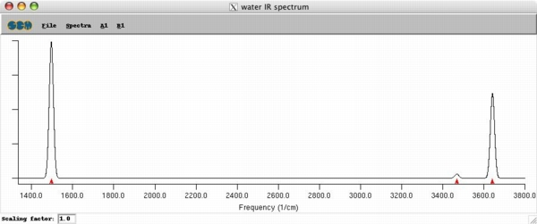
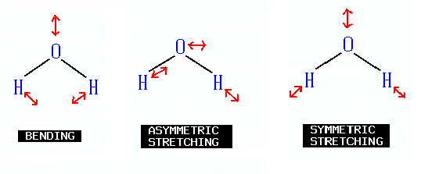
Comparing Experimental Results vs. Modern Quantum Chemical Calculations (continued)
Ex. Gas phase H₂O
Infrared vibrations
Experiment
1595 3657 3756 cm⁻¹
STO 31-G Theory
1839 3806 3902

Slide 25
Take a bow, Chemistry Professor John Pople¹
Northwestern University:(1965-2005)
Not too shabby,
for a dead guy, eh, suckers ?
¹aka…God of Quantum Computation

Slide 26
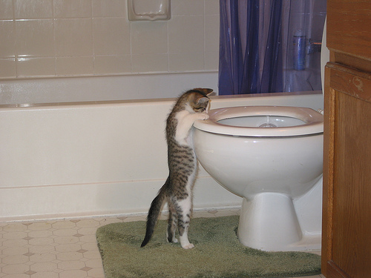
What we’re getting into next week
Specific heat, ΔH=enthalpy
and Hess’ Law
Reading:
Chapter 6
pp. 243-262

