Slide 1
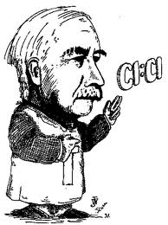
LEWIS MODEL HAS INCONSISTENCIES
WHICH HE DOESN’T BOTHER TO ADDRESS
Oh fudge off…

Slide 2
SOME ISSUES WITH THE LEWIS OCTET MODEL
How come the bond shapes in molecules look so
little like the original atomic orbitals ????
2. How does octet model account for the observed reactivity trend of ethane vs. ethene vs ethyne with halogens and ozone ?
3. How can you get all those electrons between carbons in double and triple bonds ? Don’t they repel ?

Slide 3
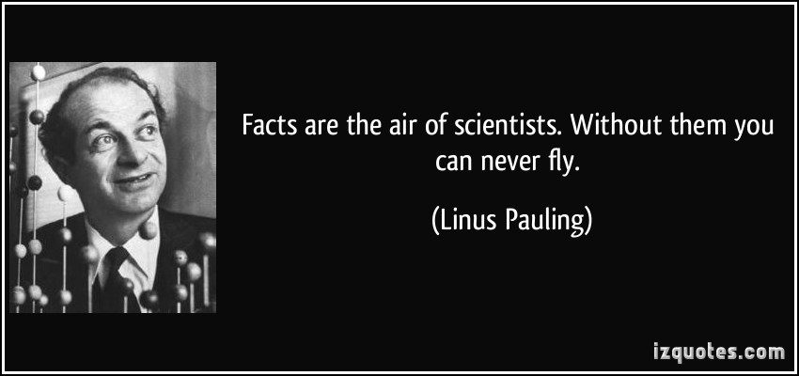
Another All- American “Superer Duperer” Chemistry Star swoops in and fixes everything (for a while)

Slide 4
Pauling’s `Localized’ Valence Bond Hybridization Model
See text: pages 205-218
PAULING’S INSIGHTS
Lewis isn’t `wrong’….he just hasn’t :
considered the role of the valence s, p, d… orbitals play
realized that all bonds are not the same.

Slide 5
Pauling’s big idea in words:
The valence shell atomic orbitals (AO) of isolated elements combine into `molecular orbitals’ (MO) on the element just prior to forming molecular bonds in molecules in a fashion that reflects the basic Lewis-predicted shapes.

Slide 6
Pauling’s big idea in equation form:
Example for Carbon:
Valence AO = 2s, 2p_{x}, 2p_{y} ,2p_{z}
The 4 AO can be recombined (mixed) into up to 4 new MO using linear combinations:
MO(1)=c₁₁ (2s) + c₂₁*(2p_{x}) +c₃₁(2p_{y}) +c₄₁*(2p_{z})
MO(2)=c₁₂ (2s) + c₂₂*(2p_{x}) +c₃₂(2p_{y}) +c₄₂*(2p_{z})
MO(3)=c₁₃ (2s) + c₂₃*(2p_{x}) +c₃₃(2p_{y}) +c₄₃*(2p_{z})
MO(4)=c₁₄ (2s) + c₂₄*(2p_{x}) +c₃₄(2p_{y})+c₄₄*(2p_{z})

Slide 7
Pauling’s big idea in picture form:
Lewis model for CO
:C≡O:
`Balloon’ (Thingies) geometry around C
C
X axis
Pauling’s MO arithmetic: The # balloons= #lobes = # AO combined starting with s then p_{x}…etc
C has two balloons=2 `MO’ lobes

Slide 8
Pauling’s big idea in picture form(continued):
Pauling’s MO arithmetic: The # balloons= #lobes = # AO combined starting with s then p_{x}…etc
C has two balloons=2 lobes
=>combine 2 AO=s + px → 2 MO lobes
+
2s +
2p_{x}
sp
C is `sp hybridized’ in CO

Slide 9
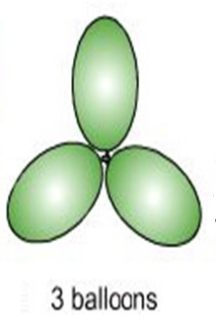
U-Do-It: What is the `hybridization’ on B in BH₃
y
x
y
x
3 MO lobes=> need 3 AO:
s + p_{x} + p_{y}
B is sp² hybridized in BH₃

Slide 10
In-Class Practice deducing hybridizations
N in NO₃⁻
sp²
C in CO₂
sp
C in CH₄
sp³
O in CO₂
sp²

Slide 11
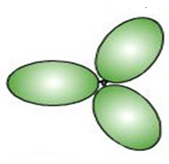
How bonds are formed from Pauling MO hybrids: O₂ example
Lewis model for O₂
Pauling hybrid MO on each O
sp²
sp²
Picture of separated MO

Slide 12
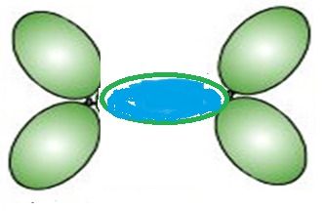
How bonds are formed from Pauling MO hybrids: O₂ example(continued)
Push separated MO together
2 electrons co-mingle/co-habitate in here
**
A sigma=σ (framework) bond

Slide 13

Another damned dumb Doc question
O₂ has two bonds between the O….What about the other one ???

Slide 14
Doc first tries to explain with his own art…☹

Slide 15
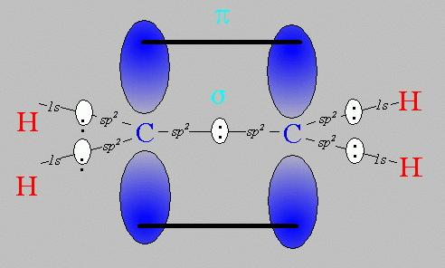
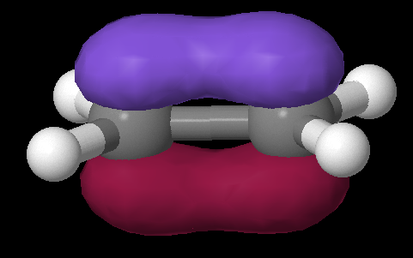
Pi (π) bonds: Pauling’s really great idea to use the `leftovers’
Equivalent Pauling `sigma’ (σ) hybrid structure
Ethene (C₂H₄) Lewis picture
σ
1 leftover p_{z} on each C
sp²
sp²
s+ p_{x} + p_{y}
s+ p_{x} + p_{y}
z
π
x
σ
y

Slide 16
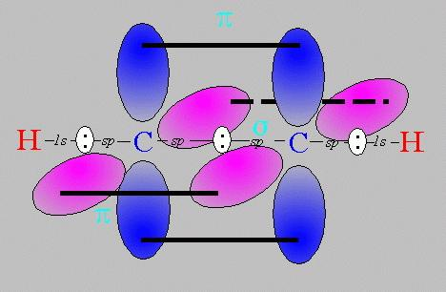
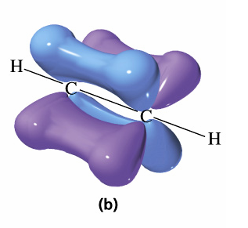
Pi bonds: Pauling’s really great idea to use the `leftovers’ (cont.)
Equivalent Pauling `sigma’ (σ) hybrid structure
Ethyne (C₂H₂) Lewis picture
σ
sp
sp
2 leftover p_{z} on each C
s+ p_{x}
s+ p_{x}
z
π
Z
x
σ
π
x
y
y

Slide 17
Describe the hybrid bond types for the compounds below, given their Lewis structures
N₂
:N≡N:
σ + 2π bonds
CO
:C≡O:
σ + 2π bonds
CO₂
σ + 1π bond

Slide 18
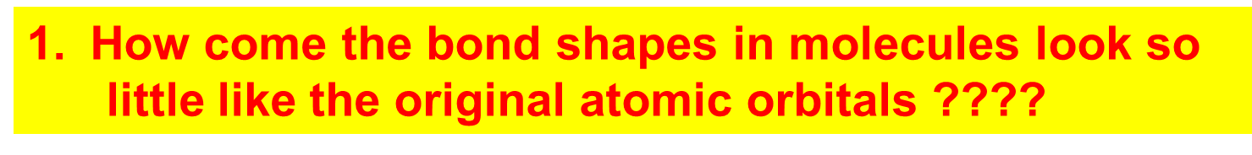
How Pauling’s model `fixes’ the problems with Lewis model
Atomic orbitals (AO) `reorganize’ (hybridize) when individual atoms approach each other such that the number of `links’ predicted by the Lewis model = the number of s, p (and d and f) orbitals combined in the reorganization. The `hybrid’ combinations are called Linear Combinations of Atomic Orbitals (LCAO). The `lobes’ in LCAO on individual atoms overlap and share two electrons between the atoms in a `sigma’ bond (often called a `valence’ or structural linkage bond.)

Slide 19
How Pauling’s model `fixes’ the problems with Lewis model
(continued)
2. How does octet model account for the observed reactivity trend of ethane vs ethene vs ethyne with halogens and ozone ?
`pi’ bonds are far less stable and far more reactive than sigma bonds. (Further out, softer, not between atoms but above and below) Ethane is held together by just `sigma bonds and is thus not very reactive.
Both ethylene and acetylene have pi bonds which are easily reacted. That acetylene is more reactive thane ethylene results because it has two pi bonds while ethylene has only 1 pi bond

Slide 20
How Pauling’s model `fixes’ the problems with Lewis model
(continued)
3. How can you get all those electrons between carbons in double and triple bonds ? Don’t they repel ?
The pi bonds occupy space above and below the sigma bond and thus do not crowd them. The two pi bonds are also on different and perpendicularly aligned planes to minimize pi-pi crowding.

Slide 21
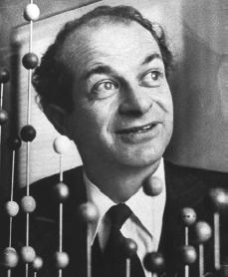
Linus Pauling
An American Chemical Genius
“I am awesome
( and kinda cute in a geeky way…)”
…one of the heroes of my chemical youth…
I
PAULING

Slide 22
Keen intuition + mathematical rigor + outside the box thinking +…he’s was a really nice guy and an inspired teacher !
FYI: You are all the great grandchildren of Linus Pauling !!!

Slide 23
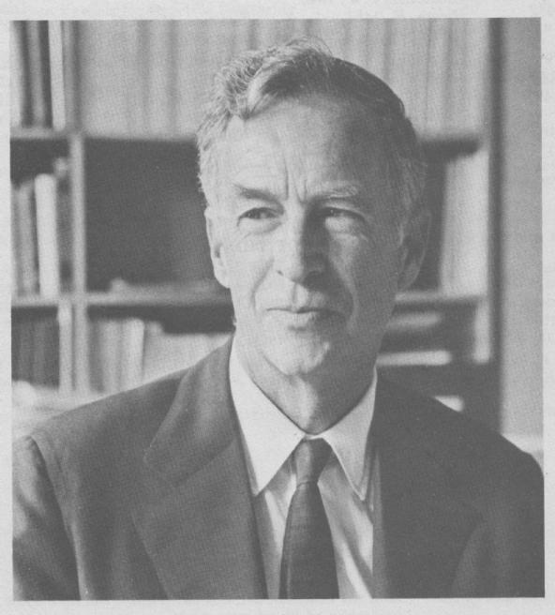
E. Bright Wilson
Harvard University, Chemistry
National Medal of Science 1975
T.W. Richards Endowed Chair
Linus Pauling
Cal Tech, Chemistry
Nobel Prize in Chemistry 1954
Nobel Peace Prize 1962

Slide 24
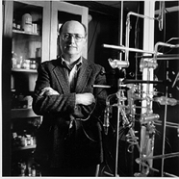
YOU !
‘Doc’ Fong
SUNY Alfred State Chemistry
Coordinator, Forensic Science Technology (and nut case)
R. L. Kuczkowski
University of Michigan, Chemistry
Department Chair

