Slide 1
FOR WEEK 11(11/2-11/6)
Suggested Homework:
Page do problem(s)
234 27,29,31
235 33,35
45,47,49
236 53,55
237 95,97
275 21,23,25,27,29,31,33,35
276 37,39,41,43,45,47
Chapter 5
pp. 193-205 VSEPR structures
pp. 205-217 hybrid bonding
Chapter 6
pp. 243-262
To do
Marathon problem 8
A Final Visit to Lewis Land
Due Monday 11 November 2013
by 4 PM

Slide 2
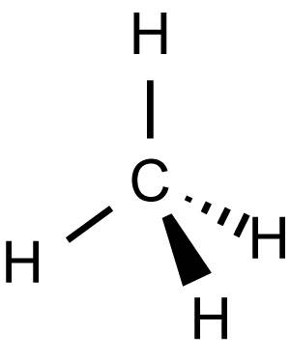
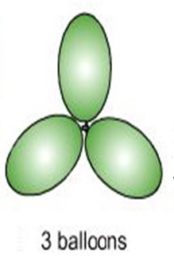
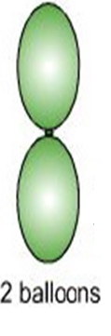
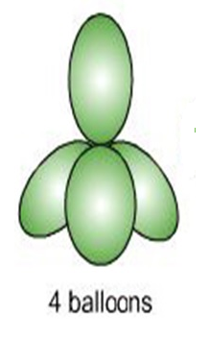
Lewis Model and Molecular Structure (pp 193-217)
(VSEPR theory : electron clouds are balloons)
:N≡N:
TRIGONAL PLANAR
LINEAR
TETRAHEDRON

Slide 3
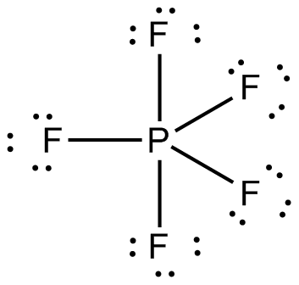
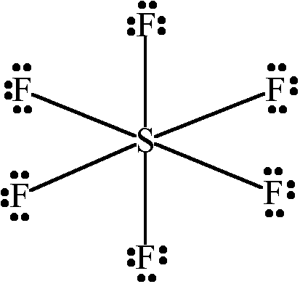
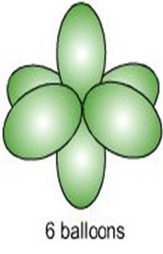
TRIGONAL BIPYRAMID
OCTAHEDRON

Slide 4
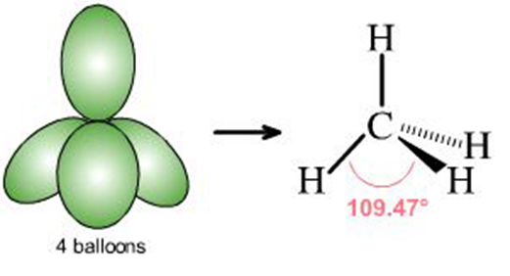
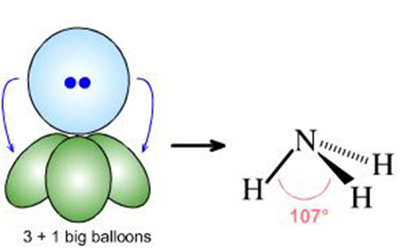
What if lone pairs take up some of the balloon space ?
No lone pairs: 4 bonds to atoms
Pyramid or tetrahedron
1 lone pair + 3 bonds to atoms
Trigonal pyramid

Slide 5
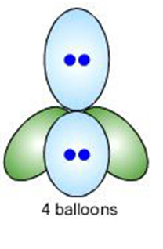

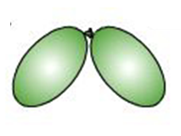
2 lone pairs + 2 bonds to atoms
Chemical example
Bent structure

Slide 6

U-try-It now…

Slide 7
Lewis structure
Relevant shape?
shape name?
Trigonal plane
formaldehyde
LINEAR
carbon dioxide

Slide 8
Lewis structure
Relevant shape?
shape name?
Bent structure
Nitrite anion
TETRAHEDRON
Sulfuric acid

Slide 9
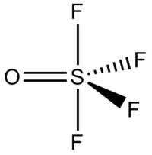
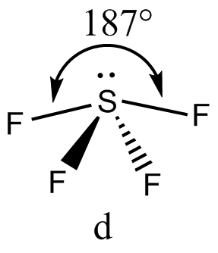
Lewis structure
Relevant shape?
shape name?
Trigonal
bipyramid
Sulfur tetrafluoride
Square pyramid
1 lone pair + 4 bonds

Slide 10
U-Predict-it From scratch…
SO₂ SO₃ SO₄²⁻
Lewis model
θ
MOLECULAR SHAPE VSEPR THEORY PREDICTS ?
Bent
Trigonal plane
pyramid
θ_{THEORY}
120^{O}
120^{O}
109.5^{O}
120^{O}
108.7^{O}
θ¹_{experiment}
119.5^{O}
¹From NIST COMPUTATIONAL COMPARISON DATA BASE (ccDB)

Slide 11
Summary of Lewis Model successes
Provides simple process leading to sensible predictions of electronic distributions in most
compounds in both ground and excited states (Extended Lewis rules)
Lewis structures lead to simple and accurate predictions of molecular shapes (VSEPR)
Lewis predictions of electronic distributions provide simple way to predict chemical interaction and relative stabilities, and provides basis for general acid-base model of reactivity. Organic Chemistry implicitly assumes Lewis model as foundation.

Slide 12
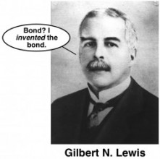
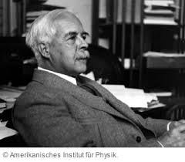

“I rock.”
America is now land of chemistry’s mega super star

Slide 13
SOME ISSUES WITH THE LEWIS OCTET MODEL (the nitpicking starts…)
How come the bond shapes in molecules look so
little like the original atomic orbitals ????
2. How does octet model account for the observed reactivity trend of ethane vs. ethene vs ethyne with halogens and ozone ?
3. How can you get all those electrons between carbons in double and triple bonds ? Don’t they repel ?

Slide 14
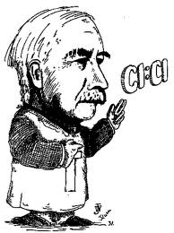
LEWIS MODEL HAS INCONSISTENCIES
WHICH HE DOESN’T BOTHER TO ADDRESS
Oh fudge off…

Slide 15

SO NOW WHAT ?

Slide 16
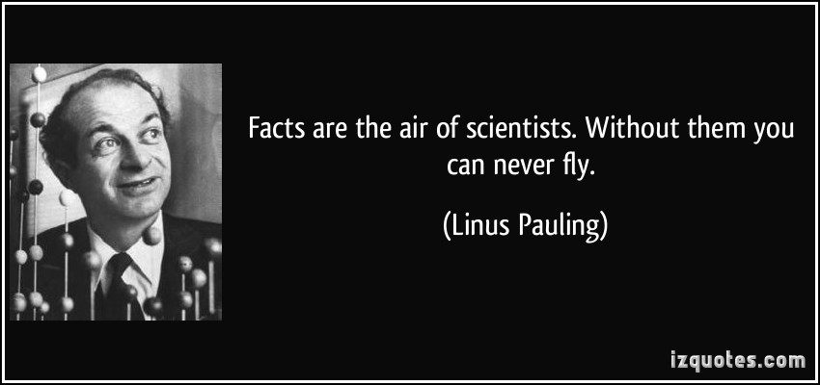
Another All- American “Superer Duperer” Chemistry Star swoops in and fixes everything (for a while)

Slide 17
Pauling’s `Localized’ Valence Bond Hybridization Model
See text: pages 205-218
PAULING’S INSIGHTS
Lewis isn’t `wrong’….he just hasn’t :
considered the role of the valence s, p, d… orbitals play
realized that all bonds are not the same.

