Slide 1
The Lewis model re-reviewed:
The original rules
All bonds contain two electrons.
All elements except H and He¹ seek an outer (valence) shell of 8 electrons.
If you can –minimize formal charge.
Added a bit later ….
4) For elements from Si onwards, break the octet rule to satisfy rule 3.
5) Watch out for resonance possibilities.
¹H and He are satisfied with 2 electrons= `duet’ rule

Slide 2
U-Do-it Examples where we minimize formal charge or simply break octet rule-
a) SO₂ SO₃ SO₄²⁻
What is the octet rule prediction for SO₂ ?
What will be the S-O bond order in SO₄²⁻ ?
(2+2+1+1)/4= 1.5

Slide 3
U-Do-it Examples where we minimize formal charge or simply break octet rule (continued)
b) H₃PO₄ PO₄³⁻
What will be the P-O bond order in PO₄³⁻ ?
(1+1+1+2)/4= 5/4 =1.25

Slide 4
U-Do-it Examples where we minimize formal charge or simply break octet rule (continued)
c) HClO₄ ClO₄¹⁻
What will be the Cl-O bond order in ClO₄⁻?
(2+2+2+1)/4 =7/4= 1.75

Slide 5
U-Do-it Examples where we minimize formal charge or simply break octet rule (continued)
d) PF₅ SF₆ really stable too!

Slide 6

The `big picture’ for the Lewis model, so far:
The Lewis Model of Bonding Tells Chemists:
Bond order and electron ownership
Formal charge distributions
Excited state configurations (COCl₂ example)
Whether resonance exists (or not)

Slide 7

The Lewis model also provides:
Insight into chemical reactivity.
Predictions of Molecular structure (VSEPR theory pp. 193-217)

Slide 8
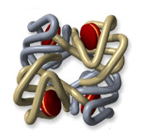
Lewis and chemical reactivity: some simple examples
1) CO and blood
Fe³⁺
vs.
-
CO has 200-400X stronger electrostatic attraction to Fe³⁺ from formal charge vs. O₂. Explains why CO so easily asphyxiates humans even at `low’ concentrations (400 ppm)…it never lets go of the Fe³⁺

Slide 9
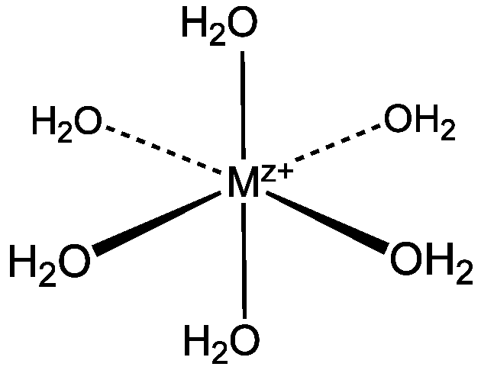
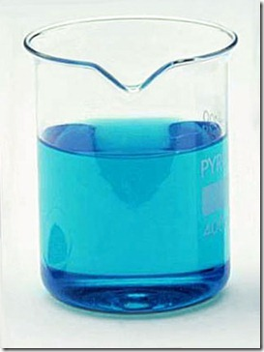
Lewis and chemical reactivity: some simple examples (cont.)
2) complexation of metals
Aquo complexes of metals’
color related to lone pair bonding to M^{z+}
Cu(OH₂)₆²⁺

Slide 10
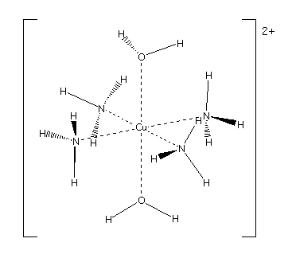


Change the source of the lone pair….. changes the color

Slide 11
Lewis and chemical reactivity: some simple examples (cont.)
In biology we need bacteria and light to fix N₂ (convert to C-N single bonds). Chemically it is very hard to `fix’ N₂ .Why ??
3 bonds are tough to rupture
When H₂O and CO₂ mix to make carbonic acid (essence of Sprite), what goes where to make the acid ??
+2δ
- 2δ
- δ
+ δ

Slide 12
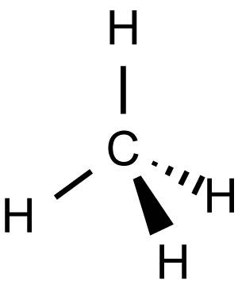
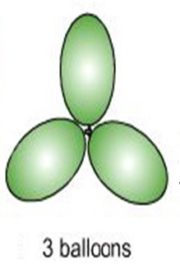
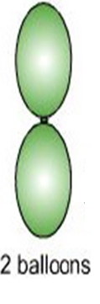
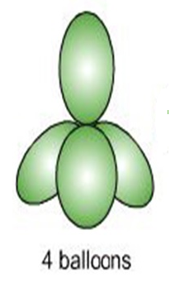
Lewis Model and Molecular Structure (pp 193-217)
(VSEPR theory : electron clouds are balloons)
:N≡N:
TRIGONAL PLANAR
LINEAR
TETRAHEDRON

Slide 13
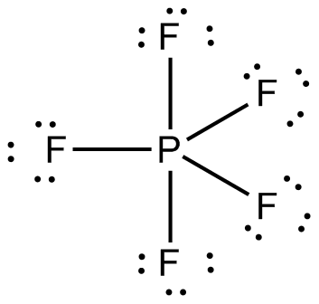
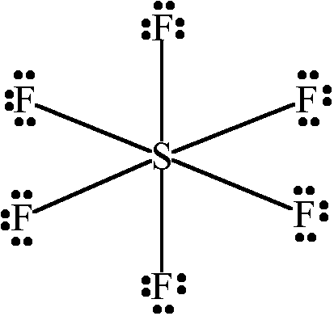
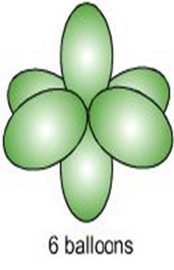
TRIGONAL BIPYRAMID
OCTAHEDRON

Slide 14
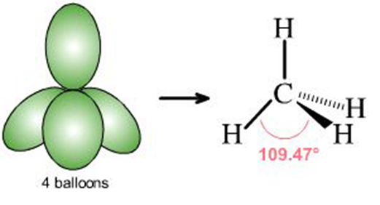
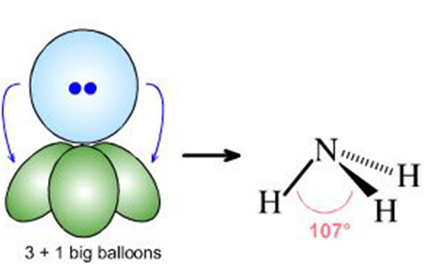
What if lone pairs take up some of the balloon space ?
No lone pairs: 4 bonds to atoms
Pyramid or tetrahedron
1 lone pair + 3 bonds to atoms
Trigonal pyramid

Slide 15
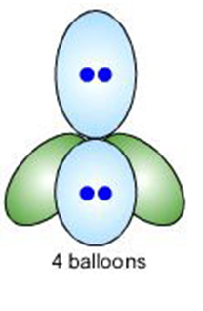
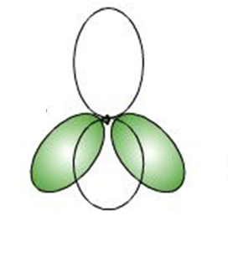
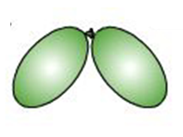
2 lone pairs + 2 bonds to atoms
Chemical example
Bent structure

Slide 16
Lewis structure
Relevant shape?
shape name?
Trigonal plane
formaldehyde
LINEAR
carbon dioxide

Slide 17
Lewis structure
Relevant shape?
shape name?
Bent structure
Nitrite anion
TETRAHEDRON
Sulfuric acid

Slide 18
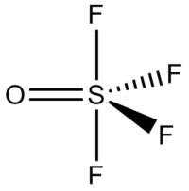
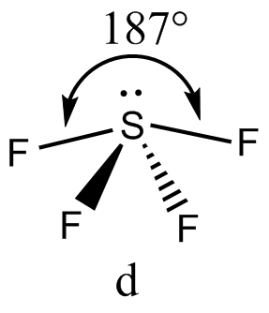
Lewis structure
Relevant shape?
shape name?
Trigonal
bipyramid
Sulfur tetrafluoride
Square pyramid
1 lone pair + 4 bonds

