Slide 1
IN-CLASS BOARD OCTET RULE PRACTICE WITH::
Diatomics O₂ √ N₂ √ CO √
tri, tetra-atomics CO₂ H₂O OF₂ COCl₂
√ √ √ √
√ √
MORE…?? H₂O₂, SO₂

Slide 2
UGLY CHEMICAL FACT OF LIFE #1
For many compounds the Lewis octet prediction of bond lengths don’t match experiment.
Example 1: Ozone O₃
Lewis model prediction
Expect O-O length = 15 pm
Expect O=O length = 12 pm
Observe : Both bond lengths
are identical=13.5 pm

Slide 3
Example 2: Benzene C₆H₆
Lewis Model and HONC prediction
Expect C-C lengths= 16 pm
Expect C=C lengths = 13 pm
Observe: all C-C lengths are identical = 14.5 pm

Slide 4
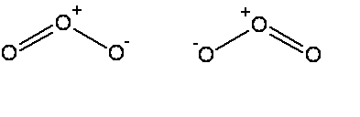


The common thread: if electrons can be moved to make the same molecule => `resonance’
Resonance structure
All bonds are equivalent
in resonance
structures
Resonance structure

Slide 5
`RESONANCE’ circulates the electrons evenly between participating atoms so that the bond lengths between those atoms are identical and an average of the possible single/ double bond distributions.
O-O length = 15 pm
O=O length = 12 pm
Observed O-O bonds all = 13.5 pm
Average = 13.5 pm
C-C lengths= 16 pm
C=C lengths = 13 pm
Average = 14.5 pm
Observed C-C bonds all
= 14.5 pm

Slide 6
U-Do-it: Oxyanion examples of resonance
NO₂⁻ NO₃⁻ CO₃⁻²
What is the static octet prediction for each ?
b) What is the actual, expected bond order to O for each example ?
3/2=1.5
4/3=1.333
4/3= 1.333

Slide 7
BEYOND THE OCTET RULE: FORMAL CHARGE
UGLY CHEMICAL FACT OF LIFE #2:
For elements starting with Si in the 3rd row, the octet rule is often broken.
EXAMPLE #1: BATTERY ACID (H₂SO₄)
From Experiment
(Kuczkowski et. al. 1983)
Lewis octet prediction for H₂SO₄ structure

Slide 8
U-Do-it Examples where we minimize formal charge or simply break octet rule-
a) SO₂ SO₃ SO₄²⁻
What is the octet rule prediction for SO₂ ?
What will be the S-O bond order in SO₄²⁻ ?
1.5

Slide 9
U-Do-it Examples where we minimize formal charge or simply break octet rule (continued)
b) H₃PO₄ PO₄³⁻
What will be the P-O bond order in PO₄³⁻ ?
5/4 =1.25

Slide 10
U-Do-it Examples where we minimize formal charge or simply break octet rule (continued)
c) HClO₄ ClO₄¹⁻
What will be the Cl-O bond order in ClO₄⁻?
7/4 =1.75

Slide 11
U-Do-it Examples where we minimize formal charge or simply break octet rule (continued)
d) PF₅ SF₆

Slide 12

The `big picture’ for the Lewis model, so far:
The Lewis Model of Bonding Tells Chemists:
Bond order and electron ownership
Formal charge distributions
Excited state configurations (COCl₂ example)
Whether resonance exists (or not)

Slide 13

The Lewis model also provides:
Insight into chemical reactivity.
Predictions of Molecular structure (VSEPR theory pp. 193-217)

Slide 14
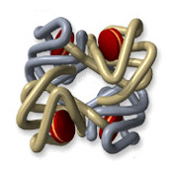
Lewis and chemical reactivity: some simple examples
1) CO and blood
Fe³⁺
vs.
-
CO has 200-400X stronger electrostatic attraction to Fe³⁺ from formal charge vs. O₂. Explains why CO so easily asphyxiates humans even at `low’ concentrations (400 ppm)

Slide 15
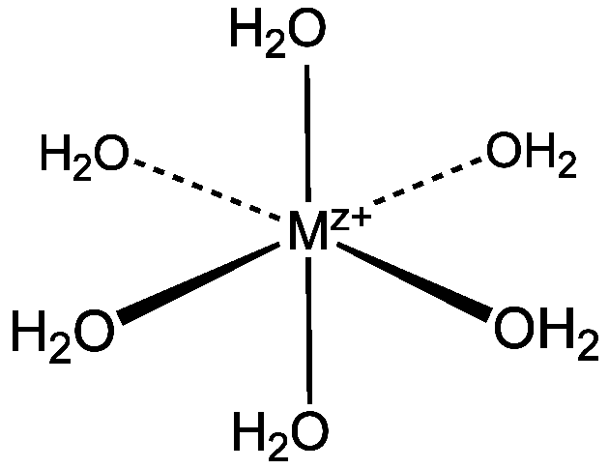
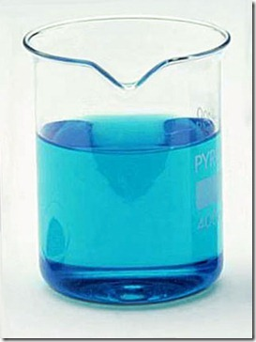
Lewis and chemical reactivity: some simple examples (cont.)
2) complexation of metals
Aquo complexes of metals’
color related to lone pair bonding to M^{z+}
Cu(OH₂)₆²⁺

Slide 16
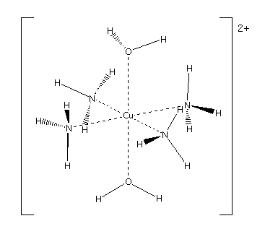


Change the source of the lone pair- change the color

Slide 17
Lewis and chemical reactivity: some simple examples (cont.)
In biology we need bacteria and light to fix N₂ . Chemically it is very hard to `fix’ N₂ (convert to C-N single bonds). Why ??
3 bonds are tough to rupture
When H₂O and CO₂ mix, to make carbonic acid (essence of Sprite), where do the H and O go ??
+2δ
- 2δ
- δ
+ δ

