Slide 1
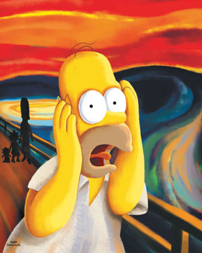
EXAM 2
MONDAY 28 OCTOBER
MOLE CALCULATIONS
ELECTRONIC TRENDS
Naming (from lab)
BONDING MODELS
  IONIC
  COVALENT

Slide 2
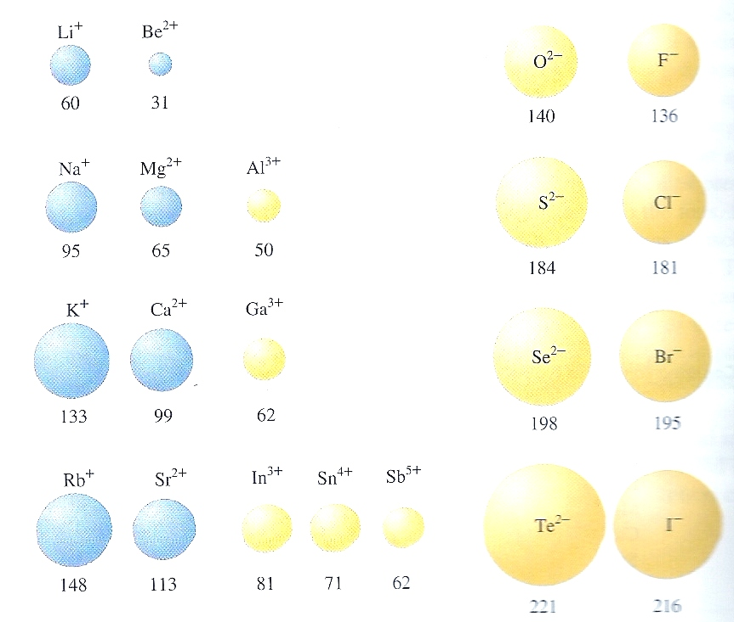
Trends in cation and anion radii
Figure 4.8 page 156
Cations and Anions
enlarge
Cations shrink
Anions~ same size

Slide 3
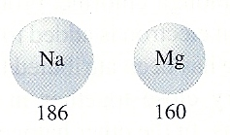
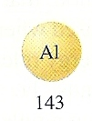
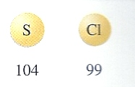
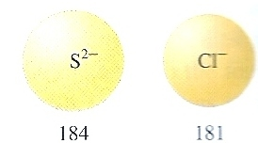

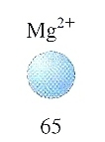

Ionic vs. neutral element sizes to scale
Neutral elements in row 3
Radii in pm
Equivalent stable ions in row 3

Slide 4
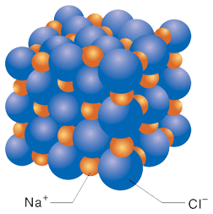
NaCl spacing to scale

Slide 5
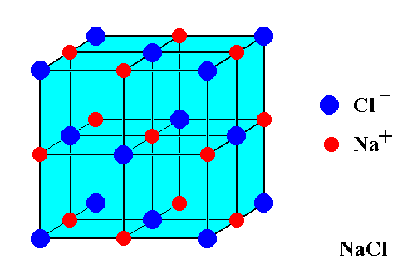

Ionic compounds form regular lattices of several sorts:
Cs⁺ Cl⁻
Body-centered cubic crystal arrangement (bcc)
Face-centered cubic crystal arrangement (fcc)

Slide 6
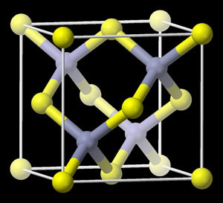
More crystallographic shapes of ionic species
S²⁻
Zn²⁺
`zinc blende’ (ZnS) cubic
(tetrahedron of Zn inside ~fcc box of S)

Slide 7
Open hyperlinks to see:
Micro-crystal (flat, no dendrites) growth (30 s)
http://www.youtube.com/watch?v=gPYc7_rFuW4
Micro-crystal Sheafs, flowers (4 min+)
http://www.youtube.com/watch?v=eHfO8pmaXMg
Radish seeds’ root growth (time lapse) 47 s
http://www.youtube.com/watch?v=d26AhcKeEbE

Slide 8
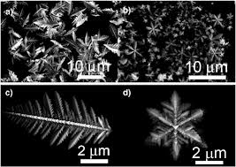
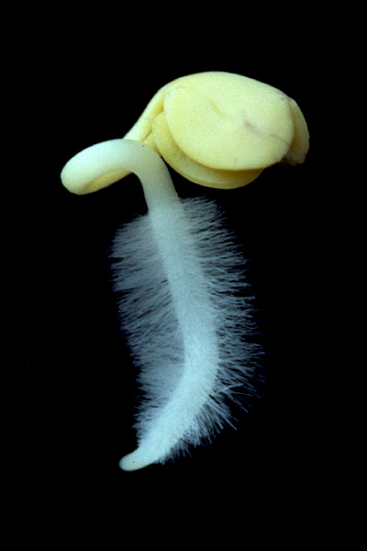
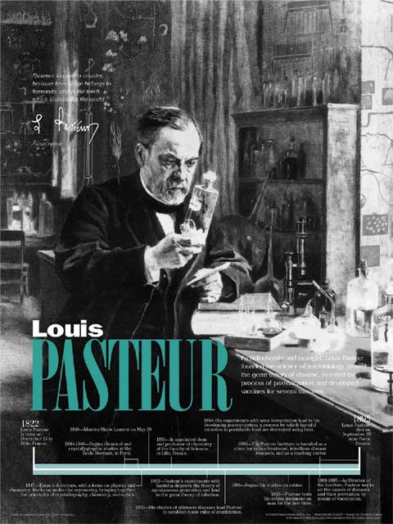
Intriguing Factoids related to crystal growth
1) Louis Pasteur (chemist of pasteurization and rabies cure fame) was so impressed with the way crystal growth mimicked bio-growth he spent the first 10 years of his scientific career trying to see if micro-crystals could spontaneously self-assemble into life.
??

Slide 9
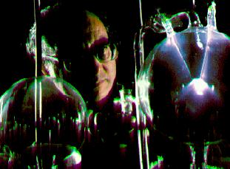
Intriguing Factoids related crystal growth
(continued)
2)Leslie Orgel (famous modern organic chemist) examined previously unstudied samples from Urey-Miller experiment * left in a freezer for over 30 years.
*Original Urey-Miller result:
electricity
HCN+ NH₃+ H₂O small amino acids
Orgel’s analysis of frozen mixture of original result
Small amino acids
Proteins, short segments of DNA !!

Slide 10
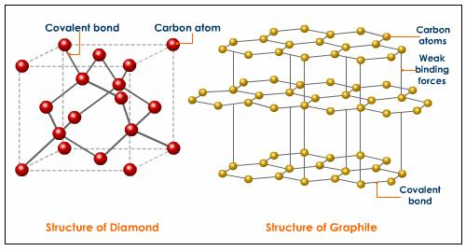
A hint of big changes about what holds covalent (non-ionic) compounds together:
none of the ionic compounds have the crystal shapes below:

Slide 11
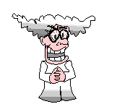
Are all compounds held together like LiF ???
THE CONDUCTIVITY TEST
Material Tested
Lights up filament ?
H₂O
CO₂ in H₂O
Paraffin oil ?
Sugar in H₂O
LiF

Slide 12
Another dumb Doc question:
“If the atoms in a compound don’t light up the bulb (not ionic) then how are the electrons distributed if not like ionic case ??”

Slide 13

The Americans land…
G.N. Lewis 1925 AD: using the Periodic table to predict covalent bonding patterns without breaking a sweat…Father of an American-style Chemistry that looks at the big picture and uses simple, intuitive models .
(sans calculations …)*
* We know how to use the fancy math…but not if there’s an easier way.

Slide 14
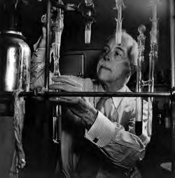
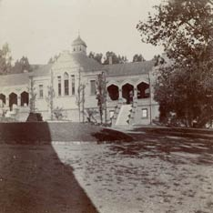
Legacies of the American chemist:
Gilbert Newton Lewis
Gilbert Newton Lewis American Chemist UC Berkeley “at work” ~1930
Before Lewis: UC Berkeley Chemistry Building ~1915

Slide 15
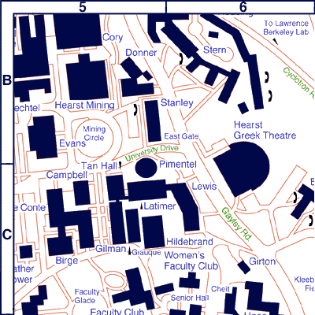
Chemistry `Quad’
UC Berkeley 2013
+ more `on the hill’ at L-L Labs

Slide 16
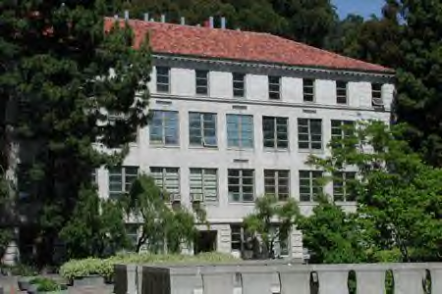
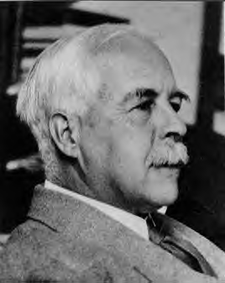
As young chemistry
nerd …Young Doc
Fong sits in here
staring every day
at a 4’x 6’ photo of…
The House that Lewis Built: Lewis Hall of Chemistry
UC Berkeley

Slide 17
Lewis `octet’ model (pp. 168-182)
The Lewis model In a nutshell:
All bonds contain two electrons.
All elements except H and He¹ seek an outer (valence) shell of 8 electrons.
If you can –minimize formal charge.
For elements from P onwards, you can break the octet rule and use rule 3.
¹H and He are satisfied with 2 electrons= `duet’ rule

Slide 18
Recipes to `cook’ the Lewis way:
p. 170 Problem solving strategy
p. 175 Review
p. 181 Rules Governing formal charge

Slide 19
IN-CLASS BOARD PRACTICE WITH::
Diatomics O₂ N₂ CO
tri, tetra-atomics CO₂ H₂O SOCl₂
oxyanions NO₃⁻ CO₃⁻ SO₄²⁻
Non-Lewis octet SO₄²⁻ SO₃ PF₅ SF₆
MORE…??

