Slide 1
FOR WEEK 9 (10/21-10/25) ~same as for week 8
Suggested Homework:
Page do problem(s)
184 23, 25
185 27, 29, 31
186 37, 39, 41, 43, 45, 51
188 73, 75, 79, 81, 87
+ 89, 91 (new)
189 93, 95
234 21,23, 25, 29 (for ex. 21)
Reading:
Chapter 4
pp. 149-153 electronegativity
and dipoles
pp. 154-157 ionic model
pp. 157-161 Born-Haber (new)
pp. 168-182 covalent model
Chapter 5
pp. 193-205 VSEPR structures
To do
Marathon problem 7
A Salt on your Brain
Due Monday 28 October

Slide 2

Are all compounds held together like LiF ???
THE CONDUCTIVITY TEST
Material Tested
Lights up filament ?
H₂O
CO₂ in H₂O
Paraffin oil ?
Sugar in H₂O
LiF

Slide 3
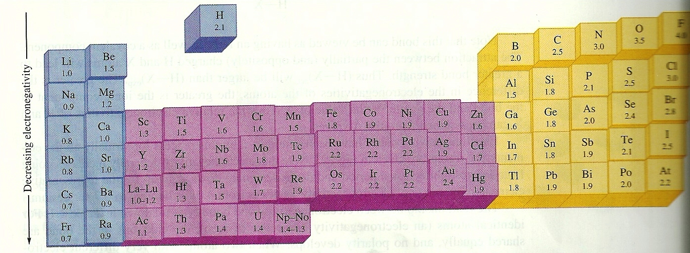
How do we `rank’ element combos in terms
of their tendency to be like LiCl or sugar ?
Linus Pauling’s Electronegativity (χ=chi) Scale
(p. 151 fig. 4.3)
Increasing electronegativity
= electron ‘suckativity’

Slide 4
Using the Pauling’s Electronegativity χ Scale
A
B
Liquid phase Conductivity
|χ_{A} - χ_{B}|
Bond character
0-0.4
Like sugar (covalent )
0.4-0.9
Like acetone (mostly
covalent-but some polarity)
0.9-1.9
Like Water (quite polar
but still sort of covalent)
> 2
Like Table salt… all ionic…

Slide 5
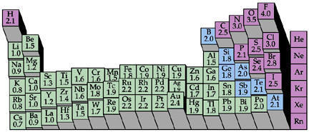
In general, ionic compounds are formed from
(column 1 and 2= + cations) +(column 6 and 7= - anions)
6 7
1 2
The fact that the melts of ionic compounds all conduct electricity means the individual atoms are charged + and -

Slide 6
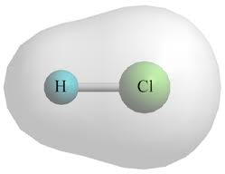
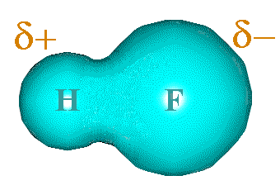
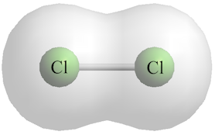
In general, polar bonds forms such that the higher
χ element has a more of the electrons than the lower χ element. Larger Δχ => the bigger the `bond dipole’ (pg. 151-152)
Δχ=0.9
Δχ=0
Δχ=1.9

Slide 7
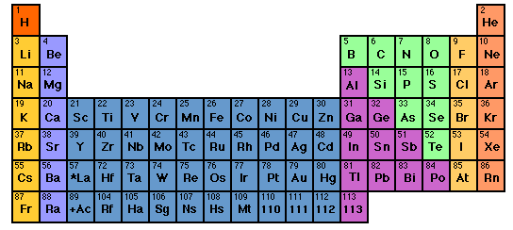
Trends in binary ionic and near-ionic formulas
LiCl
Li₂O
Li₃P
Trends down a column
M_{a} X_{b} …all M’s combine the same for a given X
NaCl
Na₂O
Na₃P
KCl
K₂O
K₃P

Slide 8
Trends in ionic and not ionic compound formulas
HCl
NaCl
Na₂O
Na₃P
CH₄
NH₃
H₂O
MgCl₂
MgO
Mg₃P₂
Al₂O₃
AlP
Is there a simple pattern here ??
Trends across columns

Slide 9
The rule of 8 ( early version of the `octet rule’ for building compound formulas)
The sum of column numbers of elements combined in many simple¹ binary compounds add to 8.
Col 2 6
Example:
CaO
2+ 6=8
¹simple ionic compounds ~formed of column 1- 2 elements (cations) with columns 5-7 (anions)

Slide 10
More examples of the rule of 8
Col 1 7
NaCl
1 + 7 = 8
Col 1 6
Li + Se→??
2*1+6=8
Li₂Se

Slide 11
You predict formulas for….
H+ N
H + O
K + P
3*1+5=8=>H₃N=NH₃
2*1+6=8=>H₂O
3*1+5=8=>K₃P

Slide 12

Is it safe to assume the rule of 8 works all the time ????

Slide 13
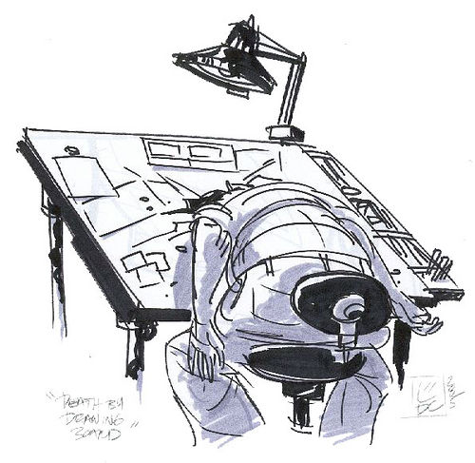
…what about…
col 2 5
Mg + N ???
Actual formula Mg₃N₂
Rule of 16 ??? 3*2 +2*5=16 =2x8
(ICKY…too much math for us Americans) ☹

Slide 14
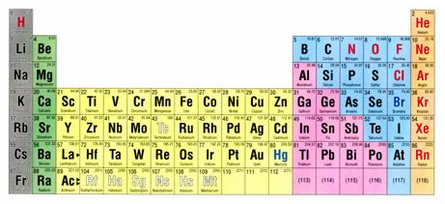
Thinking about the curious case of column 8
1 2 3 4 5 6 7 8

Slide 15
What’s so curious ??
8
The “Noble” Elements are utterly stable …
Noble gas chemistry
0
None
Nada
…And what’s with this number 8 ??
Noble…because like all aristocrats they have nothing to do with any of the lower class elements.

Slide 16
The crazy stability of the noble gas electronic configuration is the key to a better model for predicting ionic and near-ionic compound formulas (see also: p. 155-6)
Example:
CaO
Ca= [Ar]4s²
O=[He]2s²2p⁴
Lose 2 e-
gain 2 e-
Ca²⁺=[Ar]
O²⁻ =[He]2s²2p⁶=[Ne]

Slide 17
Lewis dot pix for atoms
+2
-2
Ca
Ca
O
O
Complete octets
(ns² np⁶)
Ar
Ne
[CORE]
VALENCE
Ca= [Ar]4s²
O= [He]2s²2p⁴

Slide 18

A quick visual way to know element charges
Cations: count left to col 8 for + charge
Anions: count right to col 8 for - charge
+2
-3
…but don’t do this with transition metals

Slide 19
Knowing cation and anion charges lets us predict binary compound formulas.
EXAMPLE:
Predict compound made of Na and S
1)FIND PREFERRED CHARGES
+1
-2
Na
S
2
1
2)“CROSS” CHARGE MAGNITUDES

Slide 20
In-Class practice:
Deducing formulas for…
Ca + Cl
CaCl₂
Al + O
Al₂O₃
B + N
BN
K + S
K₂S
Mg+ As
Mg₃As₂

Slide 21
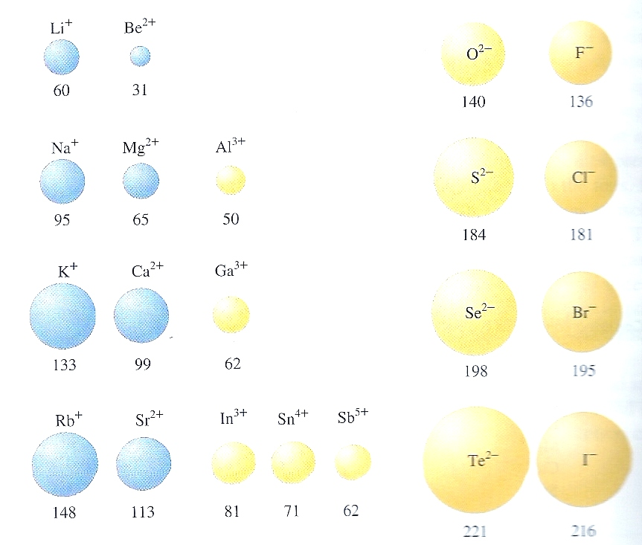
Trends in cation and anion radii
Figure 4.8 page 156
Cations and Anions
enlarge
Cations shrink
Anions~ same size

Slide 22
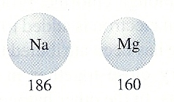
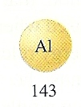
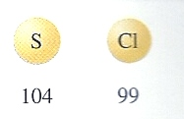
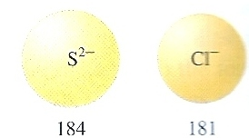

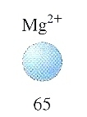

Ionic vs. neutral element sizes to scale
Neutral elements in row 3
Radii in pm
Equivalent stable ions in row 3

Slide 23
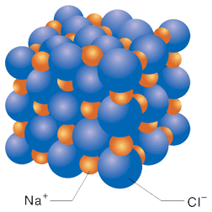
NaCl spacing to scale

Slide 24
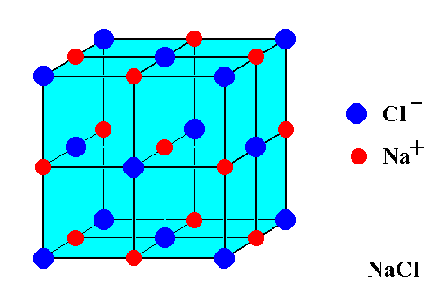

Ionic compounds form regular lattices of several sorts:
Cs⁺ Cl⁻
Body-centered cubic crystal arrangement (bcc)
Face-centered cubic crystal arrangement (fcc)

Slide 25
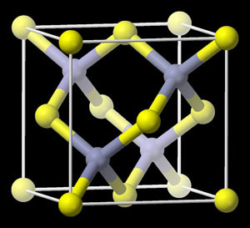
More crystallographic shapes of ionic species
S²⁻
Zn²⁺
`zinc blende’ (ZnS) cubic
(tetrahedron of Zn inside ~fcc box of S)

Slide 26
Open hyperlinks to see:
Micro-crystal (flat, no dendrites) growth (30 s)
http://www.youtube.com/watch?v=gPYc7_rFuW4
Micro-crystal Sheafs, flowers (4 min+)
http://www.youtube.com/watch?v=eHfO8pmaXMg
Radish seeds’ root growth (time lapse) 47 s
http://www.youtube.com/watch?v=d26AhcKeEbE

Slide 27
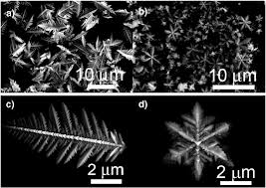
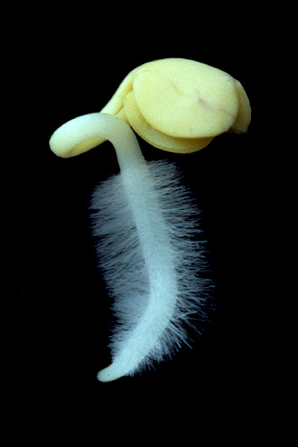
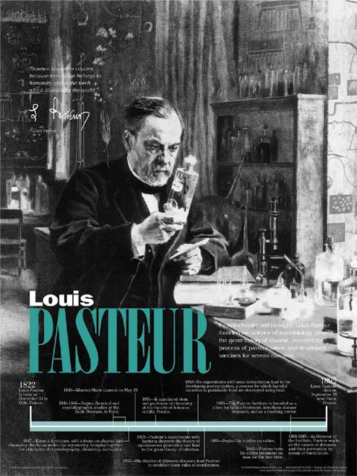
Intriguing Factoids related to crystal growth
1) Louis Pasteur (chemist of pasteurization and rabies cure fame) was so impressed with the way crystal growth mimicked bio-growth he spent the first 10 years of his scientific career trying to see if micro-crystals could spontaneously self-assemble into life.
??

Slide 28
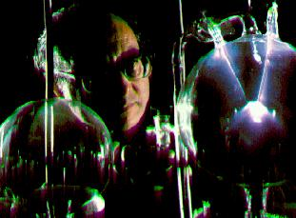
Intriguing Factoids related crystal growth
(continued)
2)Leslie Orgel (famous modern organic chemist) examined previously unstudied samples from Urey-Miller experiment * left in a freezer for over 30 years.
*Original Urey-Miller result:
electricity
HCN+ NH₃+ H₂O small amino acids
Orgel’s analysis of frozen mixture of original result
Small amino acids
Proteins, short segments of DNA !!

Slide 29
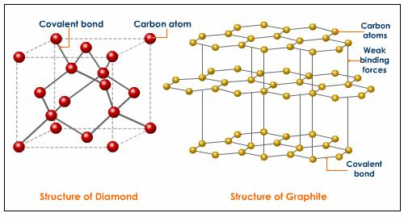
A hint of big changes about what holds covalent (non-ionic) compounds together:
none of the ionic compounds have the crystal shapes below:

