Slide 1

Who we have become over the last 3 weeks:
Basic mole and `body part’ calculations (pp.112-124)
% composition problems/combustion analysis (pp.384-392)
Reaction balancing (pp. 392-395)
Reaction stoichiometry predictions (pp. 396-400)
Limiting yield and % yield calculations (pp. 400-406) chapter ends

Slide 2

Why our ~3 week morph into mole people:
Mole thinking is what led us to:
knowing which elements and how many of each combine in compounds.
knowing what compounds transform to during reactions.
Mole thinking laid the foundation of all modern chemical knowledge

Slide 3
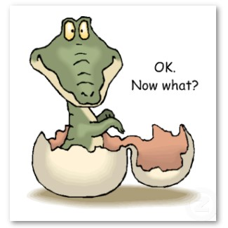

Slide 4
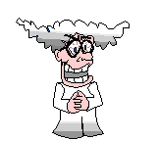
Doc asks a few more of his dumb questions.
“Ok…so we know that water is H₂O,
salt is NaCl…
Why don’t we ever see HO₂ and Na₂Cl…
…and what holds H₂O and NaCl together in the first place ? Same?? Different ????”

Slide 5

To answer Doc’s dumb questions we take a hike through several chemical bonding theories

Slide 6
Relevant Reading:
Chapter 4-Bonding General Concepts
pp. 149-153 electronegativity and dipoles
pp. 154-157 ionic model
pp. 168-182 covalent model

Slide 7
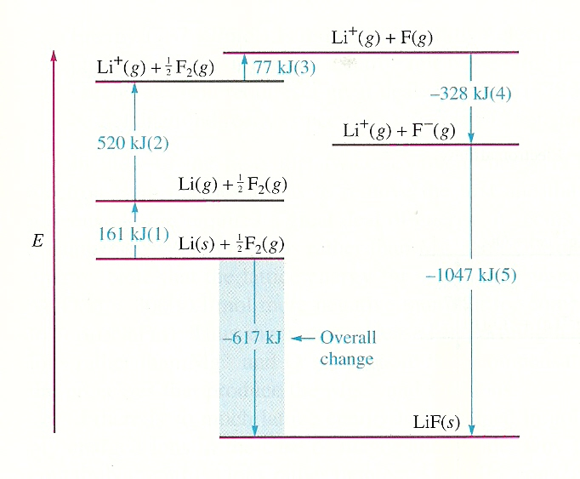
What holds a salt like LiF together ?
=>Chief `bonding’ force in LiF is +…- attraction
(=Lattice energy see p. 158)
Born-Haber Diagram for LiF (see Figure 4.9 page 159 of text)

Slide 8
Putting Lattice energy magnitudes in context
Lattice energy=1047 kJ/mol LiF
= 1047 kJ/26 g LiF
During normal operation, a typical American home uses 1-2 kW=1-2 kJ/second ~1.5 kJ
Energy released in forming 26 grams of LiF from gas phase Li⁺ and F⁻ can power your house for:
1047 kJ = 698 s (~ 12 minutes)
1.5 kJ s⁻¹

Slide 9
Are all compounds held together like LiF ???
THE CONDUCTIVITY TEST
Material Tested
Lights up filament ?
H₂O
CO₂ in H₂O
Paraffin oil ?
Sugar in H₂O
LiF

Slide 10
Molten salt example
(open hyperlink to see)
http://www.youtube.com/watch?v=ePzEVPDyJV8

Slide 11
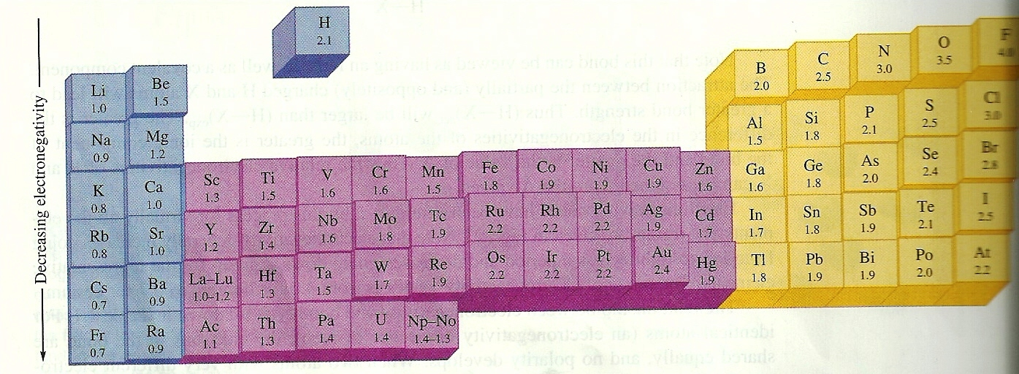
How do we `rank’ element combos in terms
of their tendency to be like LiCl or sugar ?
Linus Pauling’s Electronegativity (χ=chi) Scale
(p. 151 fig. 4.3)
Increasing electronegativity
= electron ‘suckativity’

Slide 12
Using the Pauling’s Electronegativity χ Scale
A
B
Liquid phase Conductivity
|χ_{A} - χ_{B}|
Bond character
0-0.4
Like sugar (covalent )
0.4-0.9
Like acetone (mostly
covalent-but some polarity)
0.9-1.9
Like Water, HCl (quite polar
but still sort of covalent)
> 2
Like Table salt all ionic…

Slide 13
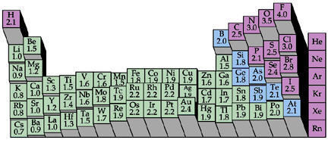
In general, ionic compounds are formed from
(column 1 and 2= + cations) +(column 6 and 7= - anions)
6 7
1 2

Slide 14
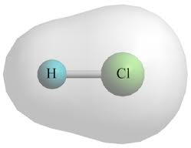
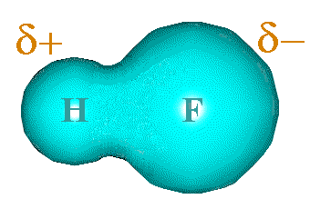
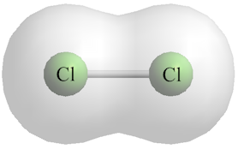
In general, polar bonds forms such that the higher
χ Element has a more of the electrons than the lower χ element…the larger the difference, the bigger the `bond dipole’ (pg. 151-152)

