Slide 1
Review of main lesson from Monday 8/26
If chemists have never had direct experience with what they study, what the hell is chemistry anyhow ?
∴Chemistry is a set of imaginative metaphors and techniques for understanding things we can’t know directly.

Slide 2
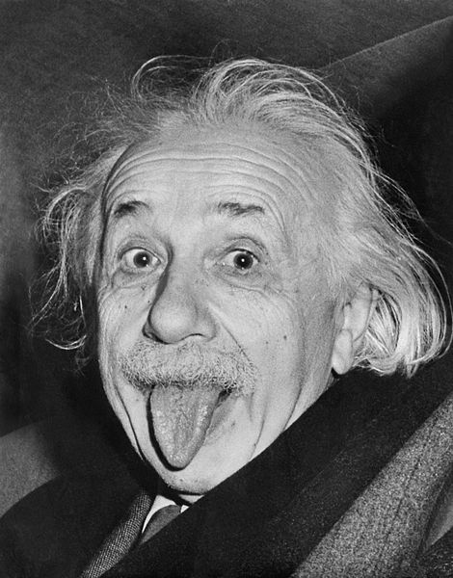
Today:
We start to scope out the freakish behavior and dimensions of electrons both inside and outside of atoms, behavior, which, according to this guy is…
“Spooky science.”

Slide 3

But first…a brief, annoying detour into units…
(see also: pp. 2-3)

Slide 4
Accepted unit system in all sciences ?
SI = Systĕme International units
Distance in meters (m)
Mass in kilograms (kg)
Time in seconds (s)
See others in Table R.1 p. 2

Slide 5
Metric-metric conversions
Among scientists, there are always `squabbles’ over preferred `metric’ measures
Examples of common units used to express bond lengths in molecules:
nm = nanometers
mμ = millimicrometers
pm = picometers
Å = angstroms (=10⁻¹⁰ m)

Slide 6
It’s really about preferences in
Unit prefixes
(see also-table R.2, pg 3 and Supplement 1) know these
Prefix symbol | Prefix name | Math equivalent
T | tera | 10¹²
G | giga | 10⁹
M | mega | 10⁶
k | kilo | 10³
d | deci | 10⁻¹
c | centi | 10⁻²
m | milli | 10⁻³
μ | micro | 10⁻⁶
n | nano | 10⁻⁹
p | pico | 10⁻¹²

Slide 7
Two typical metric-Metric conversion problems
(see also-Supplement 1)
How many ng in 5 mg ?
How many Thz in 30 Mhz ?

Slide 8

`Contemporary’ Chemistry starts when we start addressing the question:
“What is an atom made of and how do the atoms of different elements differ ?” (text, p. 44)
Today’s main lesson:
What’s inside the atomic cookie….
and more importantly how do we reason our way to this from experiment???
Notes:
Review first: simple dimple chemical heory…atoms of different elements combine like little balls to form molecules (p. 40) …poll class on what they think is inside the atom.
Mention Dalton…

Slide 9
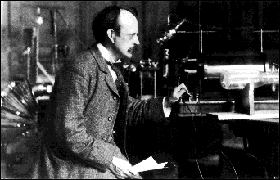
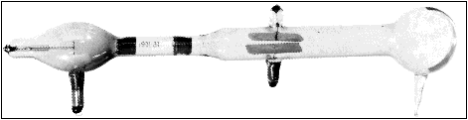
The first try at mapping the atomic cookie:
J. J. Thomson’s `Plum Pudding Model’ : 1897 (see text p.45 )
J.J. Thomson Cavendish Labs, Cambridge UK
J.J’s `Cathode Ray Tube’ (CRT)*
*factoid: Thomson was said to be astonishingly bad in the lab and fumble-fingered; the CRT was made by a gifted glassblower, E. Everett

Slide 10
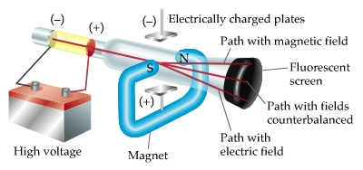
Atomic structure: try 1 –Thomson’s atom (continued)
Schematic of Thomson’s critical experiments
1)Battery voltage tears something (e-) away from metal cathode
2) e⁻ beam from cathode (- plate)
accelerated towards (+) plate
3) Fields applied and results observed on `TV’ screen
Notes:
Explain results on board….emphasize field directions vs. charge (lorentz rh rule for magnet; like repels like for electrical

Slide 11
Atomic structure: try 1-Thomson’s atom (continued)
Basic result of Thomson’s CRT experiments:
All the materials subjected to high voltage in the tube vomited the same kind of `negative’ particles-dubbed the electron.
Thomson’s Conjecture from his CRT experiments
If all matter has negative electrons, there must be a counterbalancing positive glue that sticks to and neutralizes the electrons’ negative charge (since matter is normally neutral).

Slide 12
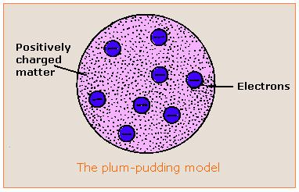
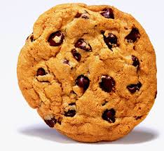
Atomic structure: try 1 –Thomson’s atom (continued)
Thompson’s conjecture morphed into the first experimentally derived atomic model:
“The Plum Pudding Model”¹
Cookie metaphor -if you’ve never had plum pudding
¹ J.J. Thomson Cathode Rays,
Philosophical Magazine 44, 295 (1897)

Slide 13
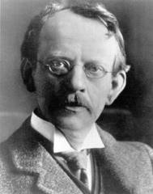
Your 3rd critical thinking challenge:
What doesn’t Thomson know about the atomic bits and pieces and what criticisms can you level about his model?
“What’s wrong with my Plum Pudding model, you feckless young maggots ?”
Notes:
Capture student thoughts on board. 1)Mass and densities of – and + parts; 2)size of the atom; 30 distribution of + and -

Slide 14
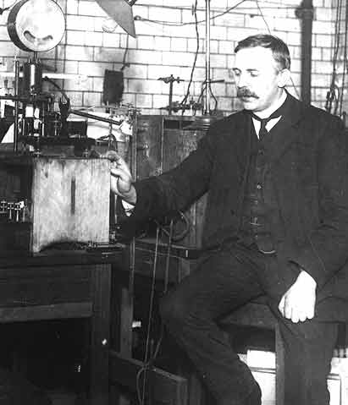
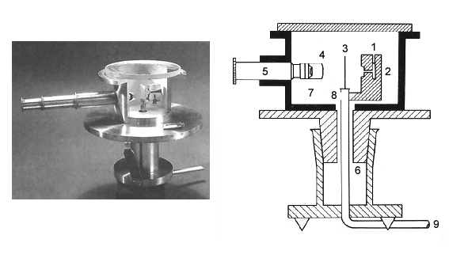
Testing the plum pudding atom: Rutherford’s gold foil experiment (1910) (see also: page 46 of text)
Ernst Rutherford
Physical Laboratory
Manchester University, UK
Rutherford’s Gold foil apparatus*
*Factoid: it’s really his students-Geiger and Marsden- who machine the device and do the measurements.

Slide 15
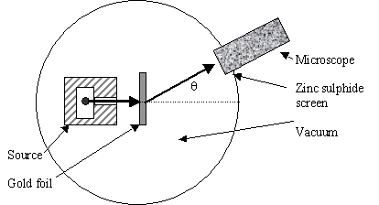
Atomic structure: testing Thomson’s Plum Pudding atomic model (continued)
Schematic of Rutherford’s `gold foil’ apparatus
Microscope
Rotated to detect scintillations
Alpha (α) particles=He⁺
ZnS screen is a scintillating surface
Gold Foil Experiment lore
Marie Curie supplied the radon =α source.
It required ~ 1 hour sitting in absolute dark to condition eyes.
You could only observe scintillations for 1-2 minutes before
desensitizing.

Slide 16
Atomic structure: testing Thomson’s Plum Pudding Atomic Model(continued)
Other Facts about the Gold Leaf Experiment not mentioned in text:
α particles move crazy fast:
velocity ~ 0.1c ~7*10⁷ mph
(can get to NYC from here in ~0.01 sec)
α particles are crazy overweight compared to the electrons (e-) in a gold atom:
~800X heavier than all 79 e- in gold atom
The gold foil is crazy thin:
~ 8.6*10⁻⁶ cm thick
(~1/3000 the thickness of cheap toilet paper )

Slide 17
Atomic structure: testing Thomson’s Plum Pudding Model (continued):
Reminder of the Plum Pudding Model being tested

Slide 18
Your 4th critical thinking challenge:
Given the three facts about gold leaf experiment:
α particles are moving crazy fast
α particles are enormously heavier compared to all electron mass in gold atom.
Gold film is impossibly thin (1/3000 of toilet paper)
What should happen to the α particles as they are shot at the gold leaf if the gold atoms are as Thomson proposes ??
Notes:
Capture student thoughts on board. Let them speculate…make sure their reasoning is sensible.

Slide 19
Plum Pudding model predicts that all the massive α particles will pass ~un-deflected through gold foil made of diffuse matter
α particles

Slide 20
What actually happens…
Rutherford’s observations mostly agree with above.
But sometimes a few curve off significantly…
And once and in a great while, one bounces back. !
Gold foil

Slide 21
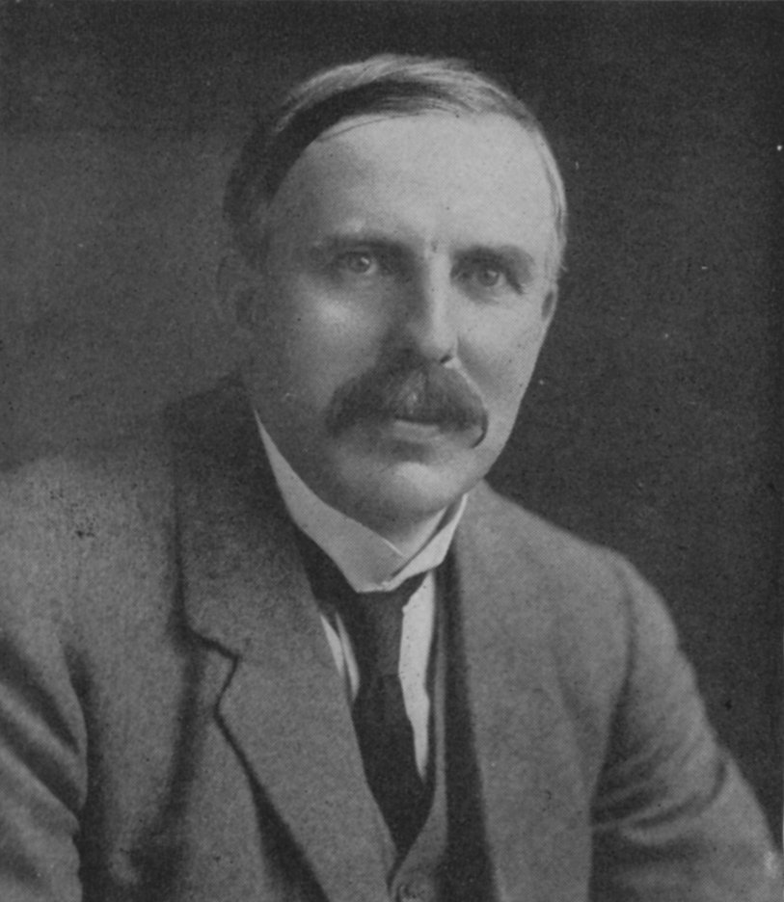
Atomic structure: testing Thomson’s Plum Pudding Atomic Model(continued)
Rutherford’s famous `take’ on Marsden and Geiger’s results:
“Like firing a howitzer at tissue paper and having the shell bounce back !!”

Slide 22
Your 5th critical thinking challenge:
Given the results of Rutherford’s (Geiger & Marsden’s) experiment which model of the atom makes most sense and why ?:
A)Electrons in ring outside;
Positives in thin ring inside
C)Electrons in ring outside;
Positives in large ball inside
B)Electrons in diffuse cloud outside;
Positives in tiny ball inside
Notes:
Capture student thoughts on board. Let them speculate…make sure their reasoning is sensible.

Slide 23
Atomic structure: Rutherford’s Atomic Model
Rutherford’s Atom:1911
The Second Experimentally-Based Model of the Atom
Electrons in diffuse cloud around tiny (but massive) positive charged nucleus.
E. Rutherford, F.R.S. The Scattering of α and β Particles by Matter and the Structure of the Atom
Philosophical Magazine Series 6, vol. 21, p. 669-688 (1911)

Slide 24
Dimensions of Rutherford atomic model*
*derived from statistics of gold leaf scattering experiment
Nuclear radius ~10⁻¹⁵ meters
Electronic cloud radius ~ 10⁻¹⁰ meters
Electronic radius/Nuclear radius ~ 10⁺⁵
Masses of subatomic pieces**
Subatomic piece | Mass (g) | Relative mass
proton
1.67*10⁻³⁰
1
neutron
1.67*10⁻³⁰
1
electron
9.11*10⁻³⁴
0.0005
** from J. Aston development of mass spectroscopy at Cavendish Labs (w/Rutherford as its’ new Director)

Slide 25
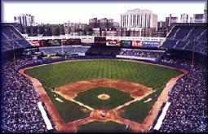


Atom dimensions in familiar terms: Metaphor 1
Electrons start here (~2.4 miles past cheap seats)
3”
Baseball as nucleus
Old Yankee Stadium, the Bronx
Notes:
Show how calculation was done on board

Slide 26

Nucleus(+)
~ dimension of Rutherford’s electronic cloud (-) (2.4 mile radius from baseball nucleus)
Notes:
Stadium at 1. E. 161st st., Bronx NY 14051

Slide 27
Metaphor 2:
pencil dot and string
Pencil dot = nucleus
~ 0.02 cm radius
Electron orbit is 100,000X nuclear radius
Electron orbit radius =??
0.02 cm * 100,000 = 2000 cm
(for us `dumb’ Americans, that’s ~ 66 ft
66 ft of string= electron radius

