Slide 1
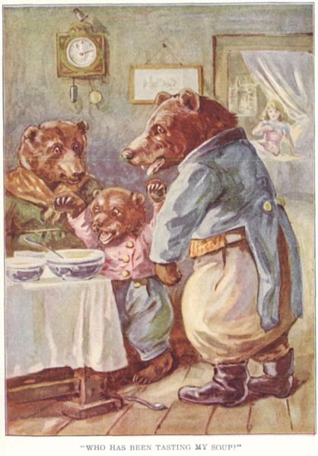

Reaction Stoichiometry and the story of Goldilocks and the 3 Bears…a demo
Mama Bear
O₂/C₃H₈>>5
Papa Bear O₂/C₃H₈<<5
Baby Bear
O₂/C₃H₈ ≡5
Goldilocks: wantonly commits breaking and entering felony
The outraged victims….

Slide 2
Simple mol-mol stoichiometry conversions
C₃H₈ + 5O₂--------→ 3CO₂ + 4H₂O
How many moles of O₂ will burn to form 1.2 moles of CO₂ ?
Method 1: factor label
1) given
2) want
1.2 mol CO₂
* 5 mol O₂
3 mol CO₂
= ? mol O₂
2
3) Use reaction stoichiometry coefficients in right ratio to cancel and connect…which ratio ???

Slide 3
Mol-mol stoichiometry conversions (continued)
Method 2: `mole ratios’
C₃H₈ + 5O₂--------→ 3CO₂ + 4H₂O
?? m
1.2 mol
Problem stated visually
How many moles of O₂ will burn to form 1.2 moles of CO₂ ?
1) ratio `wanted’ moles in numerator to given in denominator
m
1.2
5
3
2) Set equal to matching coefficients for compounds given in reaction…which ???
=
1.2* m= 1.2 *5
1.2 3
= 2
3)Solve for m

Slide 4
More complex stoichiometry problem done 2 ways
MW 44 32 44 18 g/mol
C₃H₈+ 5O₂ → 3CO₂+ 4H₂O
22 grams of C₃H₈ burned with O₂ makes how many grams of H₂O ?
Method 1: factor label
22 g C₃H₈
x
1 mole C₃H₈
44 g C₃H₈
x
4 mol H₂O
1 mole C₃H₈
x
18 g H₂O
1 mol H₂O
1) Given
= ?? g H₂O
36
2) Want
3)Find ratios that lead to desired units from reaction and MW …which ???...do on board

Slide 5
Method 2: mole ratio way (Board first)
22 grams of C₃H₈ burned with O₂ makes how many grams of H₂O ?
Given:
44 32 44 18 g/mol
Problem
stated
visually
C₃H₈+ 5O₂ → 3CO₂+ 4H₂O
?? g
22 g
0) convert all given masses and molecule counts to moles
1) ratio `wanted’ moles in numerator to given in denominator
2) Set equal to matching coefficients for compounds given in reaction…which ???
3) Solve for wanted moles
4) Convert wanted moles to wanted final units (grams)

Slide 6
Method 2: mole ratio way
22 grams of C₃H₈ burned with O₂ makes how many grams of H₂O ?
Given:
44 32 44 18 g/mol
Problem
stated
visually
C₃H₈+ 5O₂ → 3CO₂+ 4H₂O
?? g
22 g
0) convert all given and molecule counts to moles
22 g C₃H₈ * 1 mol C₃H₈
44 g C₃H₈
= 0.5 mol C₃H₈
1) ratio `wanted’ moles in numerator to given in denominator
m = mol H₂O
0.5 mol C₃H₈
= 4
1
2) Set equal to matching coefficients for compounds given in reaction…which ???

Slide 7
Method 2: mole ratio way
22 grams of C₃H₈ burned with O₂ makes how many grams of H₂O ?
Given:
44 32 44 18 g/mol
C₃H₈+ 5O₂ → 3CO₂+ 4H₂O
?? g
22 g
3) Solve for wanted moles
m
0.5
= 4
1
0.5 *
*0.5
= 2 mol H₂O
4) Convert wanted moles to wanted final units (grams)
2 mol H₂O * 18 g H₂O
1 mole H₂O
= 36 g H₂O

Slide 8
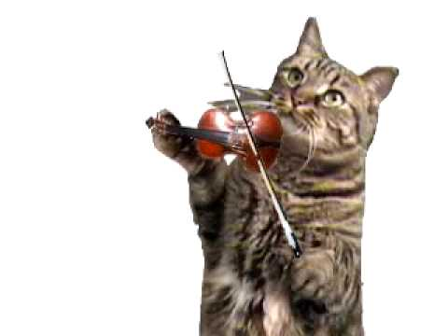
AN ANECDOTE
An `out-of-towner’ visiting NYC for the first time asks Joshua Bell (world’s greatest violinist):
“How do you get to the Lincoln
Center for the Performing Arts ?”
Joshua’s answer (supposedly):
“Practice,
practice,
practice….”

Slide 9
Sample Reaction 1 Chemical Stoichiometry Problems Solved in Detail
Sample reaction 1
C₃H₈ + 5O₂------ 3CO₂ + 4H₂O (BOOM)
44 32 44 18 g/mol

Slide 10
C₃H₈ + 5O₂--------→ 3CO₂ + 4H₂O (BOOM)
44 32 44 18 g/mol
a) moles to moles
How many moles of O₂ will burn to form 0.60 moles of CO₂ ?
1) Set up mole ratio
Mol O₂ = m(O₂) = 5
Mol CO₂ 0.6 3
2) Solve for m
m(O₂) = 5*0.6 => m=1
3

Slide 11
C₃H₈ + 5O₂--------→ 3CO₂ + 4H₂O (BOOM)
44 32 44 18 g/mol
b) moles to weight
How many grams of CO₂ are generated if
0.00757 moles of C₃H₈ are burned?
Set up mole ratio
Mol CO₂ = m(CO₂)_ = 3
Mol C₃H₈ 0.00757 1
2) Solve for m
m(CO₂) = 3*0.00757
=0.02217
3) Convert moles m to weight
Weight CO₂ = m(CO₂) * MW(CO₂)
= 0.02217*44= 1 g

Slide 12
C₃H₈ + 5O₂--------→ 3CO₂ + 4H₂O (BOOM)
44 32 44 18 g/mol
c) weight to moles
How many moles of H₂O form if 11 g of C₃H₈ are burned ?
1) convert non-moles to moles
11 g C₃H₈* 1 mol C₃H₈
44 g C₃H₈
= 0.25 mol C₃H₈
2) set up mole ratios
mol H₂O = 4 = m(H₂O)
mol C₃H₈ 1 0.25
Solve for m
4*0.25 = m(H₂O) =1 mol H₂O
5

Slide 13
C₃H₈ + 5O₂--------→ 3CO₂ + 4H₂O (BOOM)
44 32 44 18 g/mol
d) weight to weight
How many grams of O₂ are needed to burn 0.275 g
C₃H₈ ?
1) Convert g→mole
0.275/44=0.00625 mol C₃H₈
2a)Ratio target mol/known mol
Mol O₂/mol C₃H₈=5/1 = m(O₂)/0.00625
2b) solve for target moles, m
m(O₂) = 5*0.00625
= 0.03125
3) Convert target moles to mass desired
Weight O₂ = m(O₂)*MW(g/mol)
=0.03125*32
= 1 g O₂

