Slide 1
FOR WEEK 4 (9/16-9/20)
Suggested Homework:*
Page do problem(s)
p. 106 103,105,106,111,113
p. 107 115, 117, 119, 121
Re-Reading:
pp. 73-80 (quantum)
pp. 82-98 (spdf song +)
….91-98 in particular
To Do:
Exam 1
Friday 20 September
Challenge problem
Problem 154 page 109
Due Monday 23 September by 4 PM
*Periodic Trends, discussed on pp. 91-98, will be part of Exam 1. The assigned problems are typical of what to expect.

Slide 2
Exam 1 headers and point distribution
1.0 Really Basic Stuff from Chapter R (6 pts)
1.1 Rounding and Significant Figures (9 pts)
1.2. Metric-English conversion (3 pts)
1.3. Metric-metric conversions ( 9 pts total)
1.4. Basic Wave calculations (show work) (4 pts total)
1.5. Photoelectric Effect and Planck’s Equation (show work) (10 pts)
1.6. The Long, Twisting Evolutionary Path of the Atomic Model (23 pts)
1.7. Electronic Configurations (20 points)
1.8 Quantum Number Predictions for the Atom (10 pts)
1.9 Periodic Trends (4 pts)

Slide 3
Write the correct, abbreviated configurations for…
Cu
[Ar] 3d¹⁰ 4s¹
Co³⁺
[Ar] 3d⁵ 4s¹
Fe²⁺
[Ar] 3d⁵ 4s¹

Slide 4
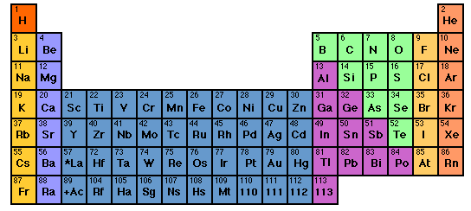
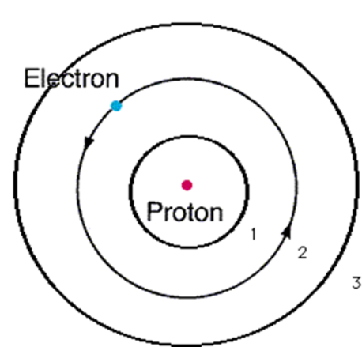

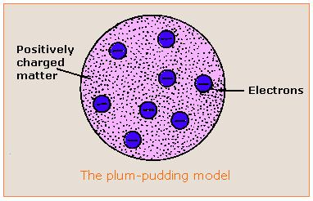
Evolution of the atomic model ….
4) Experimental
Spectroscopy Rules
~ 1930
3) Bohr Model
1913
2)Rutherford Model
1911
1) Thomson Model
1897
1s²2s²2p⁶….
Philosophical
Magazine Series 6
26. 1-25 (1913)
Philosophical
Magazine Series 6,
21, 669-688 (1911)
My way or the highway…
Philosophical Magazine
44, 295 (1897)

Slide 5
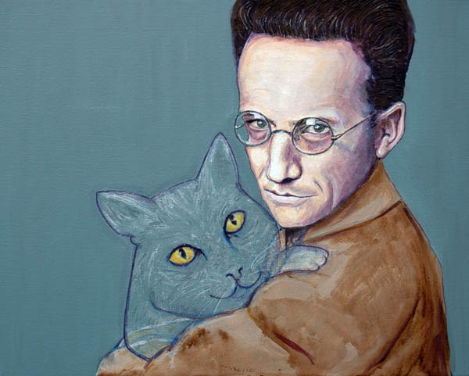

Model 5: the `final’ solution for the H atom (pp. 73-80):
Erwin Schrödinger’s Equation and Modern Quantum Theory
His theory in a nutshell:
Find ψ & E by solving the `eigenvalue’ problem:
Text p. 74
Schrödinger’s equation
2) ψ*(x)ψ(x)dx = P(x)
P(x) =probability of e⁻ being at x=> shape of orbitals

Slide 6
What P(x)=ψ*(x)ψ(x)dx means:
Electrons are now you see it, now you don’t bits of atomic popcorn
Electron here t=t₁
Electron has P(x) chance to `pop out’ at x=distance from nucleus.
It must be somewhere at all times…just can’t say where…
Electron
here at t=t₃
Electron starts here, t=0
Nucleus magnified 100,000X
Electron
here t=t₂
Electron
Here t=t₄….

Slide 7
Model 5: the `final’ solution for the H atom (pp. 73-80):
Erwin Schrödinger’s Equation and Modern Quantum Theory
His theory in a nutshell (continued): …The really important bit for chemists:
3) The possible states of the e⁻ turn out to depend on 4 quantum numbers: n, L, m_{L} and m_{s} which are connected by some simple counting rules
(See text tables 2.1 and 2.2 pp 76-7)

Slide 8
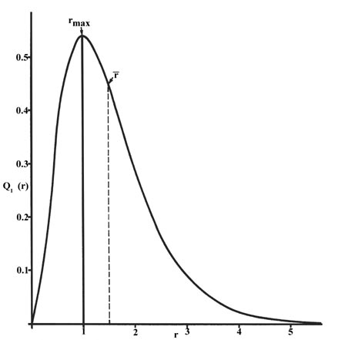
Schrödinger’s prediction of 1s electron’s Probability of being in a thin shell at distance r from H nucleus:
See also: text p. 75 Fig. 2.13
predicts effects of magnets (m_{L})
E_{H} (1s) =-13.6 eV (predicted)
E_{H} (1s) =-13.6 eV (observed)
0.52 nm (Schrödinger prediction)
0.52 nm = observed effective radius of
ground state H atom

Slide 9


The even better news: Schrödinger’s methods can be extended with success (and some reasonable approximations) to explain the rest of the elements’ spectra.
..so are theoreticians (sort of)
The spectroscopists are happy

Slide 10



the quantum cat dilemma-one consequence of
Schrodinger’s ψ
Kitty state =ψ = f₁ ϕ₁ + f₂ϕ₂
(According to Schrodinger’s physics)
f₁ ~ 1, but not quite f₂ ~ 0 but not quite

Slide 11

Another animated,
Abused quantum cat-in-a-box
story….

Slide 12
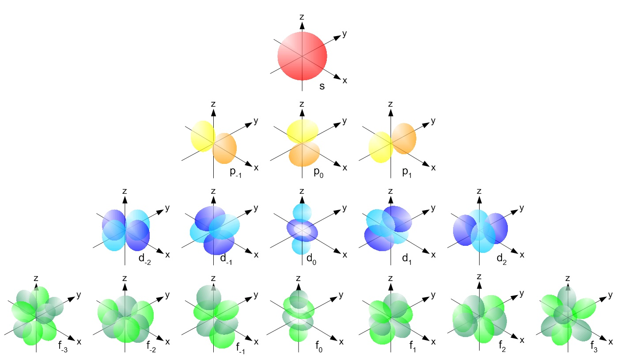
A new wrinkle from Schrödinger: orbital shapes are tied to new quantum numbers (see also: figures 2.14-2.18 pp. 77-79 of text)
HIGHER
ENERGY
Low E→ high E in magnetic field
L=0=>s
0
m_{L}= -L,(-L+1)… +L
L=1=>p
-1
0
+1
L=2=> d
L=3=> f
-2
-1
0
+1
+2
-3
-2
-1
0
+1
+2
+3
HIGHER

Slide 13
Counting Rules for assigning atomic electrons to:
n, L,m_{L} and m_{s} (see also: Table 2.2 p. 77)
Lower quantum numbers => lower energy
n=1,2,3…
=Principal quantum numbers (Bohr’s old quantum number for shells)
Given n:
L =n-1,n-2…0
Given L:
m_{L}= -L, (-L+1), (-L+2)…0, 1,2…+L
Any specific n,L,m_{L} has two possible `spin states’:
m_{s}= ½ or – ½

Slide 14
Each electron in the Schrödinger model gets a unique set or `address’ made of 4 quantum numbers: n, L, m_{L} and m_{s}
[n L m_{L} m_{s}]
The atomic electron’s `social security number’
(or apartment address)

Slide 15
Examples of allowed, one electron `addresses’ for n=2 from Schrödinger model (low→ high E)
n L m_{L} m_{s}
Low E*
2 0 0 +1/2
2 0 0 -1/2
2 1 -1 +1/2
2 1 -1 -1/2
2 1 0 +1/2
2 1 0 +1/2
2 1 1 -1/2
High E
*A positive ( +) m_{s} value is considered lower in energy since experimentalists designated the spin state that is coincident with an applied magnetic field as +1/2 . This is lower in energy than when the spin opposes the field.(m_{s} =-1/2) Schrodinger’s equations didn’t originally include spin states.

Slide 16
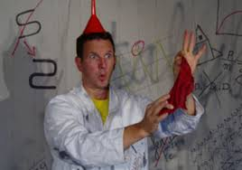
Schrödinger’s quantum number counting rules ~recreate the structure of the Periodic Table !
…A BRIEF IN -CLASS EXPOSITION

Slide 17
IN-class practice using the rules and language described on pp. 73-80
Problem 77 page 105:
How many orbitals in an atom can have the designation:
5p
3d_{z2}
4d
n=4
3
1
5
16

Slide 18
IN-class practice using the rules and language described on pp. 73-80 (continued)
Problem 79 page 105:
Give the maximum number of electrons that have these quantum numbers:
n=4
b)n=5, m_{L}=+1
e)n=2, L=1
32
8
6

