Slide 1

A CHEERFUL REMINDER FROM YOUR CHEM 1984 LAB INSTRUCTOR:
LISTEN UP, MAGGOTS !
BRING YOUR SCIENTIFIC CALCULATOR AND ITS INSTRUCTION MANUAL TO THE FIRST LAB, OR YOU DIE.

Slide 2
FOR WEEK 1 (8/26-8/30)
Reading:
Course syllabus
About Doc (website under Miscellaneous)
Review Chapter R
Supplement 1
Chapter 1: pp 44-50
Suggested Homework:*
Page do problem(s)
24 15a,b,c,f,h
17a, b
25 19
21a,d
23b,d
25a,c,f
(see also supplement 1)
26 39a,b
41a,b
49,51,53,57,59,61
28 65
To Do:
Write a letter introducing your self (1-2 pages max)
major
Hometown
> 1 juicy fact about you
Due: 8/28 in class
*Friday 8/30 quiz will
be from assigned Reading and problems similar to above

Slide 3


Images listed after `Googling’ Chemist
1st image listed
3rd image listed

Slide 4


4th image listed
5th image listed

Slide 5


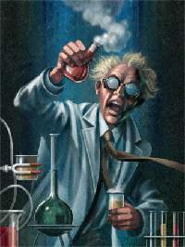

Other Google images under `chemist’

Slide 6
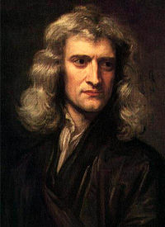
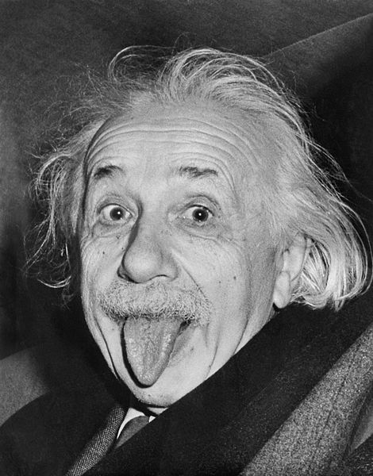
Images listed after Googling’ Physicist
1st image listed
4th image listed

Slide 7
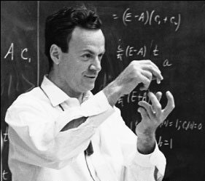
Trends w/ Physicist pix
In the first 20 images listed, all are pictures of real & famous physicists.
Einstein is in 5 out of the 20.
All 20 are men.
6th listed.
For fun and mole $ can you name him.
R. Feynman
Cal Tech
1965 Nobel Prize in Physics

Slide 8
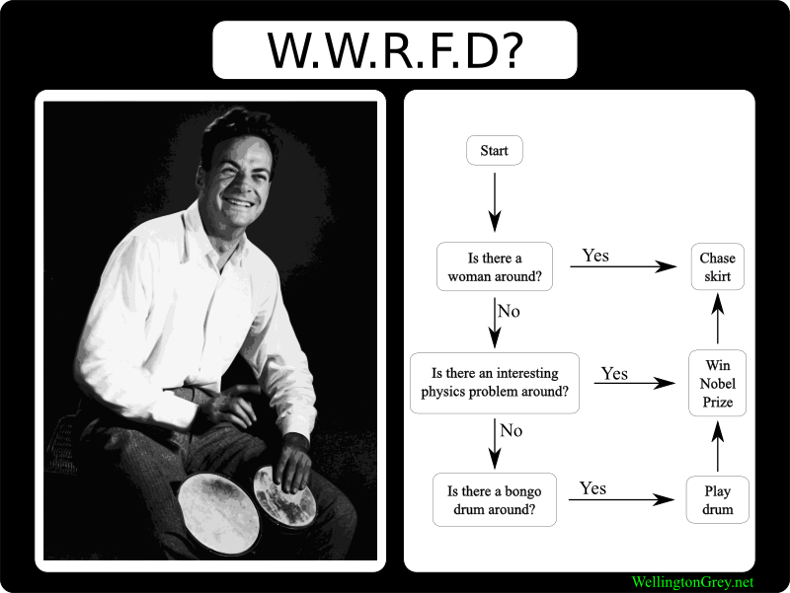
Tongue-in-cheek Modified `Feynman’ diagram

Slide 9
Your first critical thinking challenge:
Compare and contrast the common Google images of:
Chemist vs. Physicist

Slide 10
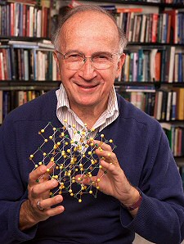
Roald Hoffman
1981 Nobel Chemistry Laureate
Cornell University
“We can seem a bit dull and tedious…”

Slide 11
“Chemists are poised between the physical and biological universes. We don’t deal with either the infinitely small or large, making us fussy and neither fish nor fowl…. the way things in the middle are.”
Roald Hoffman
Chemistry’s obsession with molecules makes it the ignored middle child of the modern sciences… ☹

Slide 12
THE “PROBLEM” WITH CHEMISTS …..
The strength and weakness of all chemists is that they are obsessed with molecules- which is like being infatuated with car parts- but not in driving the car….
You can name famous race car drivers…but what are their chief mechanics named ?

Slide 13
The “real” deal with chemistry
You can’t see molecules directly.
You can’t measure molecules directly.
You can’t watch how molecules react.
They’re just too damned small.
…and the situation gets worse…

Slide 14
You can’t see molecules directly.
You can’t measure molecules directly.
You can’t watch how molecules react.
They’re just too damned small.
To understand molecular behavior you follow how their electrons act. Electrons are way, way smaller than molecules (which are already too damned small)

Slide 15
Your second critical thinking challenge:
If chemists have never had direct experience with what they study, what the hell is chemistry anyhow ?
∴Chemistry is a set of imaginative metaphors and techniques for understanding things we can’t know directly.

Slide 16
Next lecture:
We scope out the freakish behavior and dimensions of electrons both inside and outside of atoms, behavior, which, according to this guy is…
“Spooky science.”

