Slide 1
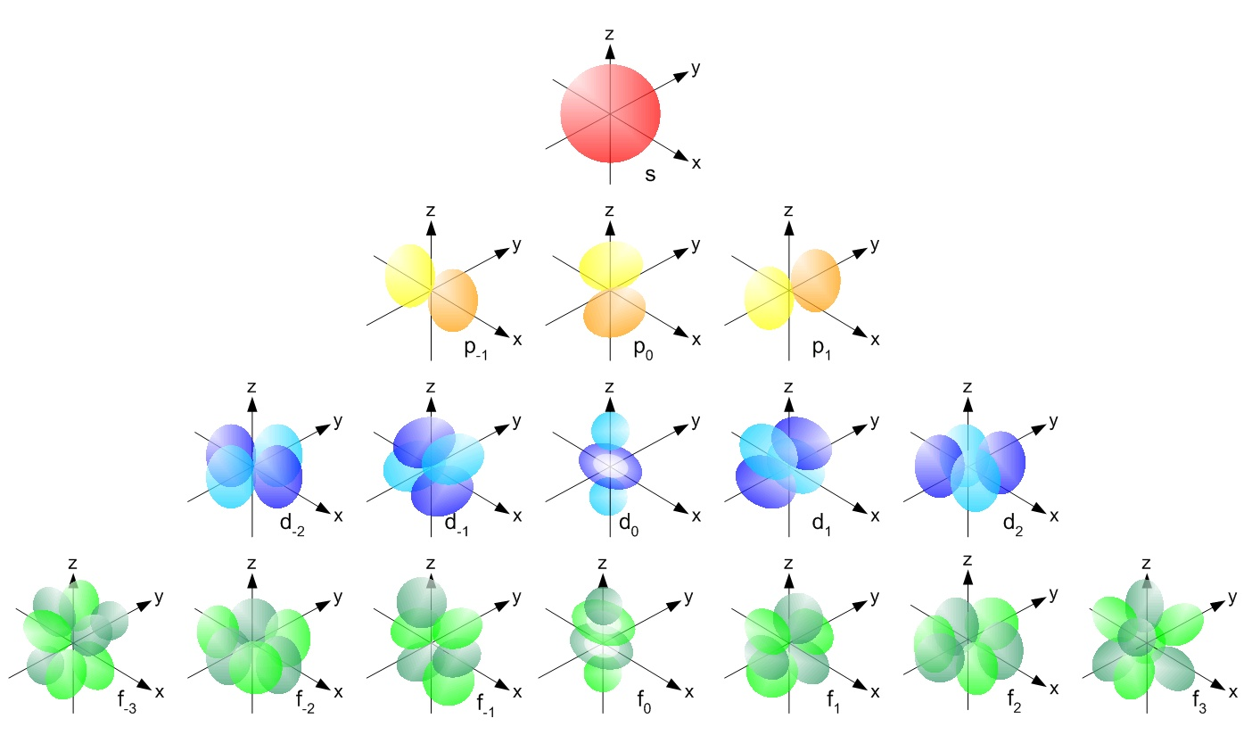
A new wrinkle from Schrödinger: orbital shapes are tied to new quantum numbers (see also: figures 2.14-2.18 pp. 77-79 of text)
HIGHER
ENERGY
Low E→ high E in magnetic field
L=0=>s
0
m_{L}= -L,(-L+1)… +L
L=1=>p
-1
0
+1
L=2=> d
L=3=> f
-2
-1
0
+1
+2
-3
-2
-1
0
+1
+2
+3
HIGHER

Slide 2
Counting Rules for assigning atomic electrons to:
n, L,m_{L} and m_{s} (see also: Table 2.2 p. 77)
Lower quantum numbers => lower energy
n=1,2,3…
=Principal quantum numbers (Bohr’s old quantum number for shells)
Given n:
L =n-1,n-2…0
Given L:
m_{L}= -L, (-L+1), (-L+2)…0, 1,2…+L
Any specific n,L,m_{L} has two possible `spin states’:
m_{s}= ½ or – ½

Slide 3
Each electron in the Schrödinger model gets a unique set or `address’ made of 4 quantum numbers: n, L, m_{L} and m_{s}
[n L m_{L} m_{s}]
The atomic electron’s `social security number’
(or apartment address)

Slide 4
Examples of allowed, one electron `addresses’ for n=2 from Schrödinger model (low→ high E)
n L m_{L} m_{s}
Low E*
2 0 0 +1/2
2 0 0 -1/2
2 1 -1 +1/2
2 1 -1 -1/2
2 1 0 +1/2
2 1 0 +1/2
2 1 1 -1/2
High E
*A positive ( +) m_{s} value is considered lower in energy since experimentalists designated the spin state that is coincident with an applied magnetic field as +1/2 . This is lower in energy than when the spin opposes the field.(m_{s} =-1/2) Schrodinger’s equations didn’t originally include spin states.

Slide 5
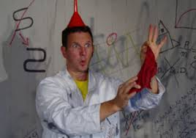
Schrödinger’s quantum number counting rules ~recreate the structure of the Periodic Table !
…A BRIEF IN -CLASS EXPOSITION

Slide 6
IN-class practice using the rules and language described on pp. 73-80
Problem 77 page 105:
How many orbitals in an atom can have the designation:
5p
3d_{z2}
4d
n=4
3
1
5
16

Slide 7
IN-class practice using the rules and language described on pp. 73-80 (continued)
Problem 79 page 105:
Give the maximum number of electrons that have these quantum numbers:
n=4
b)n=5, m_{L}=+1
e)n=2, L=1
32
8
6

Slide 8


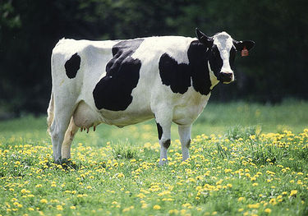
Why chemists love singing the spdf song:
Electrons utterly rule how elements react to make compounds. What kind of electronic orbitals they possess decides how they behave chemically.
Dogs drool, cats rule
s is for silly cow
p is for pretty kitty
d is for dumb dog

Slide 9
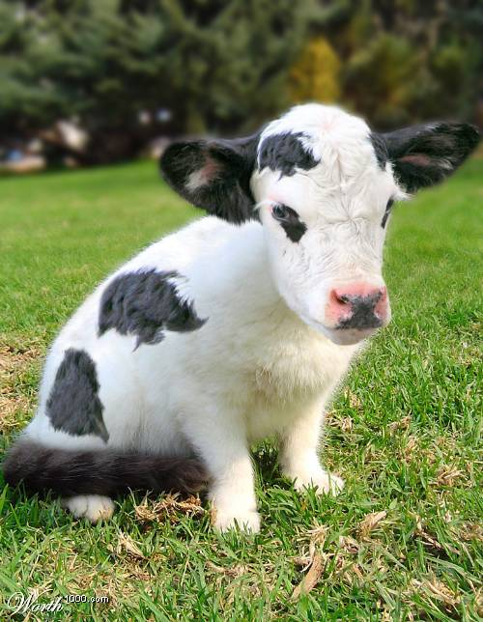
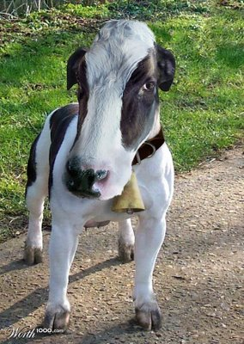
The specific combo of orbits creates the unique chemistry of an element
Be= [He]2s²
Cl=[Ne]3s² 3p⁴
Ti = [Ar] 3d²4s²
100% cow
33% cow+66% kitty
50% cow +50% dog

Slide 10
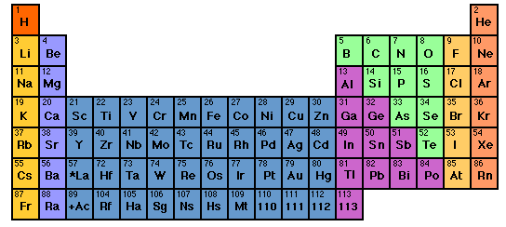
Periodic Trends in Selected* Physical Properties of the Elements
(see pp. 91-98)
Trend=> across a row
Trend=> down a column
*The usual suspects varied…
Covalent Atomic Radii, r
First Ionization Potentials, I₁
Electron Affinities, E_{A}

Slide 11
Covalent atomic radius, r, defined
2r
Atoms of element are assumed to be spherical and `covalently’ bonded (no net charge on either atom) see also: p. 95, figure 2.35

Slide 12
First Ionization Potential, I₁ defined (see also p.91)
I₁ is the energy required to remove the first electron from an initially neutral element X
(The electron ejected is the easiest one to eject)
I₁ + X → X⁺ + e⁻
Example: I₁ + Li→ Li⁺ + e-
I₁ in
2s
1s

Slide 13
Electron Affinity, E_{a} defined (see p. 94)
E_{a} is the energy released when an electron is added to an initially neutral element X. (Because the system is losing energy, E_{a} is < 0)
e⁻ + X → X⁻ + E_{a}
Example: e⁻ + Li→ Li⁻
E_{a} out
2s
Me want to bond with Li !!
1s

Slide 14
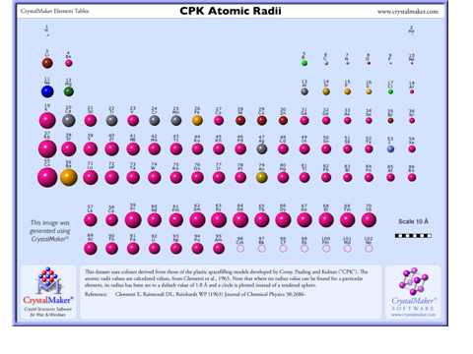
The estimated r for most of the elements (crystallographic data)

Slide 15
What’s the trend for r across a row ?
?
Trend
down
a column ?
r decreasing…→
r ~increasing
except…

Slide 16
Decrease across a row reveals that not all electrons are created equal…
Ability of given electron type to neutralize (shield off) its nuclear proton follows the order:
s> p > d > f
The weaker the neutralization (shielding), the more powerful is the pull of the un-neutralized protons…which then pull the entire electron cloud closer in. (see p. 95)

Slide 17

The increase down a column compares the sizes of the same kind of orbital electrons…except that as we go down the column, the number of electrons increases. Hence, size should increase.
H 1s
Li [He] 2s
Na [Ne] 3s
K [Ar] 4s
Rb [Kr] 5s
Cs [Xe] 6s
1 e-
3 e-
11 e-
19 e-
37 e-
55 e-
Example: column 1- the alkali metals

Slide 18
U-Do-It Predictions…
If you understand the reason for the trend in r, you can predict the trends in Ionization potential, I₁ and Electron Affinity, E_{a}
I₁ trends ?? …and why
I₁ increases across..because protons pull harder on electrons, making them harder to remove
I₁ decreases down..because electrons are further away
As we move down making them easier to remove
??
??

Slide 19
U-Do-It Predictions…
If you understand the reason for the trend in r, you can predict the trends in Ionization potential, I₁ and Electron Affinity, E_{a}
E_{a} trends ?? …and why
E_{a} increases across..because protons pull harder on new electrons, which means a deeper potential well
E_{a} decreases down..because open orbits are further away
as we move down making them more shallow in potential
??
??

Slide 20
Page 106: Problem 103
a)Arrange Te, S, Se in order of increasing size
b) Arrange K, Br, Ni in order of increasing size
c) Arrange Ba , Si, F in order of increasing size
Page 106: Problem 105
a)Arrange Te, S, Se in order of increasing I₁
b) Arrange K, Br, Ni in order of increasing I₁
c) Arrange Ba , Si, F in order of increasing I₁
NOTE: I₁ and E_{a} follow the same trends

